Slide 1

false positives and flexibility in data analysis: The problem with researcher degrees of freedom and solutions
UCLA OARC
Statistical Methods and Data Analytics Group

Slide 2
outline
Background on hypothesis tests, p-values and false positives
An argument of why current practices encourage researchers to find false positives¹
Simulations that show how researcher degrees of freedom directly increase the false positive rate¹
Solution: simple rules for authors and reviewers¹
Solution: multiverse analysis²
¹ Simmons, J. P., Nelson, L. D., & Simonsohn, U. (2011). False-positive psychology: Undisclosed flexibility in data collection and analysis allows presenting anything as significant. Psychological Science, 22(11), 1369-1366.
² Steegen, S., Tuerlinckx, F., Gelman, A., & Vanpaemel, W. (2016). Increasing transparency through a multiverse analysis. Perspectives on Psychological Science, 11(5), 702-712.

Slide 3
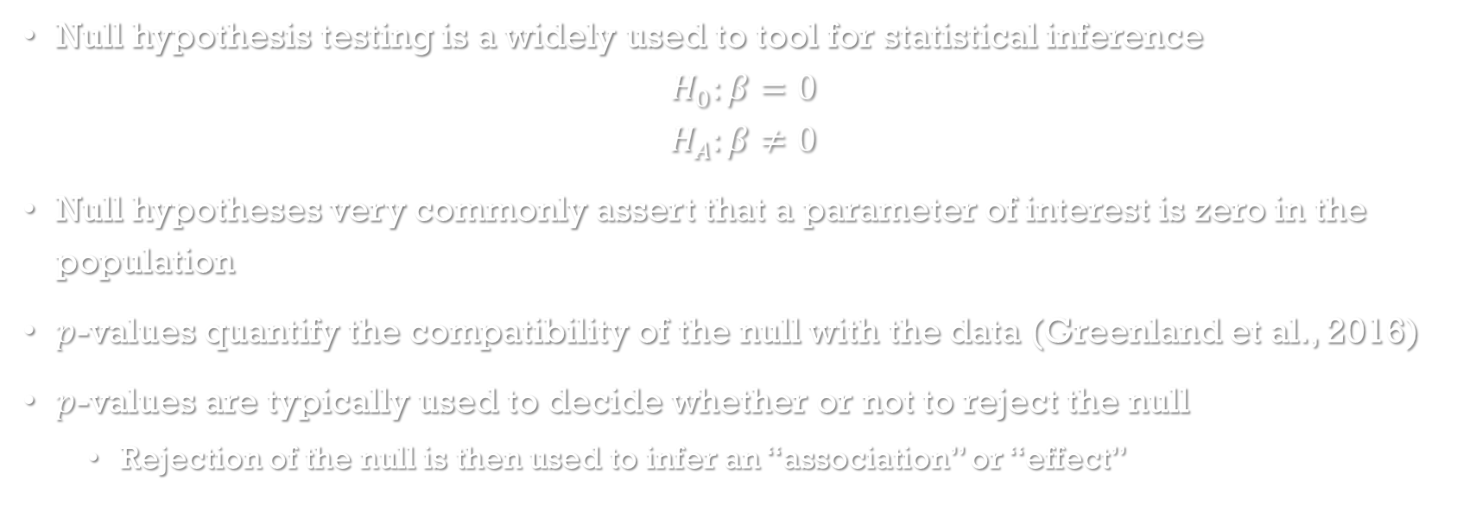
Hypothesis tests and p-values
Null hypothesis testing is a widely used to tool for statistical inference
$$H_{0}:β=0$$
$$H_{A}:β≠0$$
Null hypotheses very commonly assert that a parameter of interest is zero in the population
$p$-values quantify the compatibility of the null with the data (Greenland et al., 2016)
$p$-values are typically used to decide whether or not to reject the null
Rejection of the null is then used to infer an “association” or “effect”

Slide 4
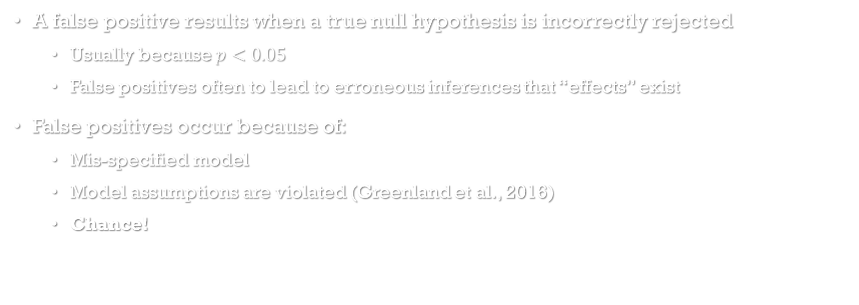
False positives
A false positive results when a true null hypothesis is incorrectly rejected
Usually because $p<0.05$
False positives often to lead to erroneous inferences that “effects” exist
False positives occur because of:
Mis-specified model
Model assumptions are violated (Greenland et al., 2016)
Chance!

Slide 5
The problem with False positives
False positives are costly errors
Published results, including false positives, inform new research and hypotheses
Garbage in – garbage out, a waste of resources
They persist in the literature
Failures to replicate the false positive (reject the null again) can be attributed to many causes
Different subjects, different setting,…
Journals often do not publish replication studies, so little incentive to re-assess a false positive result
Once discovered, credibility loss to researchers and the field as a whole

Slide 6
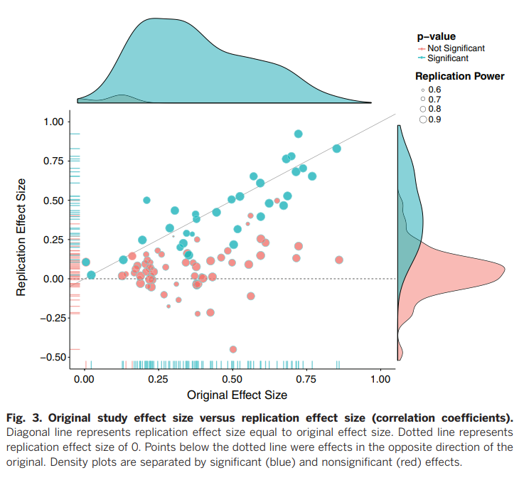
False positives and the replication crisis
A 2015 large-scale study (Open Science Collaboration, 2015) attempted to replicate 100 published psychology studies using high-powered designs
Only 36% of replications had significant results (vs 97% of original studies)
82.8% replications showed smaller effect sizes than original
False positives reported in original studies are believed to be a major reason for inability to replicate
From Open Science Collaboration (2015)

Slide 7
Why current practices encourage researchers to find false positives

Slide 8




Journals incentivize researchers to report statistically significant results.
Shun non-significant results
And replication studies
Researchers often don’t know what data processing and analysis decisions are best
Many decisions seem arbitrary
Data don’t always arrive as expected

Slide 9









Journals incentivize researchers to report statistically significant results
$$p=.02$$
$p=.1$7
$$p=.24$$
$$p=.41$$
$$p=.32$$
$$p=.06$$
$$p=.11$$
$$p=.09$$
Researchers run many tests with many versions of the data to find a significant result
More tests mean more opportunities for false positives
Researchers often don’t know what data processing and analysis decisions are best

Slide 10










$$p=.02$$
Journals incentivize researchers to report statistically significant results
The best result is published without mention of the other results
Journals do not require disclosure
Researchers self-justify decisions
$$p=.41$$
Researchers run many tests with many versions of the data to find a significant result
$$p=.09$$
$p=.1$7
$$p=.32$$
$$p=.06$$
$$p=.24$$
$$p=.11$$
Researchers often don’t know what data processing and analysis decisions are best
The bad results are discarded into the “file drawer”
Creates a publication bias

Slide 11
$$p=.02$$
Journals incentivize researchers to report statistically significant results
The best result is published without mention of the other results
ACCEPTED PRACTICE
$$p=.41$$
Researchers run many tests with many versions of the data to find a significant result
$$p=.09$$
$p=.1$7
$$p=.32$$
$$p=.06$$
$$p=.24$$
$$p=.11$$
Researchers often don’t know what data processing and analysis decisions are best
The bad results are discarded into the “file drawer”

Slide 12
POLL
Have you ever been involved in a study where a single result was reported instead of reporting that...(click all that apply)
a model/test was run more than once, after additional data were collected?
data collection was stopped because a desired model/test result was found?
observations were excluded after examining model/test results and the analysis was run again?
the same model/test was run on several related outcomes?
the same model/test was run on various transformations of the outcome?
the same model/test was run after combining some groups together?

Slide 13
Researcher degrees of freedom (RDF)
Data usually need to be processed prior to analysis
Researcher degrees of freedom: data processing options that result in alternative versions of the data
Often, decisions seem arbitrary with ambiguity in best choices
Not usually used to deceive but to find (perhaps unconsciously) a significant result
Researcher degrees of freedom become a problem when they are not disclosed

Slide 14
Example Researcher degrees of freedom
Changing sample sizes
Collect more data (often justified that smaller sample size is underpowered to detect effect)
Remove some observations
Exclusion due to missing data
Operationalizing analysis variables
Combining categories
Discretizing continuous variables
Combining variables (e.g. means, scales)
Variable transformations
Which variables need to be included in model?

Slide 15
Outliers example
Authors perused 30 Psychological Science articles analyzing reaction time
Most studies excluded some responses for being “too fast” or “too slow”
Reponses that are too slow may reflect lapses in attention
But definition of “too fast” varied:
Top 2.5%
> 2 standard deviations from mean
Faster than 100, 150, 200, or 300 ms
“Too slow” also varied:
Lowest 2.5% or 10%
< 2, 2.5 or 3 standard deviations from mean
Slower than 1,000, 1,200, 1,500, 2,000, 3,000, or 5,000 ms
None of these is “wrong”, but their variance suggests self-justified usage of researcher degrees of freedom

Slide 16
Simulating how researcher degrees of freedom increase the false positive rate

Slide 17
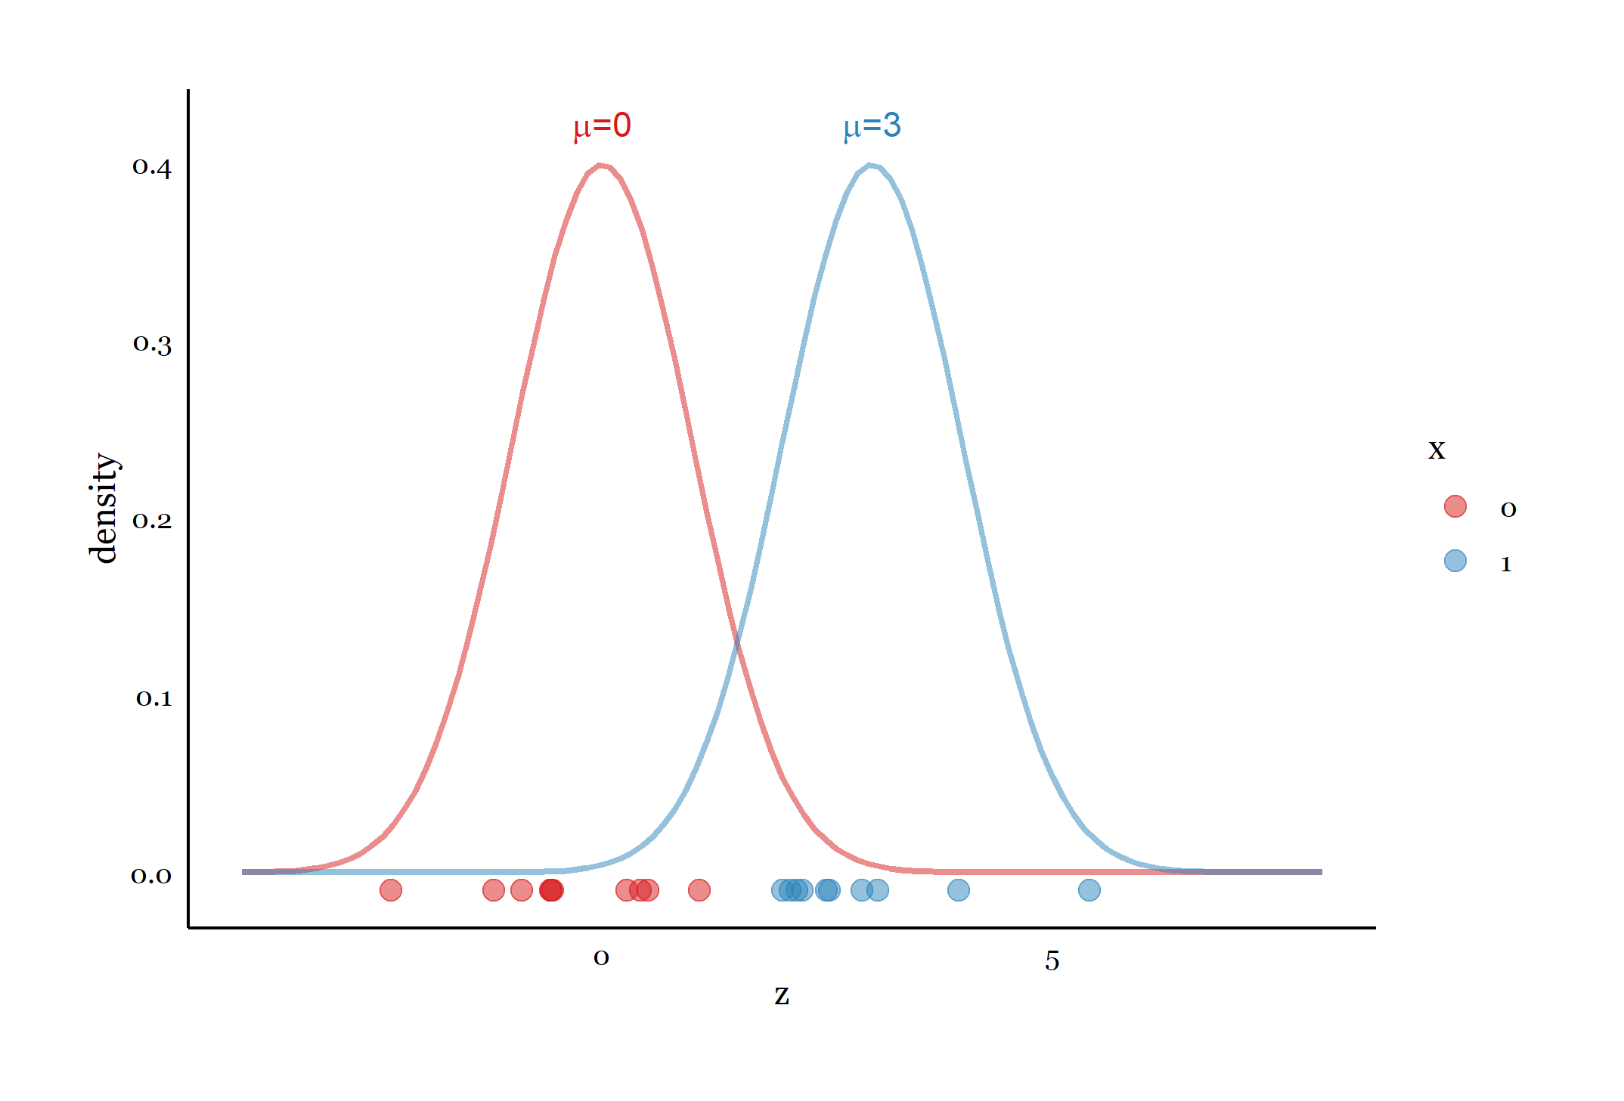
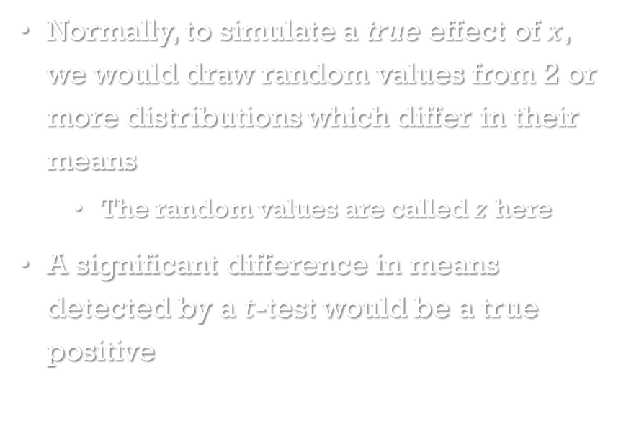
Simulating a true effect
Normally, to simulate a true effect of $x$, we would draw random values from 2 or more distributions which differ in their means
The random values are called $z$ here
A significant difference in means detected by a $t$-test would be a true positive
Fig. 1 Drawing samples from two populations

Slide 18
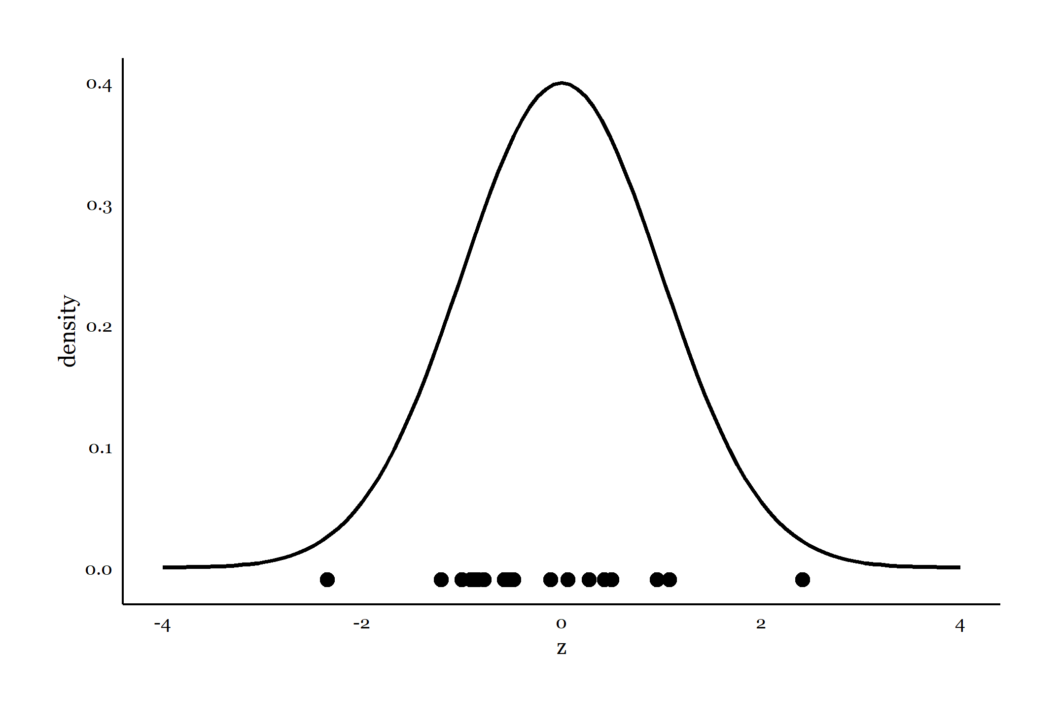

Simulating a false positive: step 1
However, here we want to simulate false positives (no effect of $x$)
So, we will instead draw 20 $z$ values from a single normal distribution
Fig. 2 Drawing samples from one population

Slide 19
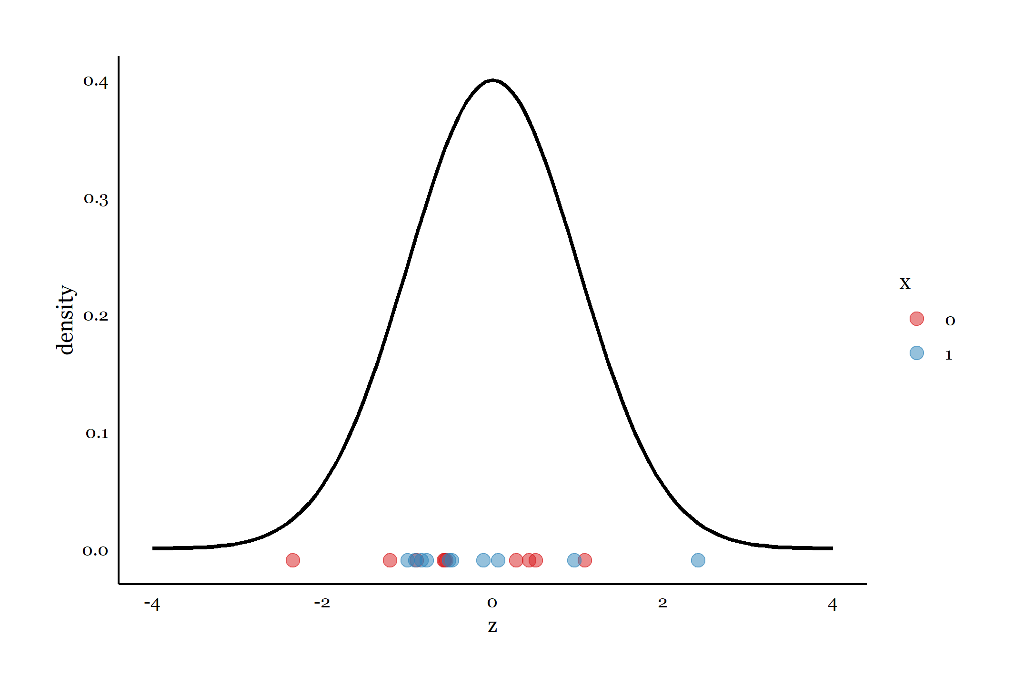

Simulating a false positive: step 2
Then we will randomly assign 10 $z$values to $x=0$, and the other 10 to $x=1$
Fig. 3 Randomly assigning samples from the same population to two different groups

Slide 20
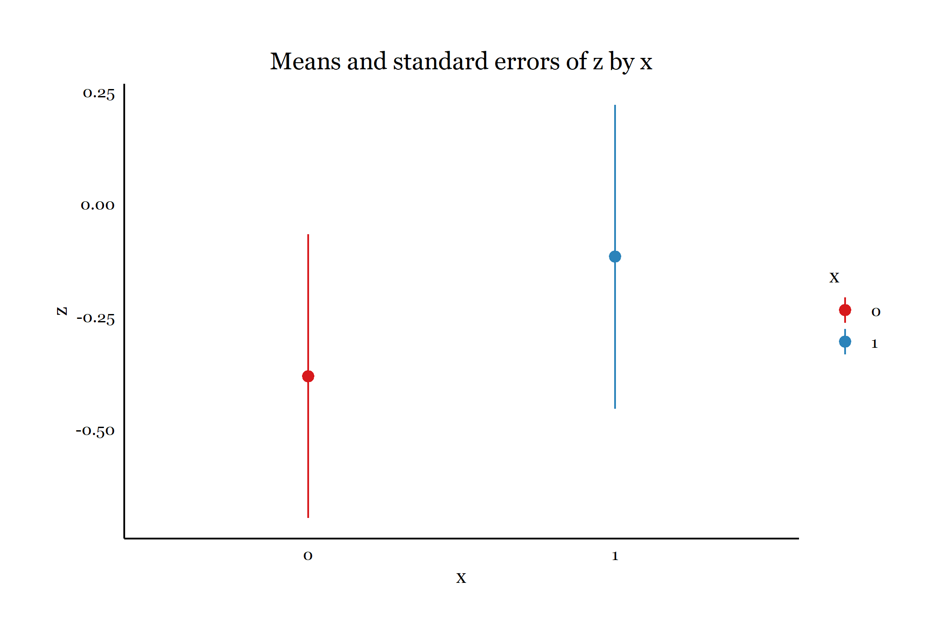
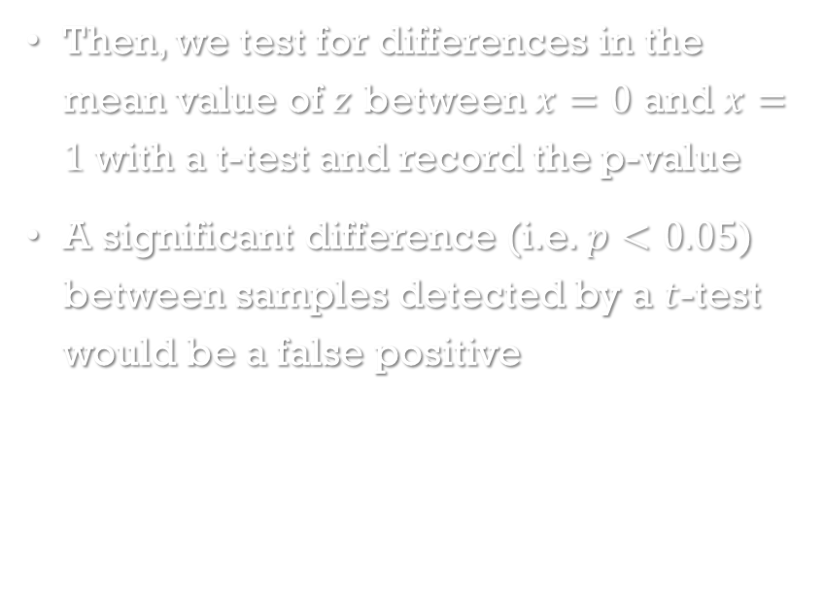
Simulating a false positive: step 3
Then, we test for differences in the mean value of $z$ between $x=0$ and $x=1$ with a t-test and record the p-value
A significant difference (i.e. $p<0.05$) between samples detected by a $t$-test would be a false positive
Fig. 4 Comparing means between 2 groups from the same population

Slide 21
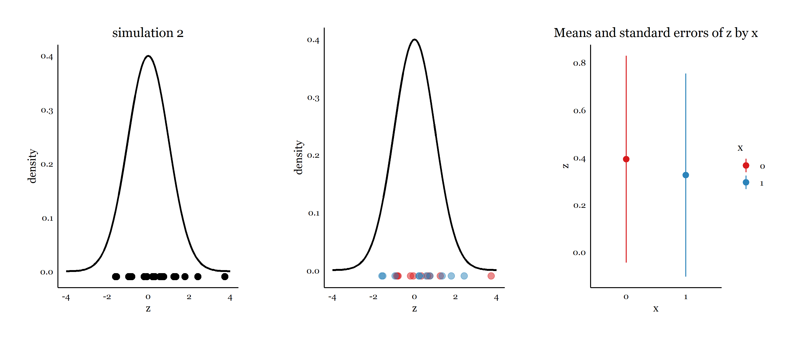
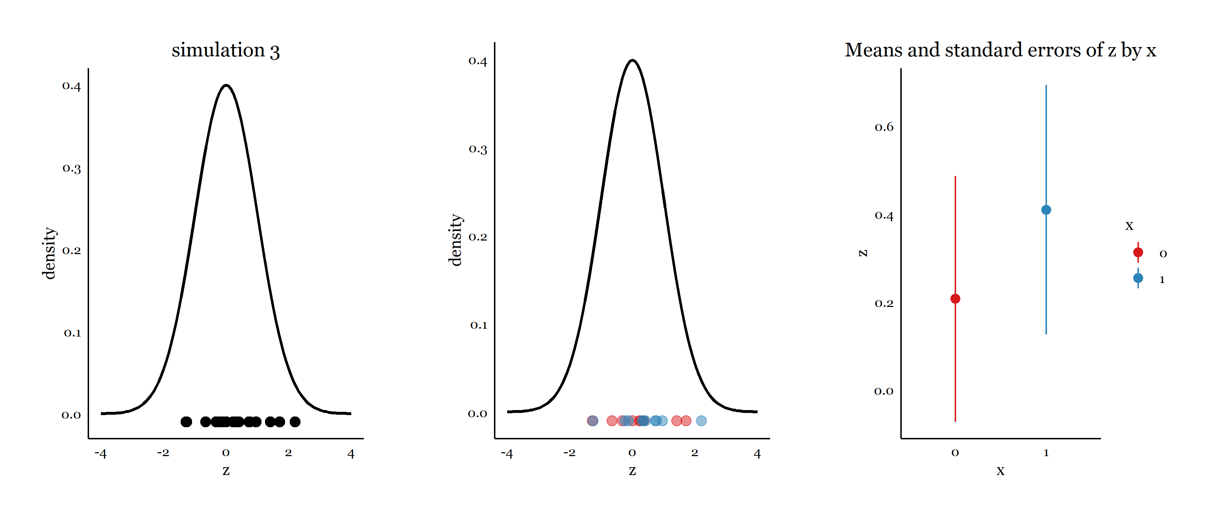
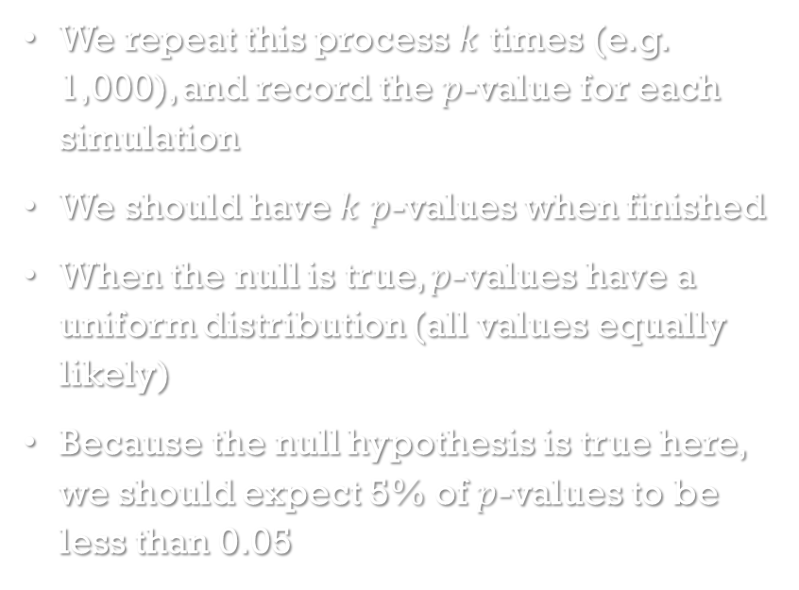
Simulating a false positive: repeat steps many times
We repeat this process $k$ times (e.g. 1,000), and record the $p$-value for each simulation
We should have $k$ $p$-values when finished
When the null is true, $p$-values have a uniform distribution (all values equally likely)
Because the null hypothesis is true here, we should expect 5% of $p$-values to be less than 0.05
Fig. 5 Repeating the simulation many times

Slide 22
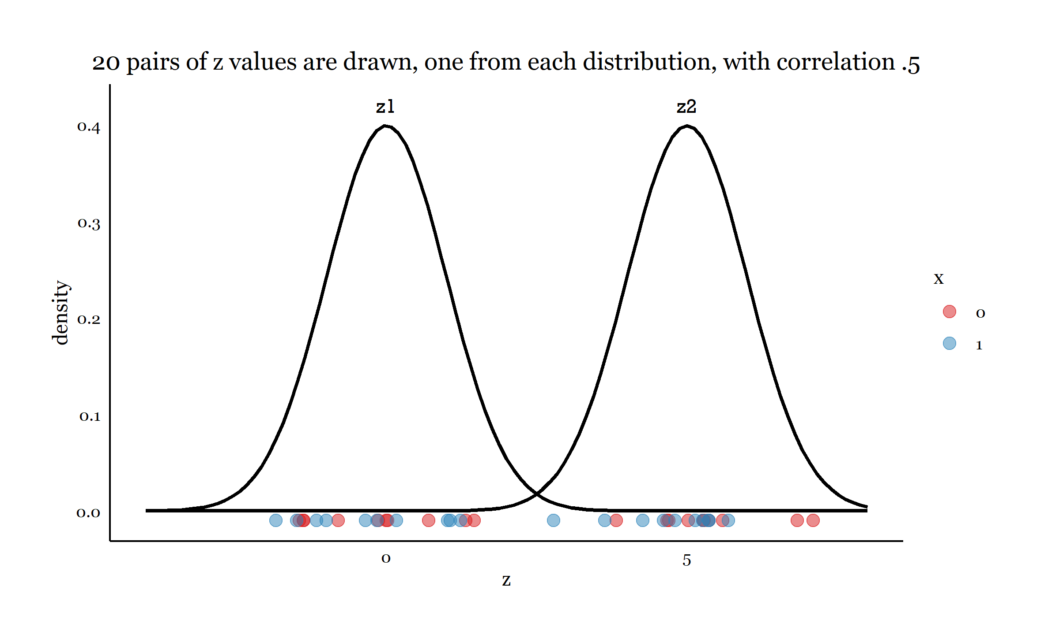
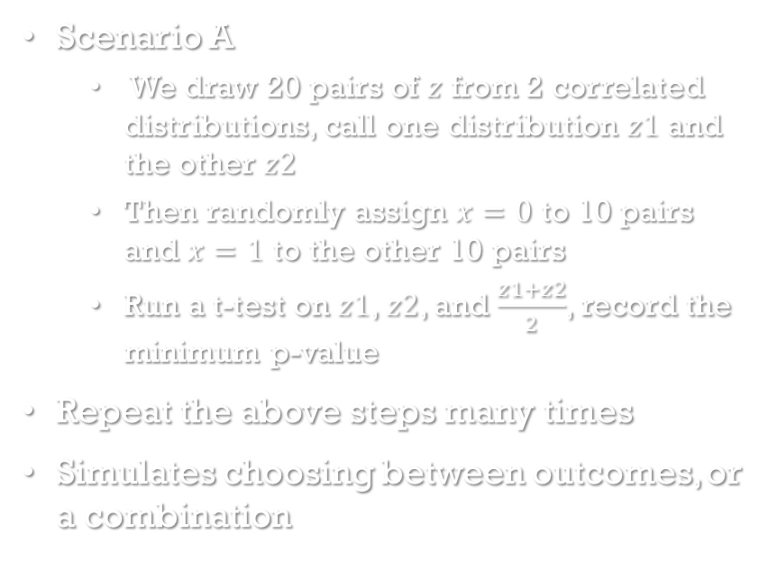
Simulating the effect of rdf on the false positive rate, scenario A
Scenario A
We draw 20 pairs of $z$ from 2 correlated distributions, call one distribution $z1$ and the other $z2$
Then randomly assign $x=0$ to 10 pairs and $x=1$ to the other 10 pairs
Run a t-test on $z1$, $z2$, and $\frac{z1+z2}{2}$, record the minimum p-value
Repeat the above steps many times
Simulates choosing between outcomes, or a combination
Fig. 6 Scenario A: Drawing correlated sample pairs from two distributions and randomly assigning pairs to two groups

Slide 23
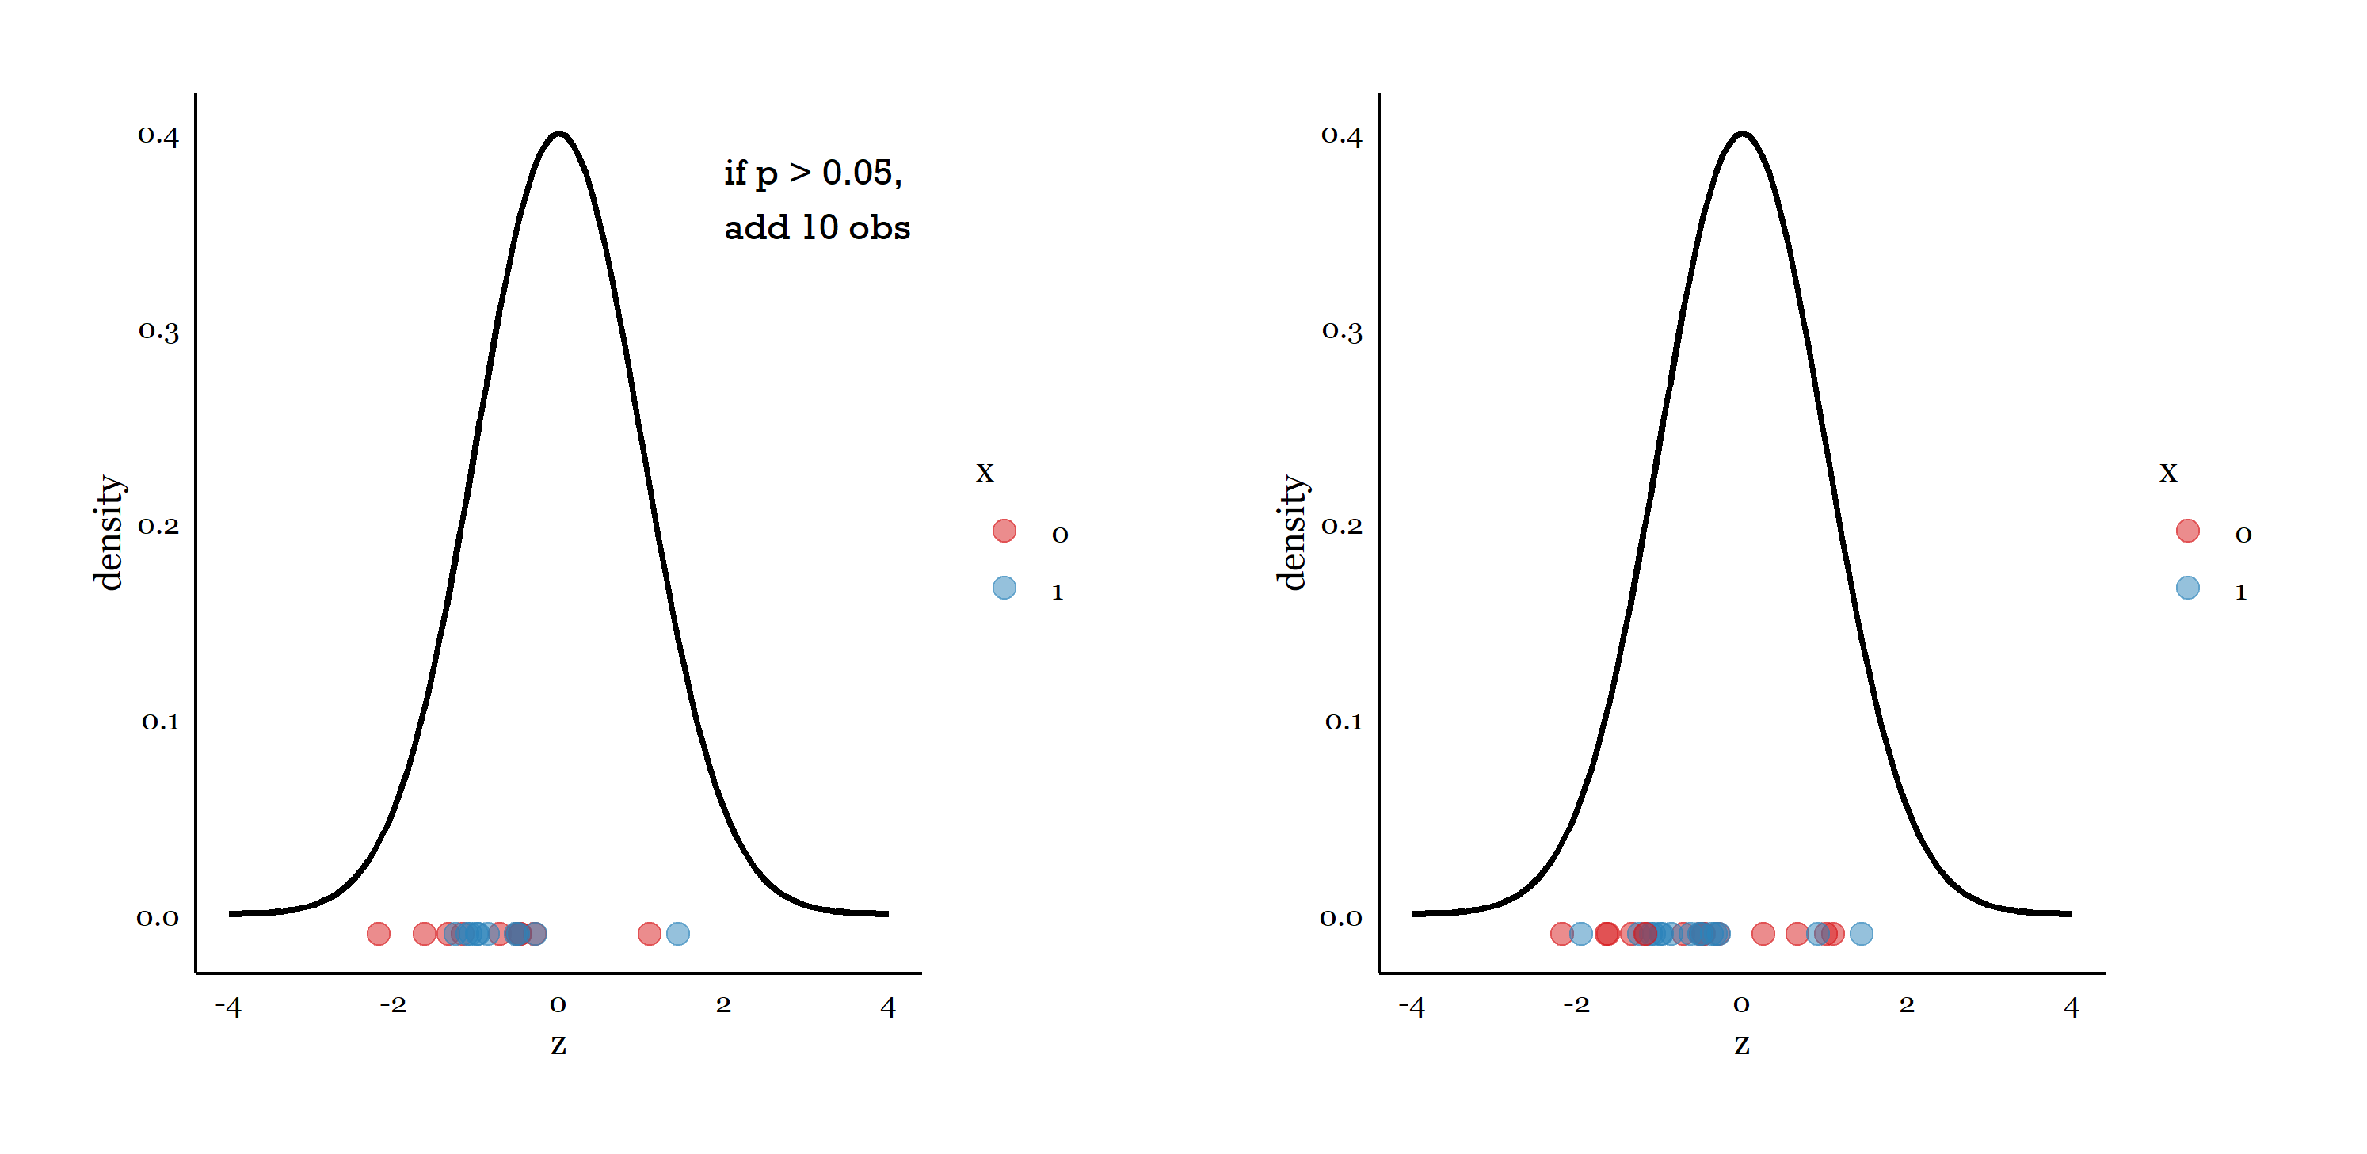
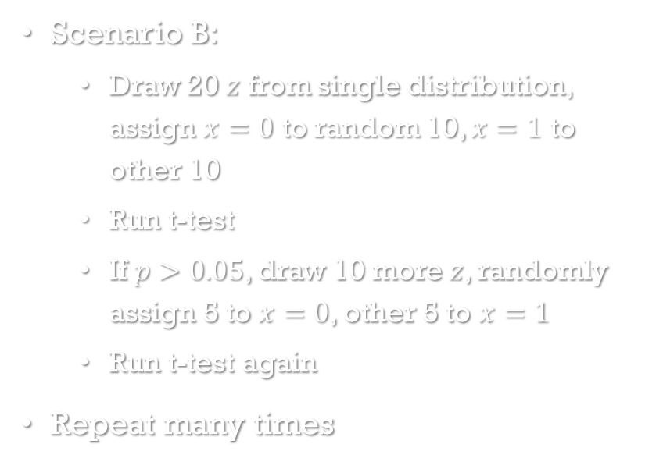

Simulating the effect of rdf on the false positive rate, scenario B
Scenario B:
Draw 20 $z$ from single distribution, assign $x=0$ to random 10, $x=1$ to other 10
Run t-test
If $p>0.05$, draw 10 more $z$, randomly assign 5 to $x=0$, other 5 to $x=1$
Run t-test again
Repeat many times
Fig. 7 Testing at $n=20$; if $p>0.05$, add ten observations and test again.

Slide 24
Two more scenarios
Scenario C: using covariates
testing for Condition effect in ANCOVA with either:
no covariate
or gender
or gender*Condition interaction
Significance achieved if either main effect of Condition or gender*Condition interaction was significant
Scenario D: reporting subsets of condition comparisons
assign 3 conditions
test all 3 pairwise contrasts and linear trend (4 tests)

Slide 25
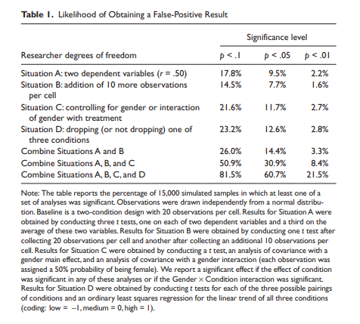
Simulation results
Each situation raises the probability of at least one false positive to above .05
Combining all of these researcher degrees of freedom (choices) leads to greater than .5 chance of false positive!
None of these are commonly flagged as problematic in reviews!
Researchers are likely using many more researcher degrees of freedom than A,B,C, and D combined
Table 1 from Simmons et al. (2011)

Slide 26
Reviewer exercise

Slide 27
Spot where researcher degrees of freedom might have been used
Assessing fertility. …[W]e created a high-fertility group (cycle days 7–14, n = 78) and a low fertility group (cycle days 17–25, n = 85)...[W]e did not include women on cycle days 15 and 16 because of the difficulty of determining fertility status on these days ...We also did not include women at the beginning of the ovulatory cycle (cycle days 1–6) or at the end of the ovulatory cycle (cycle days 26–28) to avoid potential confounds due to premenstrual or menstrual symptoms.
Relationship status. Participants indicated their current relationship status by selecting one of the following five descriptions: “not currently dating or romantically involved with anyone” (24.7%), “dating” (20.0%), “engaged or living with my partner” (23.2%), “married” (31.3%), or “other” (0.7%) …[P]articipants who indicated that they were engaged, living with a partner, or married were classified as being in a committed relationship (n = 82); all others (e.g., not dating or dating) were classified as single (n = 81).

Slide 28
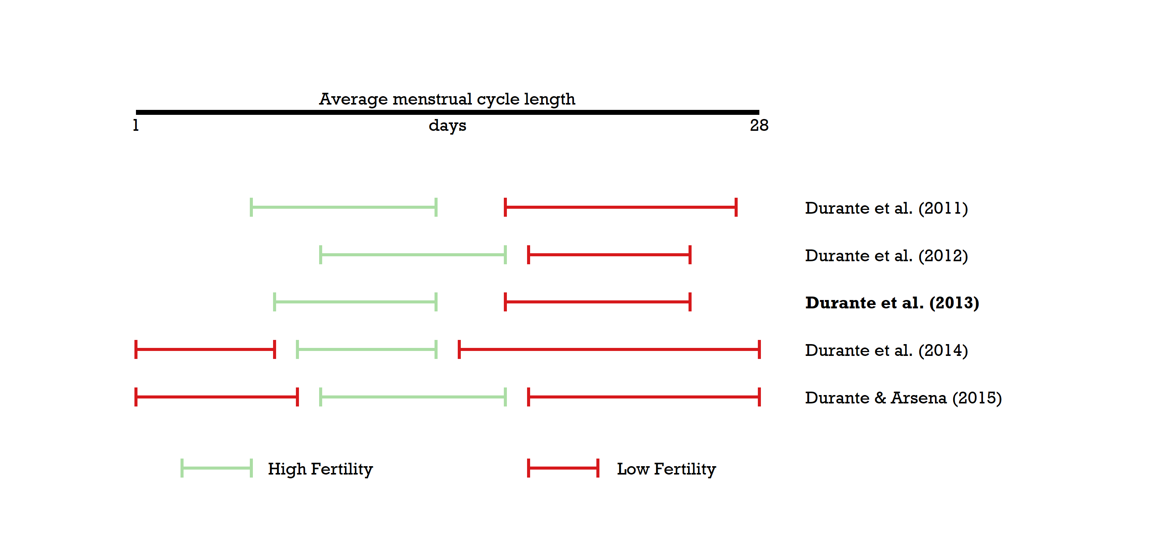
Flexibility in assessing fertility

Slide 29
Solutions: simple rules for authors and reviewers
From Simmons, Nelson & Simonsohn (2011)

Slide 30
Solutions: requirements for authors
Determine data collection termination rule before data collection and report the rule
Collect at least 20 observations per cell
List all variables collected
Report all experimental conditions
Report results that include excluded observations
Report analyses excluding covariates
Most important:
Determining rule before looking at data
Adhering to it
Reporting it
Can report power calculations
Or disclose more arbitrary rules based on other factors
“We decided to collect 50 observations based on subject availability and time constraints”

Slide 31
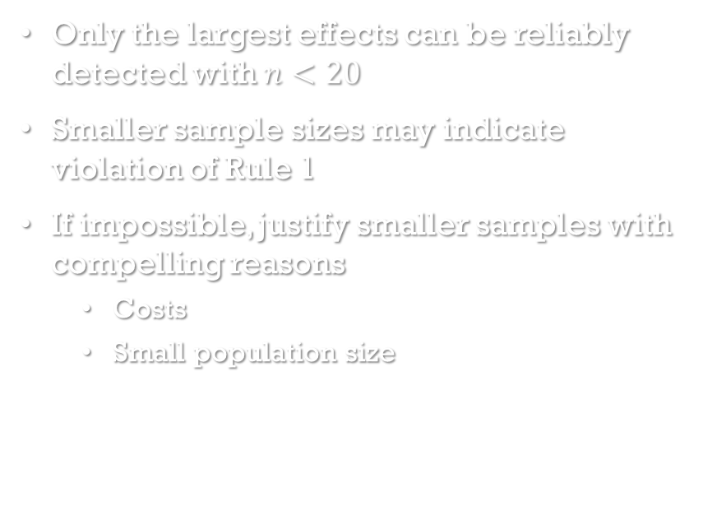
Solutions: requirements for authors
Determine data collection termination rule before data collection and report the rule
Collect at least 20 observations per cell
List all variables collected
Report all experimental conditions
Report results that include excluded observations
Report analyses excluding covariates
Only the largest effects can be reliably detected with $n<20$
Smaller sample sizes may indicate violation of Rule 1
If impossible, justify smaller samples with compelling reasons
Costs
Small population size

Slide 32
Solutions: requirements for authors
Determine data collection termination rule before data collection and report the rule
Collect at least 20 observations per cell
List all variables collected
Report all experimental conditions
Report results that include excluded observations
Report analyses excluding covariates
Allows reviewer to assess flexibility in choosing which variables enter models
Outcomes
Covariates
Use “only” to indicate list is exhaustive
“Respondents reported only the following: age, gender, and income.”

Slide 33
Solutions: requirements for authors
Determine data collection termination rule before data collection and report the rule
Collect at least 20 observations per cell
List all variables collected
Report all experimental conditions
Report results that include excluded observations
Report analyses excluding covariates
Prevents selective reporting of comparisons that produce results that agree with researcher hypotheses
Don’t report just A vs B comparison if you also had a C condition
Use “only” to indicate exhaustive list of conditions

Slide 34
Solutions: requirements for authors
Determine data collection termination rule before data collection and report the rule
Collect at least 20 observations per cell
List all variables collected
Report all experimental conditions
Report results that include excluded observations
Report analyses excluding covariates
Allows assessment of sensitivity of results to exclusion of observations
Encourages authors to justify exclusions

Slide 35
Solutions: requirements for authors
Determine data collection termination rule before data collection and report the rule
Collect at least 20 observations per cell
List all variables collected
Report all experimental conditions
Report results that include excluded observations
Report analyses excluding covariates
Similar to Rule 5, allows assessment of sensitivity of results to inclusion of covariates
Encourages justification of covariate inclusion

Slide 36
Solution: guidelines for reviewers
Ensure that authors follow requirements
Be more tolerant of imperfect results
Require authors to show that results do not depend on arbitrary decisions
If justifications for data processing choices are not compelling, require a replication
Reviewers have the power to change reporting standards
Prioritize transparency over tidiness
If a perfect results came from the use of researcher degrees of freedom, they must be reported

Slide 37
Solution: guidelines for reviewers
Ensure that authors follow requirements
Be more tolerant of imperfect results
Require authors to show that results do not depend on arbitrary decisions
If justifications for data processing choices are not compelling, require a replication
Researchers use their degrees of freedom because of the pressure to produce perfect (i.e. significant) results
Reviewers should be skeptical of underpowered studies with perfect results

Slide 38
Solution: guidelines for reviewers
Ensure that authors follow requirements
Be more tolerant of imperfect results
Require authors to show that results do not depend on arbitrary decisions
If justifications for data processing choices are not compelling, require a replication
Request robustness checks
Require consistency of decisions across experiments/studies

Slide 39
Solution: guidelines for reviewers
Ensure that authors follow requirements
Be more tolerant of imperfect results
Require authors to show that results do not depend on arbitrary decisions
If justifications for data processing choices are not compelling, require a replication
Replication is costly, but sometimes necessary

Slide 40
Solution: multiverse analysis
From Steegen, Tuerlincx, Gelman, and Vanpaemel (2016)

Slide 41
Multiverse analysis
In preparing raw data for analysis, using researcher degrees of freedom produces not one unique data set but many alternate versions
A multiverse of data sets
A multiverse of data sets yields a multiverse of statistical results

Slide 42
We begin with a single raw data set.
Data processing decisions will result in alternative versions.
raw

Slide 43
Decision 1: how to exclude based on age: over 70 or over 50?
raw
exclude age>70
exclude age>50

Slide 44
Decision 2: How to use the BMI variable as an independent variable: continuous, 3-category or 5-category?
raw
exclude age>70;
cont. bmi
exclude age>50;
cont bmi
exclude age>70;
3-cat bmi
exclude age>70;
5-cat bmi
exclude age>50;
3-cat bmi
exclude age>50;
5-cat bmi

Slide 45
Decision 3: How to transform the dependent variable: square root or log?
raw
exclude age>70;
cont. bmi;
DV sqrt
exclude age>50;
cont bmi;
DV sqrt
exclude age>70;
3-cat bmi;
DV sqrt
exclude age>70;
5-cat bmi;
DV sqrt
exclude age>50;
3-cat bmi;
DV sqrt
exclude age>50;
5-cat bmi;
DV sqrt
exclude age>70;
cont. bmi;
DV log
exclude age>70;
3-cat bmi;
DV log
exclude age>70;
5-cat bmi;
DV log
exclude age>50;
cont bmi;
DV log
exclude age>50;
3-cat bmi;
DV log
exclude age>50;
5-cat bmi;
DV log

Slide 46
Each of the 12 data sets in this multiverse is a unique combination of these 3 decisions.
Because many decisions are arbitrary, it’s not clear which data set is “best” to use
raw
exclude age>70;
cont. bmi;
DV sqrt
exclude age>50;
cont bmi;
DV sqrt
exclude age>70;
3-cat bmi;
DV sqrt
exclude age>70;
5-cat bmi;
DV sqrt
exclude age>50;
3-cat bmi;
DV sqrt
exclude age>50;
5-cat bmi;
DV sqrt
exclude age>70;
cont. bmi;
DV log
exclude age>70;
3-cat bmi;
DV log
exclude age>70;
5-cat bmi;
DV log
exclude age>50;
cont bmi;
DV log
exclude age>50;
3-cat bmi;
DV log
exclude age>50;
5-cat bmi;
DV log

Slide 47
p=.18
p=.07
The same hypothesis may be tested in many or all versions of the data, resulting in a multiverse of statistical results.
raw
exclude age>70;
cont. bmi;
DV sqrt
exclude age>50;
cont bmi;
DV sqrt
exclude age>70;
3-cat bmi;
DV sqrt
exclude age>70;
5-cat bmi;
DV sqrt
exclude age>50;
3-cat bmi;
DV sqrt
exclude age>50;
5-cat bmi;
DV sqrt
exclude age>70;
cont. bmi;
DV log
exclude age>70;
3-cat bmi;
DV log
exclude age>70;
5-cat bmi;
DV log
exclude age>50;
cont bmi;
DV log
exclude age>50;
3-cat bmi;
DV log
exclude age>50;
5-cat bmi;
DV log
p=.32
p=.24
p=.10
p=.07
p=.01
p=.15
p=.22
p=.12
p=. 03
p=.32

Slide 48
p=.18
p=.07
However, results are often presented as if only one of the data sets was analyzed.
raw
exclude age>70;
cont. bmi;
DV sqrt
exclude age>50;
cont bmi;
DV sqrt
exclude age>70;
3-cat bmi;
DV sqrt
exclude age>70;
5-cat bmi;
DV sqrt
exclude age>50;
3-cat bmi;
DV sqrt
exclude age>50;
5-cat bmi;
DV sqrt
exclude age>70;
cont. bmi;
DV log
exclude age>70;
3-cat bmi;
DV log
exclude age>70;
5-cat bmi;
DV log
exclude age>50;
cont bmi;
DV log
exclude age>50;
3-cat bmi;
DV log
exclude age>50;
5-cat bmi;
DV log
p=.32
p=.24
p=.10
p=.07
p=.01
p=.15
p=.22
p=.12
p=. 03
p=.32

Slide 49
Multiverse analysis: everything everywhere all at once
Selectively reporting the result from a single data set from a data multiverse obscures the sensitivity of the result to the data processing decisions
Multiverse analysis is running the same analyses across all data sets in the multiverse and presenting all results
Reveals number of data sets analyzed
Allows assessment of robustness of results to data processing choices
To demonstrate, Steegen et al. (2016) performed a multiverse analysis of data used for a study of how fertility and relationship status interact to affect religiosity and political preferences, by Durante et al. (2013)

Slide 50
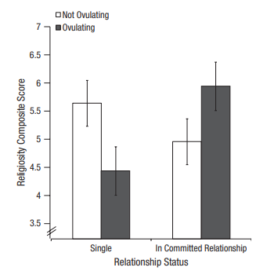
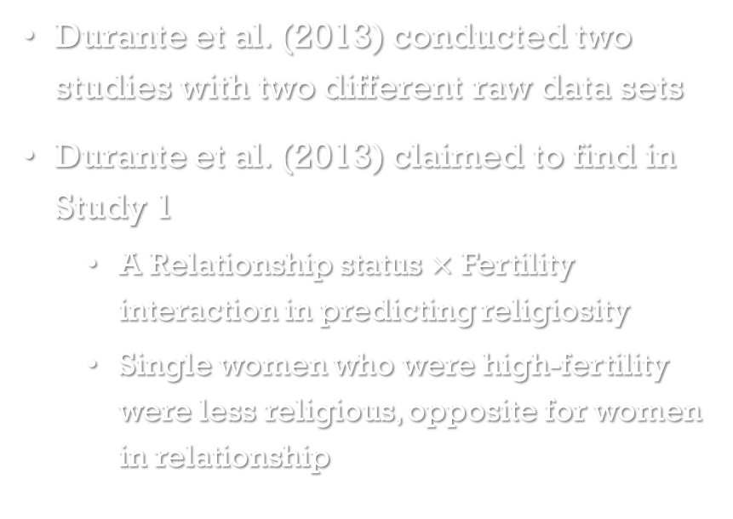
Multiverse analysis of durante et al. (2013)
Durante et al. (2013) conducted two studies with two different raw data sets
Durante et al. (2013) claimed to find in Study 1
A Relationship status $×$ Fertility interaction in predicting religiosity
Single women who were high-fertility were less religious, opposite for women in relationship
Fig. 1 from Durante et al. (2013)

Slide 51
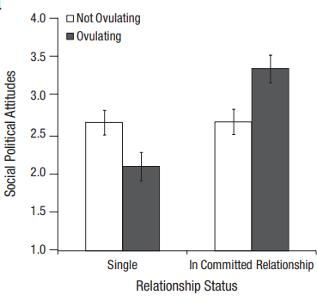
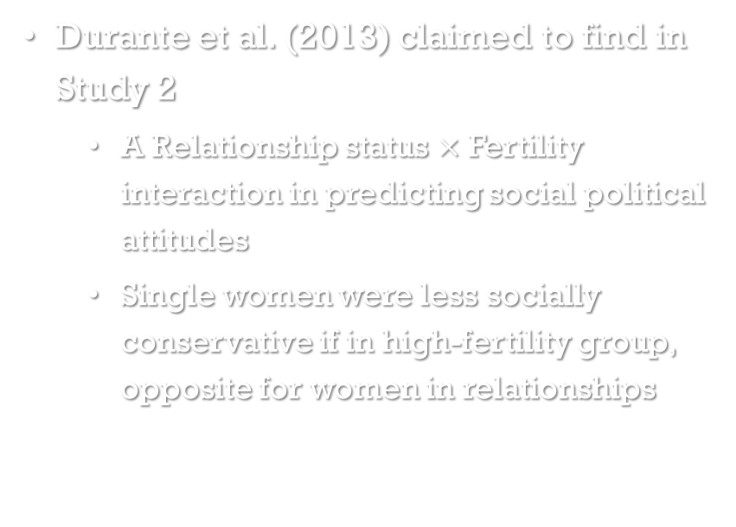
Multiverse analysis of durante et al. (2013)
Durante et al. (2013) claimed to find in Study 2
A Relationship status $×$ Fertility interaction in predicting social political attitudes
Single women were less socially conservative if in high-fertility group, opposite for women in relationships
Fig. 2a from Durante et al. (2013)

Slide 52
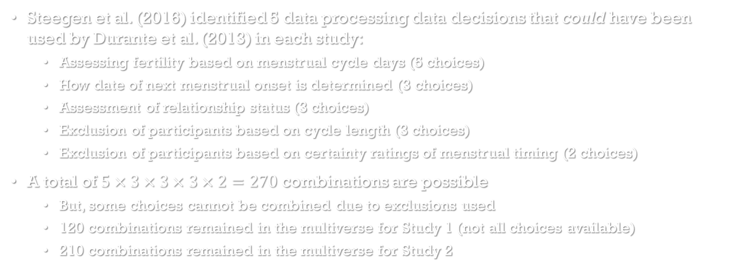
Multiverse analysis of durante et al. (2013)
Steegen et al. (2016) identified 5 data processing data decisions that could have been used by Durante et al. (2013) in each study:
Assessing fertility based on menstrual cycle days (5 choices)
How date of next menstrual onset is determined (3 choices)
Assessment of relationship status (3 choices)
Exclusion of participants based on cycle length (3 choices)
Exclusion of participants based on certainty ratings of menstrual timing (2 choices)
A total of $5×3×3×3×2=270$ combinations are possible
But, some choices cannot be combined due to exclusions used
120 combinations remained in the multiverse for Study 1 (not all choices available)
210 combinations remained in the multiverse for Study 2

Slide 53
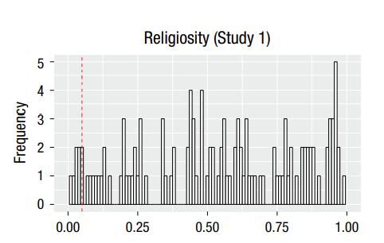
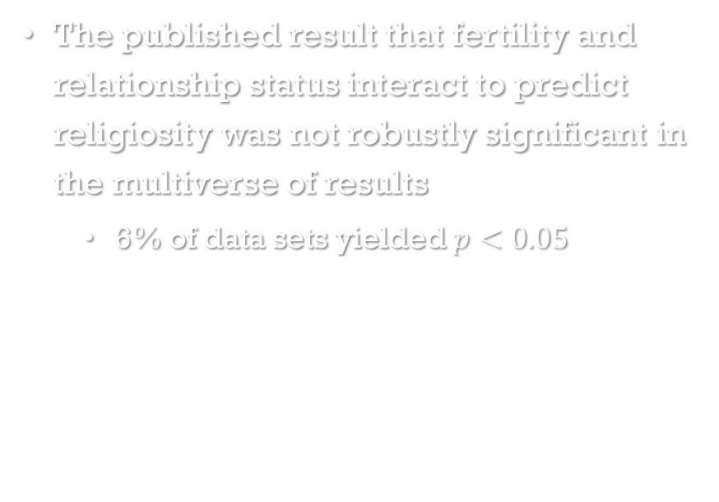
Multiverse analysis results: religiosity
The published result that fertility and relationship status interact to predict religiosity was not robustly significant in the multiverse of results
6% of data sets yielded $p<0.05$
Histogram of multiverse p-values
Fig 1A from Steegen et al. (2016)

Slide 54
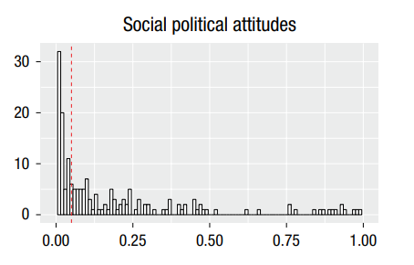
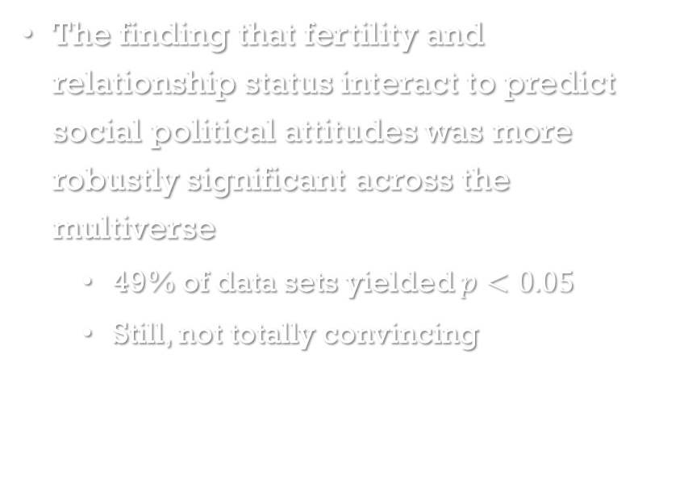
Multiverse analysis results: voting preference
The finding that fertility and relationship status interact to predict social political attitudes was more robustly significant across the multiverse
49% of data sets yielded $p<0.05$
Still, not totally convincing
Fig 1D from Steegen et al. (2016)

Slide 55
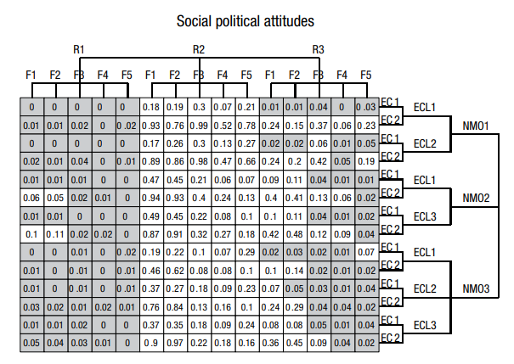
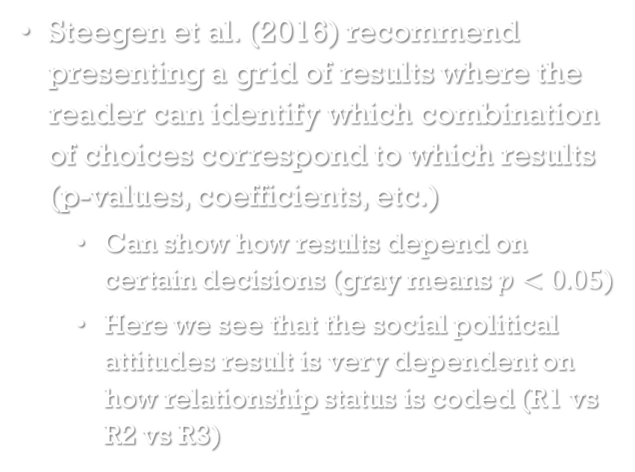
Presentation of multiverse results
Steegen et al. (2016) recommend presenting a grid of results where the reader can identify which combination of choices correspond to which results (p-values, coefficients, etc.)
Can show how results depend on certain decisions (gray means $p<0.05$)
Here we see that the social political attitudes result is very dependent on how relationship status is coded (R1 vs R2 vs R3)
Fig 2B from Steegen et al. (2016)

Slide 56
An example of a published study using multiverse analysis

Slide 57
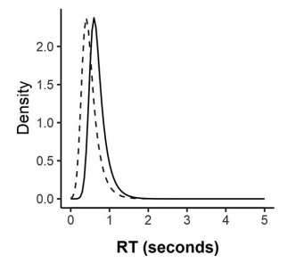
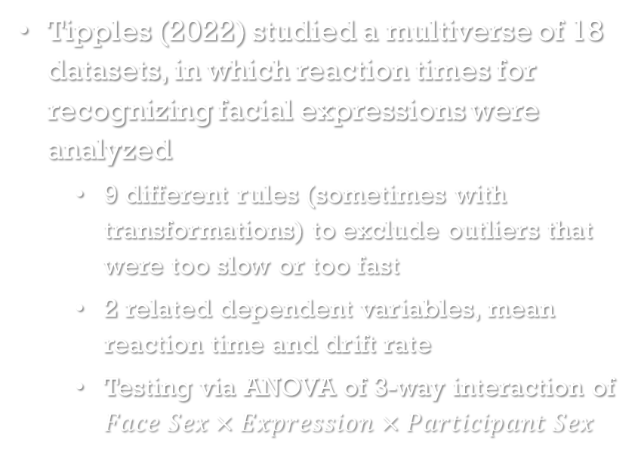
Multiverse analysis of reaction times
Tipples (2022) studied a multiverse of 18 datasets, in which reaction times for recognizing facial expressions were analyzed
9 different rules (sometimes with transformations) to exclude outliers that were too slow or too fast
2 related dependent variables, mean reaction time and drift rate
Testing via ANOVA of 3-way interaction of $Face Sex×Expression×Participant Sex$
A distribution used to fit RT data
Fig 2(left) from Tipples(2022)

Slide 58
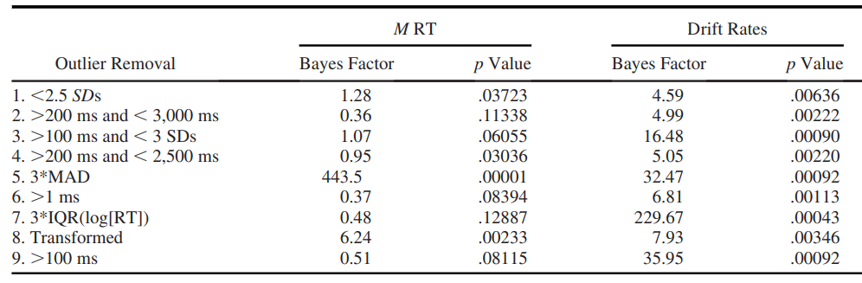
Multiverse analysis of reaction times: comparing p-values
Tipples (2022) found that the significance (and Bayes Factors) of mean reaction time results was dependent on outlier removal method
Recommended outlier removal methods (5 and 8 in Table 1) resulted in larger effects
Results from other outlier removal methods may explain why this 3-way interaction is inconsistently found in previous studies

Slide 59
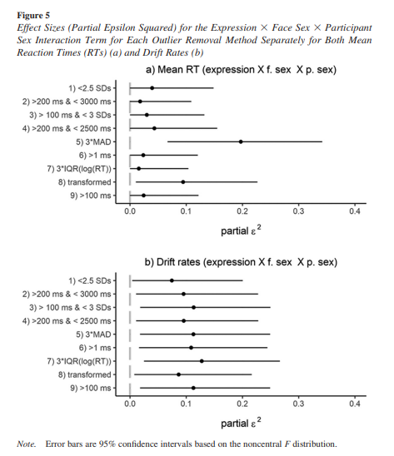
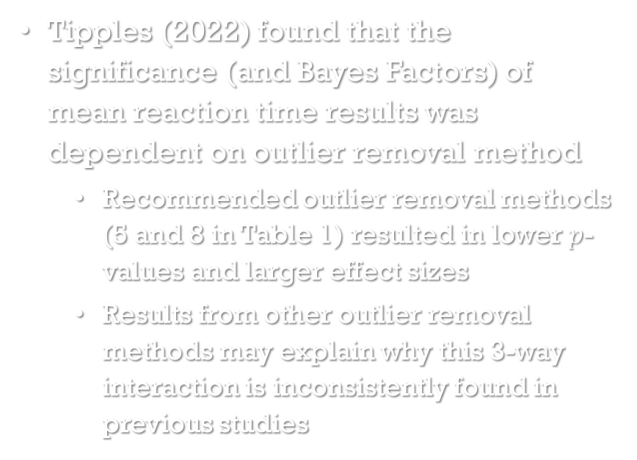
Multiverse analysis of reaction times: comparing effect sizes
Tipples (2022) found that the significance (and Bayes Factors) of mean reaction time results was dependent on outlier removal method
Recommended outlier removal methods (5 and 8 in Table 1) resulted in lower $p$-values and larger effect sizes
Results from other outlier removal methods may explain why this 3-way interaction is inconsistently found in previous studies

Slide 60
Final words

Slide 61
Concluding remarks
Scientific researchers are incentivized to find significant results and report them without disclosing the researcher degrees of freedom used to find them
Using researcher degrees of freedom increases the false positive rate
False positives can explain why many scientific results cannot be replicated
False positives are costly results that erode trust in scientists and science in general
With more transparent publishing requirements, we can make false positives easier to detect
incentives to publish null findings and replications would also help
Multiverse analysis should become the norm, especially for exploratory analyses
We haven’t even discussed the modeling multiverse!

Slide 62
References (Fertility studies)
Durante, K. M., & Arsena, A. R. (2015). Playing the field: The effect of fertility on women’s desire for variety. Journal of Consumer Research, 41, 1372–1391
Durante, K. M., Griskevicius, V., Cantú, S. M., & Simpson, J. A. (2014). Money, status, and the ovulatory cycle. Journal of Marketing Research, 51, 27–39.
Durante, K. M., Griskevicius, V., Hill, S. E., Perilloux, C., & Li, N. P. (2011). Ovulation, female competition, and product choice: Hormonal influences on consumer behavior. Journal of Consumer Research, 37, 921–934.
Durante, K. M., Griskevicius, V., Simpson, J. A., Cantú, S. M., & Li, N. P. (2012). Ovulation leads women to perceive sexy cads as good dads. Journal of Personality and Social Psychology, 103, 292–305.
Durante, K. M., Rae, A., & Griskevicius, V. (2013). The fluctuating female vote: Politics, religion, and the ovulatory cycle. Psychological Science, 24, 1007–1016.

Slide 63
References
Greenland, S., Senn, S. J., Rothman, K. J., Carlin, J. B., Poole, C., Goodman, S. N., & Altman, D. G. (2016). Statistical tests, P values, confidence intervals, and power: a guide to misinterpretations. European journal of epidemiology, 31(4), 337-350.
Open Science Collaboration. (2015). Estimating the reproducibility of psychological science. Science, 349(6251).
Simmons, J. P., Nelson, L. D., & Simonsohn, U. (2011). False-positive psychology: Undisclosed flexibility in data collection and analysis allows presenting anything as significant. Psychological Science, 22(11), 1369-1366.
Steegen, S., Tuerlinckx, F., Gelman, A., & Vanpaemel, W. (2016). Increasing transparency through a multiverse analysis. Perspectives on Psychological Science, 11(5), 702-712.
Tipples, J. (2022). Analyzing Facial Expression Decision Times: Reaction Time Distribution Matters. Emotion, 1-20.

Slide 64
Thank you!

