Slide 1
Applied Survey Data Analysis in SAS
UCLA OARC Statistical Methods and Data Analytics

Slide 2
Outline
Populations and samples
Complex survey samples
Statistical analysis of complex survey samples
NHANES 2011-2012 demographics data
Complex survey data analysis in SAS

Slide 3
Populations and samples
With statistics we estimate quantities and make inferences for a population, a complete set of units
People in the US
Retail stores in California
Intersections in Los Angeles
Usually can’t measure the whole population, so take a sample
Sample must be representative for unbiased estimation and accurate inference
How to achieve representativeness?

Slide 4
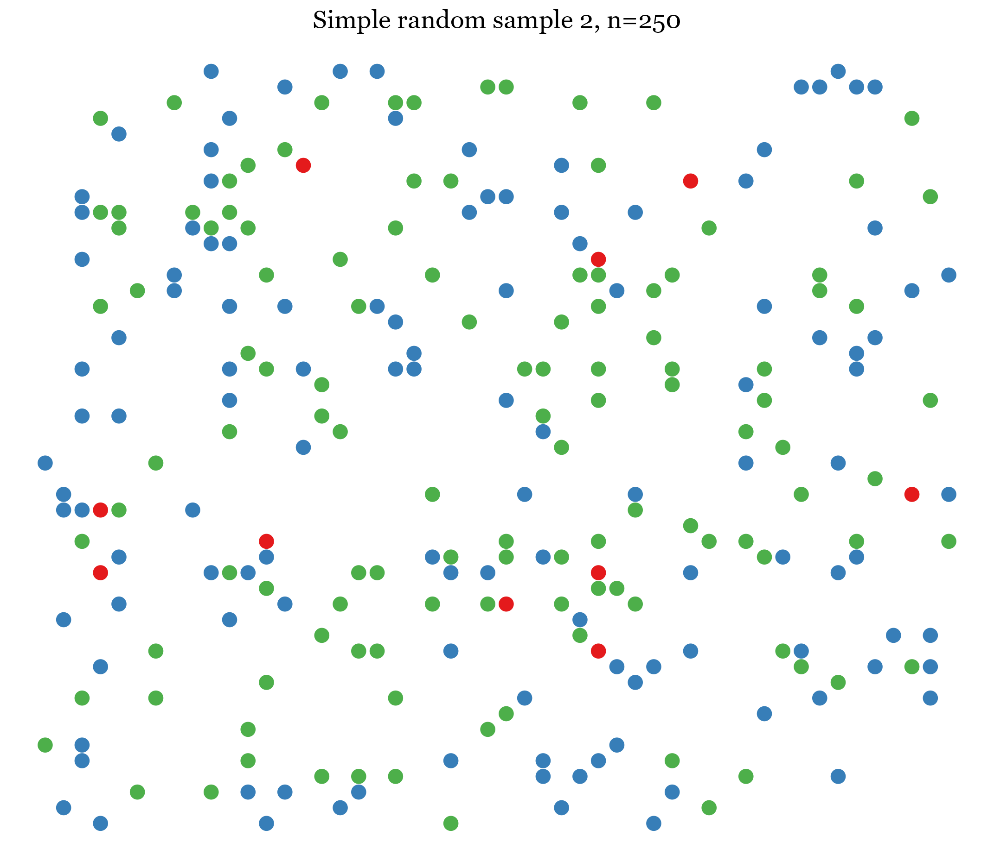
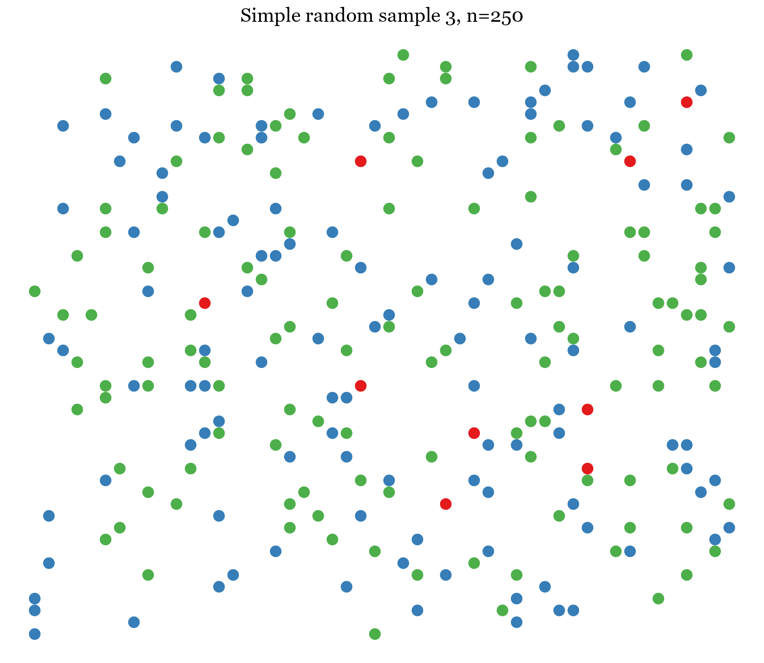
Simple random samples (SRS)
Selects population units with equal probability
Representative of the population in the long run
Simplest statistical analysis
Can be prohibitively costly or impractical
Hard to reach population elements
Small subpopulations underrepresented or absent

Slide 5
Complex survey samples

Slide 6
Survey samples
Surveys are relatively inexpensive so studies often use large samples
Rarely are SRS
Instead, use sampling strategies try to maximize precision of estimates while minimizing costs
Stratification
Oversampling
Clustered sampling
Often use multistage sampling designs
Randomly sample larger aggregates of units first then individual units are sampled at final stage

Slide 7
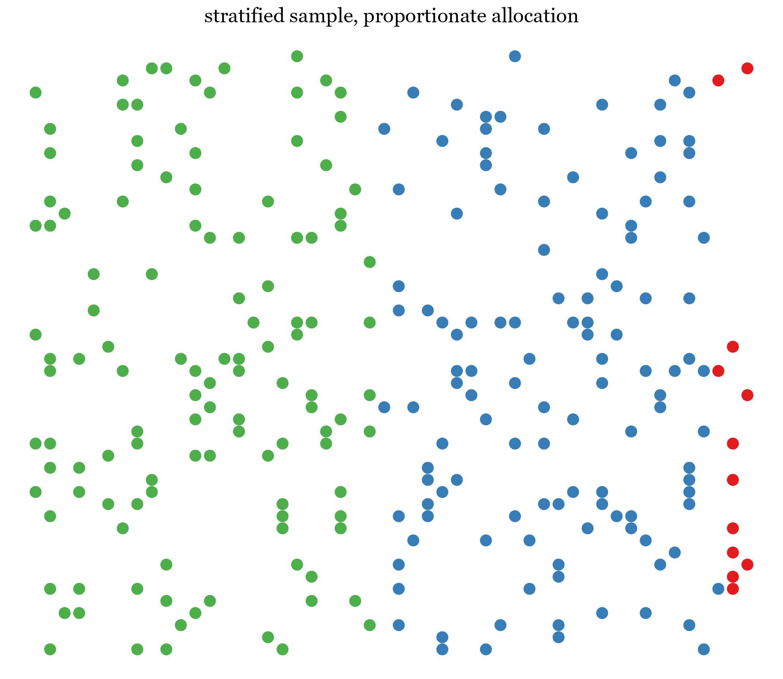
Stratified sampling
Population divided into mutually exclusive strata, groups of similar units
Common stratification variables: geographic region, race, age, education
Ensures some members of small strata are sampled
Units are typically randomly sampled within strata
Strata sample sizes may be proportional to their size in the population
Representative
Or strata sample sizes may be disproportional
Non-representative due to unequal probability of selection
Oversampling of small subpopulations

Slide 8
Oversampling
Oversampling produces larger samples of small subgroups (strata)
Key interest in the small subgroup
or subgroup is very different from rest of population
e.g. sampling billionaires to estimate total wealth of US
Weights are used to make the sample representative of the population

Slide 9
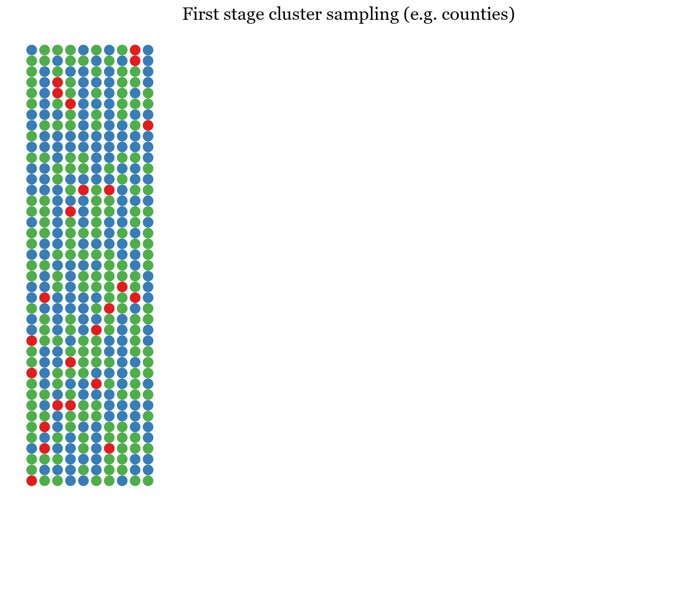
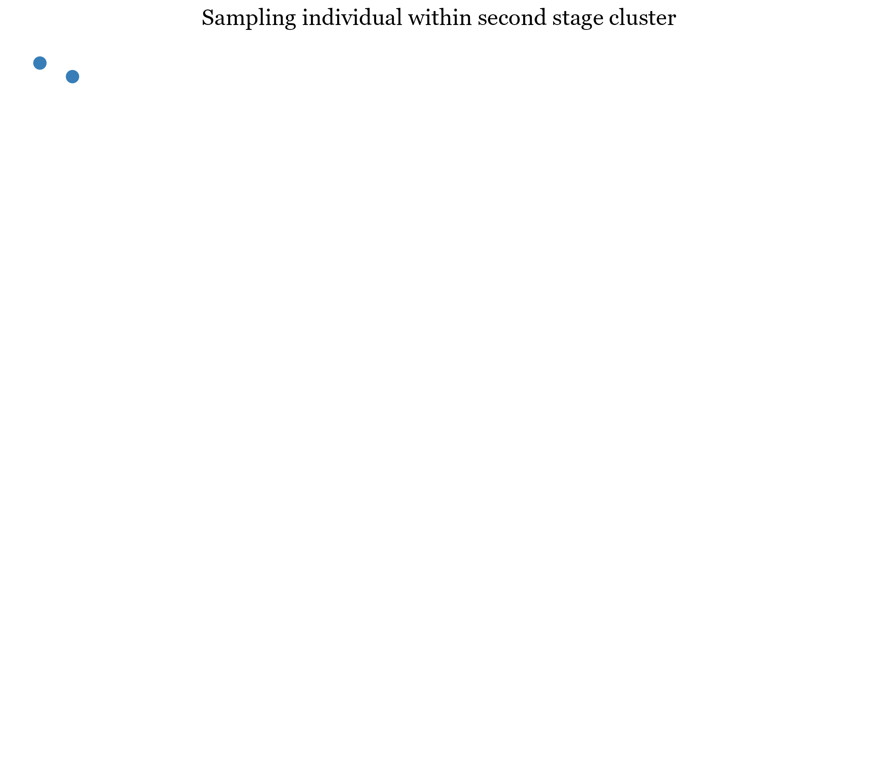
Clustered sampling
Clusters of units are randomly sampled first, then eventually individuals within clusters
Multi-stage designs
e.g. counties -> households -> individuals
Generally reduces costs
Generally reduces precision of estimates
Units within clusters are correlated on many variables
Less independent information

Slide 10
Statistical analysis of complex survey samples

Slide 11
Complex survey sample design effects
Each of the discussed sampling design strategies can affect estimation of population quantities
Many survey samples combine these strategies
Stratified, multi-stage designs are commonly used
Failure to account for design elements can result in biased estimates and standard errors
*Image from Heeringa, West & Berglund (2010).

Slide 12
Complex survey weights
Weights are used in statistical analysis of complex survey data to make the sample representative of the population
Often, a “final weight” is calculated that accounts for:
Unequal probabilities of selection
Unequal probabilities of non-response
Poststratification adjustments to meet population totals after sampling
Final weight value interpreted as number of people in the population that the observation represents
Sum of weights estimates population size
Using weights generally decreases precision (increase standard errors) compared to SRS

Slide 13
Estimates and uncertainty with complex survey weights
Weights affect both the point estimate of a parameter and its uncertainty (standard error)
With weights, standard errors cannot be calculated the typical way as in SRS, so Taylor series linearization is used to approximate them
Requires strata and cluster identifiers if used
Alternatively, replication methods can be used to approximate variances
Several sets of weights are released to mimic resampling/replication
Replicate weights are increasingly used in place of cluster and strata identifiers to protect individual identities

Slide 14
Estimation with stratified and clustered samples
Stratified sampling and estimation can increase precision by removing variation across strata
To estimate average weight of individuals, can stratify by sex
Parameter and standard error are estimated within each stratum
Standard errors will be small within strata because of homogeneity
Stratified estimates and standard errors are averaged together for final estimate
Clustered sampling generally decreases precision compared to SRS due to less independent information

Slide 15
Design effect
Design effect summarizes how all design elements affect precision of estimation
Ratio of variance of parameter accounting for complex survey design to variance assuming SRS
$$D=\frac{Var_{complex}\left(θ\right)}{Var_{SRS}\left(θ\right)}$$
Usually, $D>1$
Often reported by statistical software

Slide 16
Look for design variables in survey documentation
Most survey documentation will describe the complex sampling design and identify key variables
Weights
Strata identifiers
Cluster identifiers
Look for words like “sample design” and “variance estimation”
Some documentation gives statistical software code to use to account for design elements

Slide 17
NHANES 2011-2012 demographics data

Slide 18
NHANES 2011-2014 objectives
National Health and Nutrition Examination Survey
Primary objective: produce descriptive health and nutrition statistics for various sex, race/ethnicity, and age subdomains of US population
Includes a questionnaire/interview and medical exam
Survey population: noninstitutionalized US civilians
For this workshop, we will use a data set of demographics for respondents interviewed in 2011-2012

Slide 19
NHANES 2011-2014 Sample design
Description of sampling plan:
Look in “Sample Design” section
Stratified, multistage sampling design
Stratified by state-level health (death rate, infant mortality rate, etc.) and urban-rural population distribution
4-stage design
First-stage primary sampling unit (PSU) is county
Second stage is census blocks, third stage is households, fourth is individuals
Oversampled Hispanic, black, and Asian people as well as low-income white people and adults over 80

Slide 20
NHANES 2011-2012 data set and documentation
Data download page:
Click “DEMO_G Data [XPT-3.6MB]” link to download SAS XPT file
Use libname and data step to import data into SAS
Data documentation (including codebook)
Design variables
WTINT2YR – sampling weight
Includes adjustments for unequal probability of selection, nonresponse, and poststratification adjustments to meet population totals from the American Community Survey (US Census Bureau); see the Estimation Procedures guide for more information
SDMVPSU – Primary sampling unit (cluster) variable
SDMVSTRA – strata variable

Slide 21
Complex survey data analysis in SAS

Slide 22
SAS PROCs for complex survey data
7 SAS procedures dedicated to analysis of complex survey data
PROC SURVEYMEANS: descriptives for continuous variables
PROC SURVEYFREQ: frequency tables for categorical variables
PROC SURVEYREG: linear regression
PROC SURVEYLOGISTIC: logistic regression
PROC SURVEYPHREG: Cox proportional hazards models
PROC SURVEYSELECT: selecting a probability sample from a data set
PROC SURVEYIMPUTE: imputing missing values (not multiple and not model-based)

Slide 23
Specifying design variables
Each of the survey PROCs have the following statements to specify design variables:
WEIGHT
STRATA
CLUSTER
Simply specify the corresponding design variable on each statement
Most PROCs also include a REPWEIGHTS statement to specify a set of replicate weights for standard error estimation
Generally, Taylor series linearization will be used to estimate standard errors unless REPWEIGHTS is used

Slide 24
PROC SURVEYMEANS
For means, variances, quantiles, etc. of numeric/continuous variables
PROC SURVEYMEANS statement options include:
mean, min, max, range for mean, minimum, maximum and range
percentile=(values) for percentiles at list of values
nmiss for number missing
df for degrees of freedom
cv for coefficient of variation
deff for design effect for standard errors of mean
VAR statement: specify variables to analyze

Slide 25
PROC SURVEYFREQ
For weighted one-way frequency tables and multi-way crosstabulations
Weighted frequencies are estimates of subpopulation sizes
TABLES statement: specify variables to analyze
Use * between variables for cross-tabulations
Options:
row, col for row and column percentages
deff for design effect for standard errors of percentages
expected for expected cell frequencies assuming independence
Design-adjusted $χ^{2}−$tests
chisq for Rao-Scott $χ^{2}$-test
lrchisq for Rao-Scott likelihood ratio $χ^{2}$-test
wchisq for Wald $χ^{2}$-test
wllchisq for Wald log-linear $χ^{2}$-test

Slide 26
DOMAIN statement
For subpopulation analysis, use the DOMAIN statement rather than BY or WHERE
Using the DOMAIN statement will properly account for uncertainty in the size of subpopulations
Standard errors may be incorrect if you don’t
Specify one or more grouping variables after DOMAIN
Analysis will be run on each group
e.g. DOMAIN RACE*EDUC in PROC SURVEYMEANS will calculate means for each group formed by crossing race and education
Or, specify a formatted value in parentheses and quotes after the variable to restrict analyses to just that group
e.g. DOMAIN RACE(‘white’)*EDUC(‘HS or less’) to run analyses only on whites with less than high school education

Slide 27
PROC SURVEYREG
Linear regression models
Somewhat more similar to PROC GLM than PROC REG
Includes LSMEANS, ESTIMATE, and CONTRAST statements not found in PROC REG
On the MODEL statement, we will include option SOLUTION to produce a table of parameter estimates
True likelihoods are not estimated with survey data, so most likelihood based statistics (e.g. AIC, BIC) not available

Slide 28
PROC SURVEYLOGISTIC
Binary, ordinal, and multinomial logistic regression models
Similar to PROC LOGISTIC, but lacks ODDSRATIO and ROC statements
Odds ratio tables are produced by default
True likelihoods are not estimated

Slide 29
PROC SURVEYIMPUTE
Impute missing values by replacing them with observed values
Not model-based, but instead, define “cells” of similar observations
Cells defined by grouping variables like age, gender, health variables
Observations with missing on a variable will have value replaced by value from donor within the same cell
Hot-deck imputation
e.g. if missing on income, define cells by age and education; an observation with missing on income will have value replaced by donor with same age and education
CELLS statement used to specify variables that define cells
VAR statement used to specify variables to impute
OUTPUT statement used to name single imputed dataset (with OUT=)

Slide 30
THANK YOU!

Slide 31
References
Chen TC, Parker JD, Clark J, Shin HC, Rammon JR, Burt VL. (2018) National Health and Nutrition Examination Survey: Estimation procedures, 2011–2014. National Center for Health Statistics. Vital Health Stat 2(177).
Heeringa SG, West BT, Berglund PA. (2010). Applied Survey Data Analysis; Chapman Hall.
Johnson CL, Dohrmann SM, Burt VL, Mohadjer LK. (2014). National Health and Nutrition Examination Survey: Sample design, 2011-2014. National Center for Health Statistics. Vital Health Stat 2(162).

