Slide 1
INTRODUCTION TO
November 2023

Slide 2
WHAT IS SAS?
SAS is a powerful and versatile statistical software for:
Data management
Data analysis
Statistical modeling
It is a popular choice for organizations in fields such as government, healthcare, finance, and research due to:
Reliability: has a long history in handling complex data analysis
Scalability: designed to handle large datasets

Slide 3
PURPOSE OF THE WORKSHOP
Designed for people who are just getting started using SAS
Although SAS provides a graphical point-and-click user interface, we will concentrate on using SAS programming language
We will present the most common data processing steps and tasks
Access data
Explore data
Modify data
Manage data
Analyze data
Notes:
Entering data

Slide 4
SAS On Demand for Academics
Available on www.sas.com
An educational program provided by SAS and its purpose is to facilitate learning and teaching SAS programming, data analytics, and statistical analysis
Web-based platform that connects to SAS server
No downloading required
Free

Slide 5
NAVIGATING SAS ON DEMAND FOR ACADEMCS INTERFACE

Slide 6
https://welcome.oda.sas.com

Slide 7
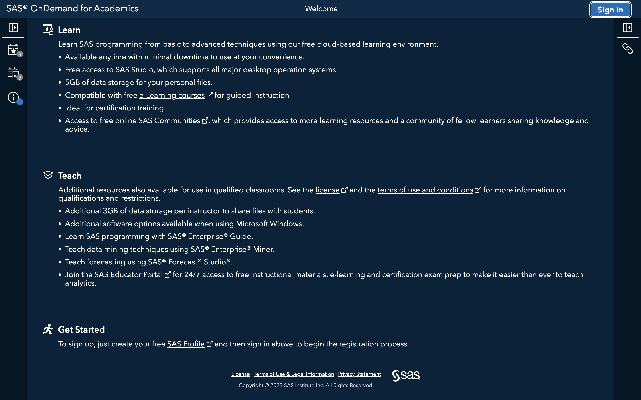

Slide 8
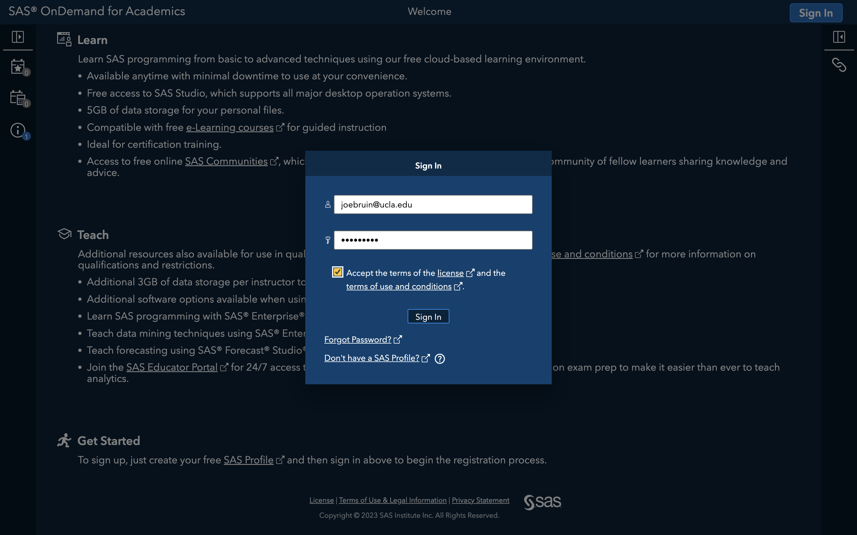

Slide 9
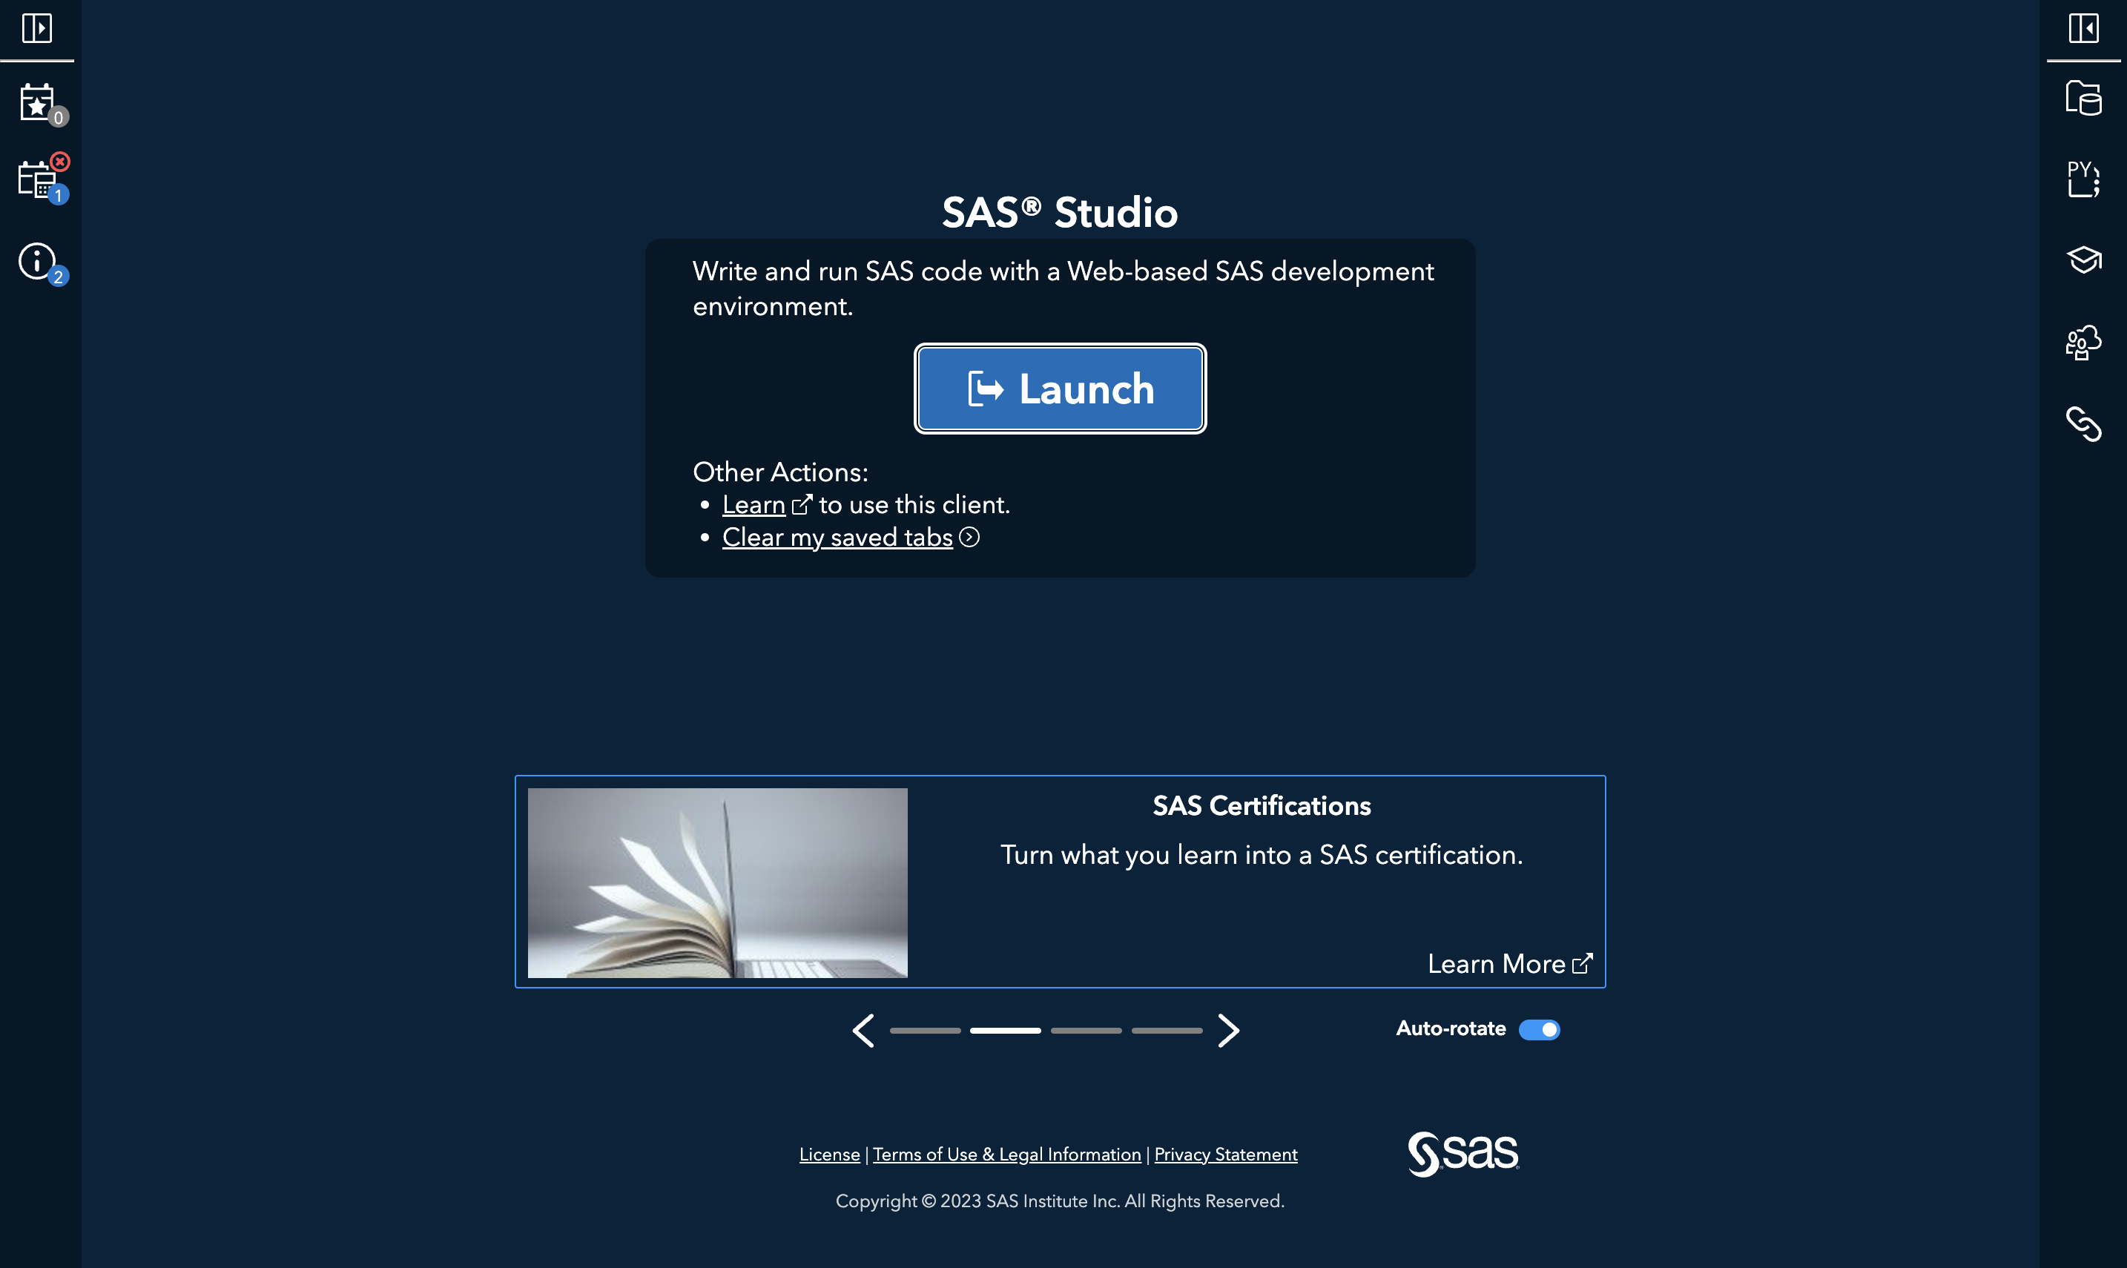

Slide 10
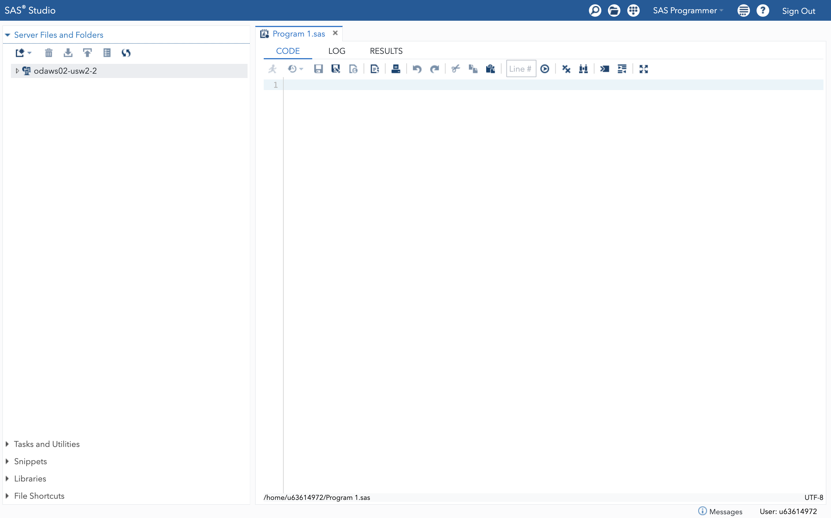

Slide 11
CODE, LOG AND RESULTS
WINDOWS
Together, these windows help you write, execute, and review the results of your SAS program

Slide 12
CODE WINDOW
Code window is where you write and edit SAS program code
SAS programs typically consists of data steps and procedures

Slide 13
LOG WINDOW
The Log window displays information about the execution of your program
You can find notes, warnings and error messages in the Log window

Slide 14
RESULTS WINDOW
Displays the results generated by your SAS program
You can view, save, and export the results from the Results window

Slide 15
SEARCH AND OPEN
You can search for files, folder, datasets
You can open files and view datasets

Slide 16
OPTIONS
You can start a new SAS Program (create a clean Code, Log, and Results)
You can import files into SAS server

Slide 17
SAS PROGRAMMER
SAS programmer perspective is mainly for writing and editing SAS programs.
Visual programmer perspective is used for working with process flows in a project-based environment.

Slide 18
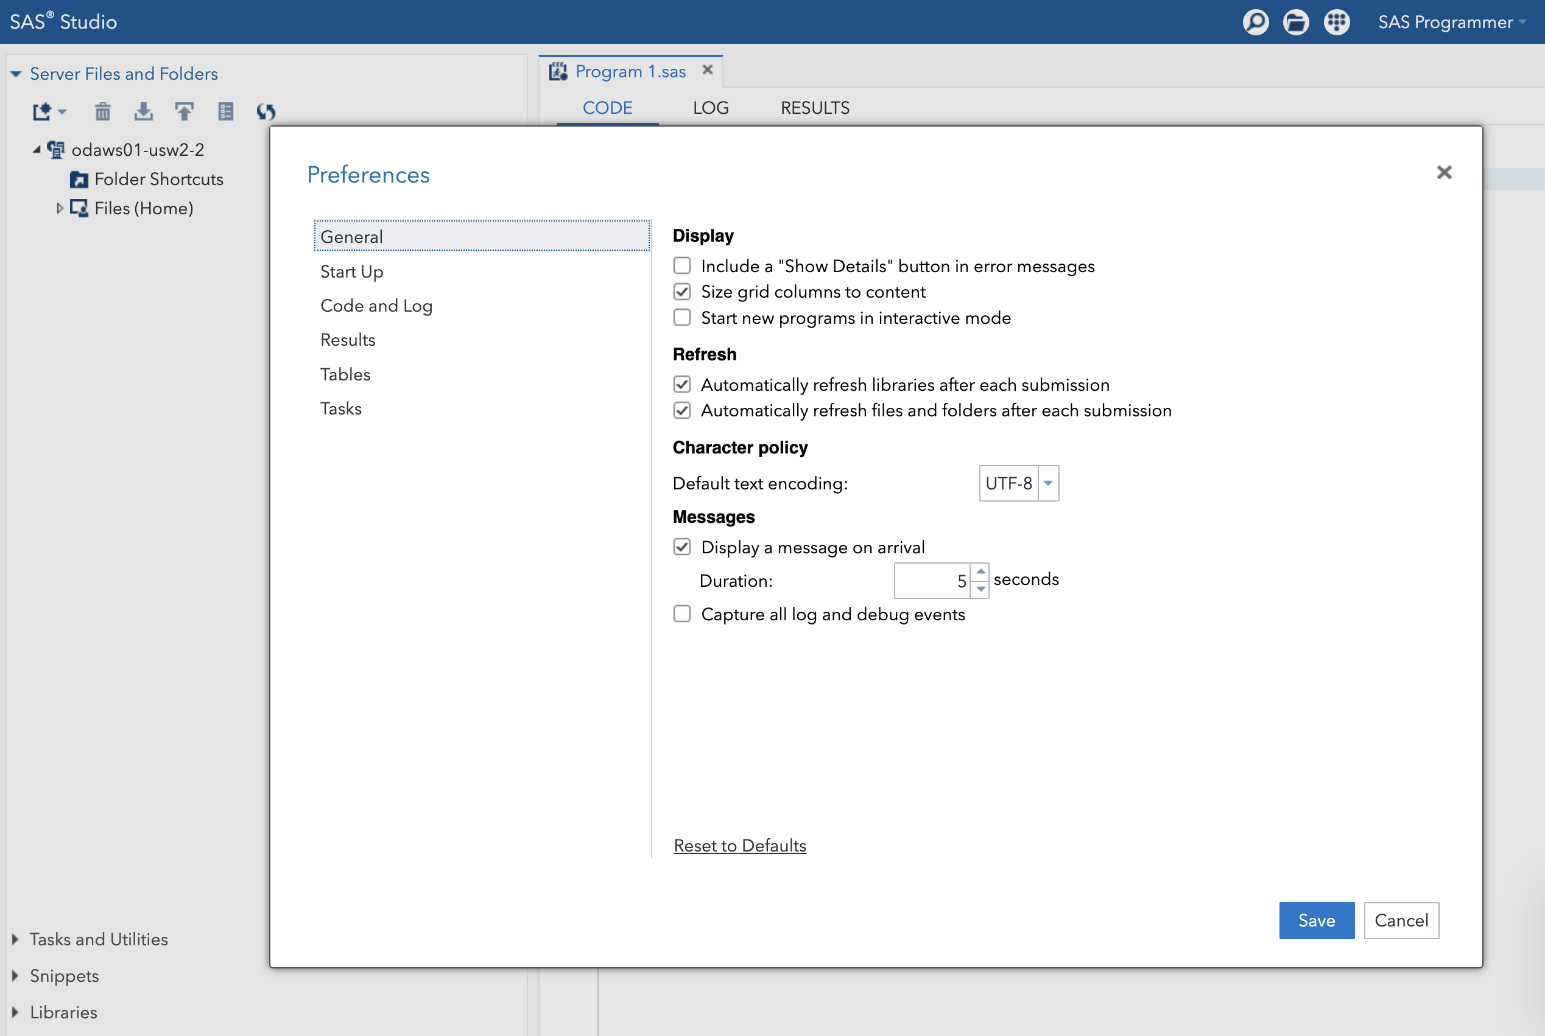
MORE APPLICATION OPTIONS

Slide 19
UPLOADING YOUR FILES TO SAS SERVER

Slide 20
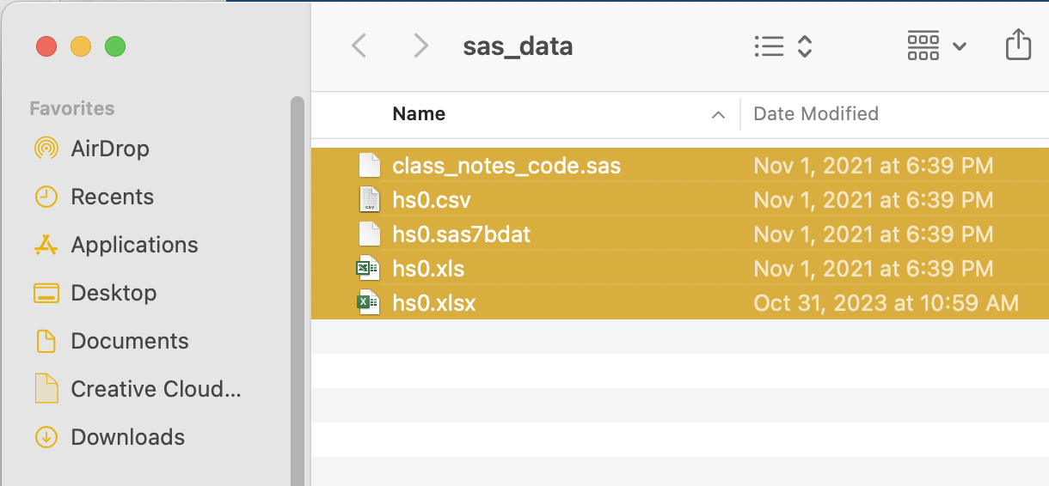
UPLOAD DATA
To use SAS On Demand for Academics, all your data files, SAS programs, and other necessary files have to be uploaded to SAS server
You get 5GB of personal storage

Slide 21
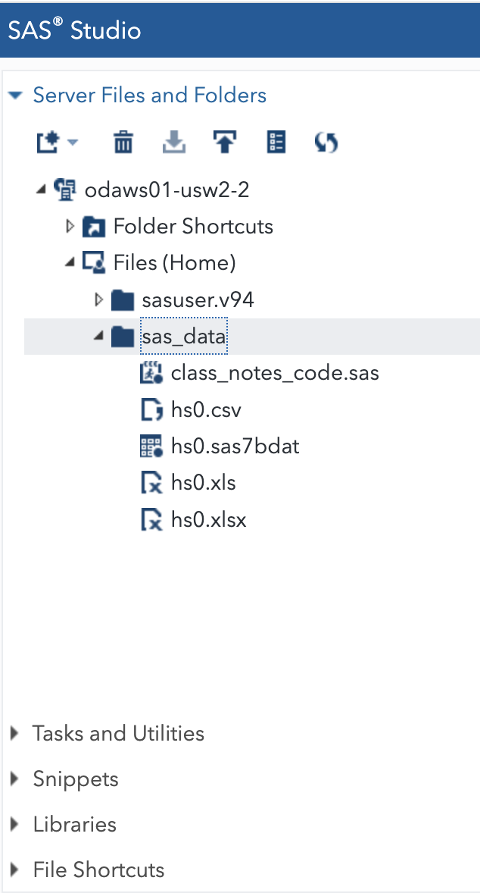
FILES AND FOLDERS
Your files and folders are stored in Files (Home) folder
After you uploaded the data and other necessary files, you can use that data within SAS Studio
To use your data, you have to use SAS libraries

Slide 22
SAS LIBRARIES

Slide 23
SAS LIBRARIES
SAS library is a collection of SAS files that are stored in the same directory
When you create a library, you are creating a shortcut to a that directory
This shortcut allows SAS to easily access specific files within the directory without storing them in the library

Slide 24
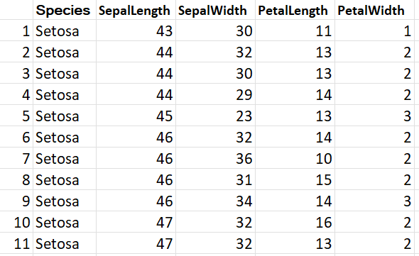
SAS DATA
SAS reads and works with the data in form of SAS data sets.
SAS data sets have a file extension .sas7bdat.
Like most statistical software, SAS stores data is two dimensions, columns and rows.
Rows are observations and columns are variables.
Two main type of variables are Character and Numeric.
Variable names should start with letter or underscore and cannot exceed 32 characters.
Variable Species
First Observation

Slide 25
SAS code syntax
SAS syntax or code includes series of instructions called statements. Each statement ends with a semicolon.
SAS code, including variable names, are not case sensitive.
There are two main type of blocks of code, called steps in SAS, DATA step and PROC step.
You can make comments in your code using
* … ; for one line, and /* …*/ for many lines,
*select only Setosa species;
data dsl; set sashelp.iris; if species= "Setosa"; run; /* print the result; */ proc print data = dsl (obs=10); run;

Slide 26
DATA step
DATA steps are used for creating or modifying data.
SAS executes DATA steps one observation at a time.
Input data
Data manipulations
Output data
observation 1
observation 2
observation 3
.
.
.
statement 1
statement 2
statement 3
observation 1
observation 2
observation 3
.
.
.

Slide 27
PROC step
PROC steps are used for analyzing data.
Results
Table 1
Table 2
Plot 1
Data
Proc step
Most of the time, PROC steps and DATA steps conclude with the RUN statement.
Certain statements, known as global statements, are placed outside DATA steps and PROC steps. For instance, the LIBNAME statement is used to define SAS libraries, and the OPTIONS statement allows users to customize printing output.

Slide 28
proc import Imports data into SAS
saving data Saving data permanently
libname Defines a link between a SAS session and a folder
ACCESING DATA

Slide 29
proc contents Content of a SAS dataset
proc print Displays the data
proc means Descriptive statistics
proc univariate More descriptive statistics
proc freq Frequency tables, frequency charts, crosstabs
proc corr Correlation matrix and scatterplots
Proc sgplot Produces many types of plots
EXPLORING DATA

Slide 30
MODIFYING DATA
proc format Creates formats (aka value labels)
label Creates labels for variables
rename Changes the name of a variable in a data step
if then Executes a statement only if the condition is true
functions Creating new variables using SAS functions

Slide 31
if and where Conditional statement
keep Keeps named variables
drop Drops named variables
appending Reads in named file(s), proc set
proc sort Sorts cases in a dataset
merge Merges files
MANAGING DATA

Slide 32
ANALYZING DATA
proc freq Used here for chi-squared tests
proc ttest t-tests, including one sample, two sample and paired
proc reg Simple and multiple regression
proc logistic logistic regression

Slide 33
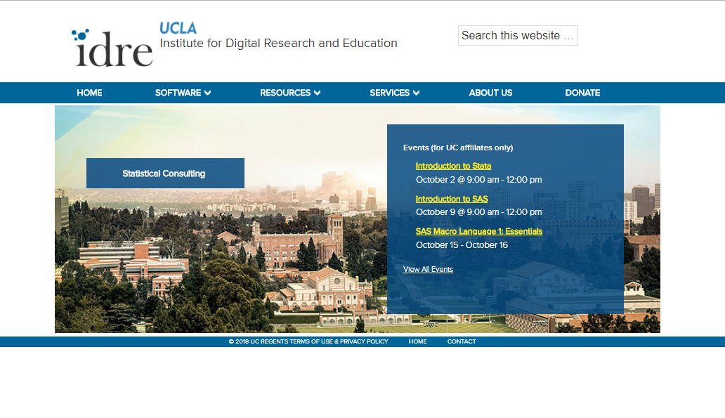
ADDITIONAL RESOURCES
UCLA OARC statistical consulting website
https://stats.oarc.ucla.edu/
On the website you’ll find many links to our SAS resources pages:
Seminars provide deeper dives into SAS topics
Learning modules for basic SAS commands
Data analysis examples of many different regression commands
Annotated output of many regression commands

Slide 34
EXTERNAL RESOURCES
SAS Users YouTube channel
SAS Base Programming Reference sheet (compact guide to SAS commands)
OARC YouTube channel (SAS and other workshops)

Slide 35
THANK YOU!
Notes:
SIAVASH

