Slide 1
Introduction to Mediation Analysis using Mplus
Presented by Christine R. Wells, Ph.D.
Statistical Methods and Data Analytics
UCLA Office of Advanced Research Computing

Slide 2
Outline
What is mediation?
Mediation as regression
Mediation as a type of SEM model
Bootstrapping confidence intervals
Standardizing coefficients
Binary predictor
Multi-category predictor
Adding covariates
Parallel mediation
Serial mediation
Missing data (MCAR only)
Causal modeling
References

Slide 3
Resources
Intro to Mplus: Introduction to Mplus seminar page and video
Introduction to Mediation, Moderation and Conditional Process Analysis: A Regression-based Approach, Third Edition by Andrew F. Hayes (2022)
https://www.figureitout.org.uk/mplusmedmod.htm
Regression and Mediation Analysis Using Mplus by Bengt O. Muthen, Linda K. Muthen and Tihomir Asparouhov (2016)
Data Analysis with Mplus by Christian Geiser (2013)

Slide 4
Questions for audience:
What is mediation?
How is mediation different from other types of analyses?
Are all mediation models causal models (meaning that the model describes a causal relationship between the variables in the model)?

Slide 5
Answers
What is mediation?
Mediation is a type of statistical model that describes a causal relationship between at least three variables. The predictor variable (X) causes the outcome variable (Y) through two mechanisms: directly and via the mediator (M).
How is mediation different form other types of analyses?
Mediation is different from:
Regression: relationship v. causal mechanism
SEM: absence v. presence of latent variables
Are all mediation models causal models?
Yes

Slide 6
Introduction to dataset
Simulated data!
5000 cases
No missing data (until examples at end)
Experiment in which Ss were randomly assigned to amounts of the IV.
All variables continuous unless otherwise noted
X: detail (level of detail of information provided by researcher at start of study)
M: exper (amount of experience participants received, measured in hours)
Y: opinion (opinion expressed by participants at end of study)

Slide 7
Simple mediation model
Simple mediation model
e_{m}
M
a b
X Y e_{y}
_{C’}
Indirect effect is the effect of X on Y via M; calculated as a*b
Total effect (c) = direct effect (c’) + indirect effect

Slide 8
Regression approach
Two linear regression models:
X predicts M (a path)
X and M predict Y (c’ and b paths)
Shortcomings:
No calculation of indirect effect (but could calculate it by hand)
No calculation of total effect (but could calculate it by hand)
a*b = indirect effect, but the sampling distribution is not normal (and not asymptotically normal)
You need to create the path diagram yourself and include the estimates and standard errors (or CIs)

Slide 9
Regression of MV on IV (b path)
title: regression of MV on IV
data: file is intro_mediation.dat;
variable: names are detail exper impact opinion ccovar bcovar;
usevariables = exper detail;
model: exper on detail;

Slide 10
Output of regression of MV on IV
MODEL RESULTS
Two-Tailed
Estimate S.E. Est./S.E. P-Value
EXPER ON
DETAIL 0.614 0.015 40.588 0.000
Intercepts
EXPER 80.964 1.262 64.169 0.000
Residual Variances
EXPER 102.673 2.053 50.000 0.000

Slide 11
Regression of DV on IV and MV (c’ and a paths)
title: regression of DV on IV and mediator
data: file is intro_mediation.dat;
variable: names are detail exper impact opinion ccovar bcovar;
usevariables = exper opinion detail;
model: opinion on detail exper;

Slide 12
Output of regression of DV on IV and MV
MODEL RESULTS
Two-Tailed
Estimate S.E. Est./S.E. P-Value
OPINION ON
DETAIL 1.011 0.019 51.976 0.000
EXPER 0.314 0.016 19.901 0.000
Intercepts
OPINION 101.915 1.901 53.611 0.000
Residual Variances
OPINION 127.809 2.556 50.000 0.000

Slide 13
Using Mplus to run mediation model
Much like the regression code
Must include either Model Constraint or Model Indirect
Model Constraint
Need to label parameters
Need to create two new variables (called cprime and total in examples)
Model Indirect
Use Mplus keyword “ind”
Diagram available on Windows
Mplus runs on Macs, but there is no Diagram viewer

Slide 14
Simple mediation model – constraint - 1
title: simple mediation model - all continuous variables with model constraint
! predictor variable - x: detail
! mediator variable(s) - m: exper
! outcome variable - y: opinion
data: file is intro_mediation.dat;
variable: names are detail exper impact opinion ccovar bcovar;
usevariables = detail exper opinion;
analysis:
type = general;
estimator = ml;

Slide 15
Simple mediation model – constraint - 2
! in model statement, name each path using parentheses
model:
opinion on exper (b1);
opinion on detail (cprime); ! Direct effect of x on y
exper on detail (a1);
! use model constraint to calculate indirect and total effect
model constraint:
new(a1b1 total);
a1b1 = a1*b1; ! Indirect effect of x on y via m
total = a1*b1 + cprime; ! Total effect of x on y

Slide 16
Diagram of simple mediation model

Slide 17
Output: Summary of analysis
Syntax echoed
Input reading terminated normally: good sign
Number of observations: 5000
Number of groups: 1
Number of DVs: 2
Number of observed IVs: 1
Number of latent variables: 0

Slide 18
Output: Univariate sample statistics
Always check these at least once
Easier to do with no missing data
Variable/Sample size
Mean/Variance
Skewness/Kurtosis
Minimum/Maximum
% with Min/Max
20%/60%
Percentiles 40%/80%
Median

Slide 19
Output: Model fit information
Model estimation terminated normally
Number of free parameters
Log likelihood: model comparison
Model fit indices: not useful with this type of model (saturated model)
Chi-square test of model fit
RMSEA
CFI/TLI
Chi-square test of model fit for the baseline model: want this to be statistically significant
SRMR: not useful with this type of model

Slide 20
Output: Model results - 1
MODEL RESULTS
Two-Tailed
Estimate S.E. Est./S.E. P-Value
OPINION ON
EXPER 0.314 0.016 19.901 0.000
DETAIL 1.011 0.019 51.976 0.000
EXPER ON
DETAIL 0.614 0.015 40.588 0.000

Slide 21
Output: Model results - 2
Intercepts
EXPER 80.964 1.262 64.169 0.000
OPINION 101.915 1.901 53.611 0.000
Residual Variances
EXPER 102.672 2.053 50.000 0.000
OPINION 127.810 2.556 50.000 0.000
New/Additional Parameters
A1B1 0.193 0.011 17.868 0.000
TOTAL 1.204 0.018 68.685 0.000

Slide 22
Seven free parameters
1. the coefficient from detail to opinion;
2. the coefficient from detail to exper;
3. the coefficient from exper to opinion;
4. the intercept for the regression with exper as the outcome;
5. the intercept for the regression with opinion as the outcome;
6. the residual variance for exper; and
7. the residual variance for opinion

Slide 23
Question for audience
How would you interpret the path coefficients?

Slide 24
Interpretation of coefficients
Just like OLS regression!
Direct effect of detail (X) on opinion (Y): 1.011 is the expected change in opinion (Y) for a one-unit change in detail (X), holding exper (M) constant; AKA c’ path
Effect of exper (M) on opinion (Y): 0.314 is the expected change in opinion (Y) for a one-unit change in exper, holding detail (X) constant; AKA b path
Effect of detail (X) on exper (M): 0.614 is the expected change in exper, for a one-unit change in detail (X); AKA a path

Slide 25
Indirect effect and total effect
Indirect effect: Multiply the coefficient for a path and the coefficient for b path:
0.614*0.314 = 0.192796
The effect of detail (X) on opinion (Y) via exper (M) is 0.19. For a one-unit change in detail (X), we expect the opinion (Y) to increase by 0.19 via exper (M).
Total effect: Add the direct and indirect effect:
1.011 + 0.192796 = 1.204
Beware of rounding!

Slide 26
Model indirect - 1
title: simple mediation model - all continuous variables with indirect
! predictor variable - x: detail
! mediator variable(s) - m: exper
! outcome variable - y: opinion
data: file is intro_mediation.dat;
variable:
names are detail exper impact opinion ccovar bcovar;
usevariables = detail exper opinion;
analysis:
type = general;
estimator = ml;

Slide 27
Model indirect - 2
model:
opinion on detail exper;
exper on detail;
model indirect:
opinion ind detail;

Slide 28
Output from Model Indirect
TOTAL, TOTAL INDIRECT, SPECIFIC INDIRECT, AND DIRECT EFFECTS
Two-Tailed
Estimate S.E. Est./S.E. P-Value
Effects from DETAIL to OPINION
Total 1.204 0.018 68.685 0.000
Total indirect 0.193 0.011 17.868 0.000
Specific indirect 1
OPINION
EXPER
DETAIL 0.193 0.011 17.868 0.000
Direct
OPINION
DETAIL 1.011 0.019 51.976 0.000

Slide 29
Any questions?

Slide 30
Bootstrapping
Add Boostrap statement to Analysis command (gives bootstrapped standard errors in Model Results section)
Add Output command
Add Cint statement
A few options
bcbootstrap is currently preferred
BC stands for “bias corrected”
bootstrap is also an option

Slide 31
A quick note on bootstrapping
Bootstrapping is a resampling method that selects samples of the same size with replacement from the dataset.
It is used to create a sampling distribution from which variance estimates can be calculated.
It is often used when the sampling distribution is unknown or is suspected to be non-normally distributed.
It can be used with almost any type of statistical test.

Slide 32
Confidence intervals
The frequentist settings are SYMMETRIC, BOOTSTRAP, and BCBOOTSTRAP.
SYMMETRIC is the default for frequentist estimation.
The bootstrapped distribution of each parameter estimate is used to determine the bootstrap and bias-corrected bootstrap confidence intervals.
These intervals take non-normality of the parameter estimate distribution into account; hence, they are not necessarily symmetric around the parameter estimate.

Slide 33
Using boostrapping options
output:
cint(bootstrap); ! Bootstrapped CIs
output:
cint(bcbootstrap); ! Bias-corrected boostrapped CIs
output:
cinterval; ! Just getting the CIs in the output

Slide 34
Bootstrapping syntax - 1
title: simple mediation model - all continuous variables with bootstrap
! predictor variable - x: detail
! mediator variable(s) - m: exper
! outcome variable - y: opinion
data: file is intro_mediation.dat;
variable: names are detail exper impact opinion ccovar bcovar;
usevariables = detail exper opinion;
analysis:
type = general;
estimator = ml;
bootstrap = 10000;

Slide 35
Bootstrapping syntax - 2
model:
opinion on exper (b1);
opinion on detail (cprime);
exper on detail (a1);
model constraint:
new(a1b1 total);
a1b1 = a1*b1;
total = a1*b1 + cprime;
output:
cint(bcbootstrap);

Slide 36
Slightly different standard errors (for residuals only in this example)

Slide 37
Mplus output from Output command
CONFIDENCE INTERVALS OF MODEL RESULTS
Lower .5% Lower 2.5% Lower 5% Estimate Upper 5% Upper 2.5% Upper .5%
OPINION ON
EXPER 0.275 0.284 0.289 0.314 0.341 0.346 0.357
DETAIL 0.961 0.973 0.979 1.011 1.043 1.049 1.063
EXPER ON
DETAIL 0.576 0.584 0.589 0.614 0.638 0.643 0.652
Intercepts
EXPER 77.783 78.585 78.939 80.964 82.996 83.385 84.221
OPINION 97.097 98.267 98.849 101.915 105.024 105.548 106.654
Residual Variances
EXPER 97.459 98.714 99.329 102.672 106.225 106.876 107.955
OPINION 121.282 122.806 123.646 127.810 132.239 133.128 134.621
New/Additional Parameters
A1B1 0.166 0.173 0.176 0.193 0.211 0.214 0.222
TOTAL 1.159 1.170 1.175 1.204 1.233 1.239 1.249

Slide 38
Any questions?

Slide 39
Standardization
Decide what type of standardization to request (if any) depending on the type of interpretation desired.
A result may be statistically significant when in its original metric and not statistically significant when standardized, or vice versa.
Perhaps because the standardized and unstandardized parameter estimates have different sampling distributions
If one of the two parameter estimates has a non-symmetric sampling distribution, then a non-symmetric confidence interval should be used, and this can be obtained with bootstrapping.

Slide 40
The standardization options available
The standardized (stand) gives all possible types of standardization in the output, which usually means lots and lots of output!
The stdy option standardizes only the Y variable and is interpreted as the change Y standard deviation units when X changes by one unit.
In a mediation model, both the (ultimate) outcome and the mediator are outcome variables, and so they are both standardized.
The stdy option may be useful when the independent variable is dichotomous – usually do not want to standardize a dichotomous predictor.
The stdyx standardizes with respect to both X and Y and is interpreted as the change in Y standard deviation units for a one standard deviation unit change in X.
In the output, the section labeled “STD” is standardized to the latent variable. Because there is no latent variable in this model, the results are identical to the unstandardized output.

Slide 41
How the standardization is done
StdYX uses the variances of the continuous latent variables as well as the variances of the background and outcome variables for standardization.
The StdYX standardization is the one used in the linear regression of Y on X. The standardized coefficient bStdYX is interpreted as the change in Y in Y standard deviation units for a standard deviation change in X.
StdY uses the variances of the continuous latent variables a well as the variances of the outcome variables for standardization. StdY should be used for binary covariates because a standard deviation change of a binary variable is not meaningful. The standardized coefficient bStdY is interpreted as the change in Y in Y standard deviation units when X changes from 0 to 1.

Slide 42
Using options to get standardized coefficients
output:
stand; ! Short for standardized; can get both symmetric and non-symmetric CIs; lots of output
output:
stdyx;
output:
stdy;
output:
std; ! used with latent variable(s)

Slide 43
Syntax for standardized coefficients - 1
title: adding the standardized option
! predictor variable - x: detail
! mediator variable(s) - m: exper
! outcome variable - y: opinion
data: file is intro_mediation.dat;
variable: names are detail exper impact opinion ccovar bcovar;
usevariables = detail exper opinion;
analysis:
type = general;
estimator = ml;
Boostrap = 10000;

Slide 44
Syntax for standardized coefficients - 2
model:
opinion on detail exper;
exper on detail;
model indirect:
opinion ind detail;
output:
standardized cint(bcbootstrap);

Slide 45
Output with standardized coefficients - 1
STANDARDIZED MODEL RESULTS
STDYX Standardization
Two-Tailed
Estimate S.E. Est./S.E. P-Value
OPINION ON
DETAIL 0.585 0.010 59.054 0.000
EXPER 0.224 0.011 20.001 0.000
EXPER ON
DETAIL 0.498 0.010 47.607 0.000
Intercepts
EXPER 6.930 0.159 43.476 0.000
OPINION 6.225 0.160 38.964 0.000
Residual Variances
EXPER 0.752 0.010 72.284 0.000
OPINION 0.477 0.010 48.968 0.000

Slide 46
Output with standardized coefficients - 2
STDY Standardization
Two-Tailed
Estimate S.E. Est./S.E. P-Value
OPINION ON
DETAIL 0.062 0.001 59.238 0.000
EXPER 0.224 0.011 20.001 0.000
EXPER ON
DETAIL 0.053 0.001 50.700 0.000
Intercepts
EXPER 6.930 0.159 43.476 0.000
OPINION 6.225 0.160 38.964 0.000
Residual Variances
EXPER 0.752 0.010 72.284 0.000
OPINION 0.477 0.010 48.968 0.000

Slide 47
Output with standardized coefficients - 3
STD Standardization
Two-Tailed
Estimate S.E. Est./S.E. P-Value
OPINION ON
DETAIL 1.011 0.019 52.117 0.000
EXPER 0.314 0.016 19.845 0.000
EXPER ON
DETAIL 0.614 0.015 41.116 0.000
Intercepts
EXPER 80.964 1.239 65.321 0.000
OPINION 101.915 1.861 54.763 0.000
Residual Variances
EXPER 102.672 2.086 49.217 0.000
OPINION 127.810 2.597 49.212 0.000

Slide 48
Output with standardized coefficients - 4
STANDARDIZED TOTAL, TOTAL INDIRECT, SPECIFIC INDIRECT, AND DIRECT EFFECTS
STDYX Standardization
Two-Tailed
Estimate S.E. Est./S.E. P-Value
Effects from DETAIL to OPINION
Total 0.697 0.007 94.976 0.000
Total indirect 0.112 0.006 18.500 0.000
Specific indirect 1
OPINION
EXPER
DETAIL 0.112 0.006 18.500 0.000
Direct
OPINION
DETAIL 0.585 0.010 59.054 0.000

Slide 49
Output with standardized coefficients - 5
STDY Standardization
Two-Tailed
Estimate S.E. Est./S.E. P-Value
Effects from DETAIL to OPINION
Total 0.074 0.001 95.803 0.000
Total indirect 0.012 0.001 18.511 0.000
Specific indirect 1
OPINION
EXPER
DETAIL 0.012 0.001 18.511 0.000
Direct
OPINION
DETAIL 0.062 0.001 59.238 0.000

Slide 50
Output with standardized coefficients - 6
STD Standardization
Two-Tailed
Estimate S.E. Est./S.E. P-Value
Effects from DETAIL to OPINION
Total 1.204 0.017 69.235 0.000
Total indirect 0.193 0.011 17.945 0.000
Specific indirect 1
OPINION
EXPER
DETAIL 0.193 0.011 17.945 0.000
Direct
OPINION
DETAIL 1.011 0.019 52.117 0.000

Slide 51
Output with standardized coefficients - 7
CONFIDENCE INTERVALS OF STANDARDIZED MODEL RESULTS
STDYX Standardization
Lower .5% Lower 2.5% Lower 5% Estimate Upper 5% Upper 2.5% Upper .5%
OPINION ON
DETAIL 0.559 0.565 0.569 0.585 0.601 0.604 0.610
EXPER 0.196 0.202 0.206 0.224 0.242 0.246 0.254
EXPER ON
DETAIL 0.470 0.477 0.480 0.498 0.515 0.518 0.523
Intercepts
EXPER 6.517 6.628 6.675 6.930 7.197 7.246 7.342
OPINION 5.823 5.910 5.964 6.225 6.489 6.542 6.641
Residual Variances
EXPER 0.726 0.732 0.735 0.752 0.769 0.773 0.779
OPINION 0.453 0.459 0.461 0.477 0.493 0.497 0.503

Slide 52
Output with standardized coefficients - 8
STDY Standardization
Lower .5% Lower 2.5% Lower 5% Estimate Upper 5% Upper 2.5% Upper .5%
OPINION ON
DETAIL 0.059 0.060 0.060 0.062 0.063 0.064 0.064
EXPER 0.196 0.202 0.206 0.224 0.242 0.246 0.254
EXPER ON
DETAIL 0.050 0.050 0.051 0.053 0.054 0.055 0.055
Intercepts
EXPER 6.517 6.628 6.675 6.930 7.197 7.246 7.342
OPINION 5.823 5.910 5.964 6.225 6.489 6.542 6.641
Residual Variances
EXPER 0.726 0.732 0.735 0.752 0.769 0.773 0.779
OPINION 0.453 0.459 0.461 0.477 0.493 0.497 0.503

Slide 53
Output with standardized coefficients - 9
STD Standardization
Lower .5% Lower 2.5% Lower 5% Estimate Upper 5% Upper 2.5% Upper .5%
OPINION ON
DETAIL 0.961 0.973 0.979 1.011 1.043 1.049 1.063
EXPER 0.275 0.284 0.289 0.314 0.341 0.346 0.357
EXPER ON
DETAIL 0.576 0.584 0.589 0.614 0.638 0.643 0.652
Intercepts
EXPER 77.783 78.585 78.939 80.964 82.996 83.385 84.221
OPINION 97.097 98.267 98.849 101.915 105.024 105.548 106.654
Residual Variances
EXPER 97.459 98.714 99.329 102.672 106.225 106.876 107.955
OPINION 121.282 122.806 123.646 127.810 132.239 133.128 134.621

Slide 54
Output with standardized coefficients - 10
CONFIDENCE INTERVALS OF STANDARDIZED TOTAL, TOTAL INDIRECT, SPECIFIC INDIRECT, AND DIRECT EFFECTS
STDYX Standardization
Lower .5% Lower 2.5% Lower 5% Estimate Upper 5% Upper 2.5% Upper .5%
Effects from DETAIL to OPINION
Total 0.677 0.682 0.684 0.697 0.708 0.710 0.715
Total indirect 0.097 0.100 0.102 0.112 0.122 0.124 0.128
Specific indirect 1
OPINION
EXPER
DETAIL 0.097 0.100 0.102 0.112 0.122 0.124 0.128
Direct
OPINION
DETAIL 0.559 0.565 0.569 0.585 0.601 0.604 0.610

Slide 55
Output with standardized coefficients - 11
STDY Standardization
Lower .5% Lower 2.5% Lower 5% Estimate Upper 5% Upper 2.5% Upper .5%
Effects from DETAIL to OPINION
Total 0.072 0.072 0.072 0.074 0.075 0.075 0.075
Total indirect 0.010 0.011 0.011 0.012 0.013 0.013 0.013
Specific indirect 1
OPINION
EXPER
DETAIL 0.010 0.011 0.011 0.012 0.013 0.013 0.013
Direct
OPINION
DETAIL 0.059 0.060 0.060 0.062 0.063 0.064 0.064

Slide 56
Output with standardized coefficients - 12
STD Standardization
Lower .5% Lower 2.5% Lower 5% Estimate Upper 5% Upper 2.5% Upper .5%
Effects from DETAIL to OPINION
Total 1.159 1.170 1.175 1.204 1.233 1.239 1.249
Total indirect 0.166 0.173 0.176 0.193 0.211 0.214 0.222
Specific indirect 1
OPINION
EXPER
DETAIL 0.166 0.173 0.176 0.193 0.211 0.214 0.222
Direct
OPINION
DETAIL 0.961 0.973 0.979 1.011 1.043 1.049 1.063

Slide 57
Any questions?

Slide 58
Creating binary variables
Do not recommend dichotomized a continuous predictor unless there is a substantive reason to do so
Add Define command
Two ways to create a binary variable:
If and cut
The value at which the variable is cut is determined by theory or descriptive statistics.
Interpretation will be the same as when the predictor variable detail was continuous.
The coefficients are very different.

Slide 59
Creating a binary variable with if - 1
! binary predictor variable - x: detail01
! mediator variable(s) - m: exper
! outcome variable - y: opinion
data: file is intro_mediation.dat;
variable:
names are detail exper impact opinion ccovar bcovar;
usevariables = exper opinion detail01;
define:
detail01 = 0;
if detail gt 83 then detail01 = 1;

Slide 60
Creating a binary variable with if - 2
analysis:
type = general;
estimator = ml;
bootstrap = 10000;
model:
opinion on detail01 exper;
exper on detail01;
model indirect:
opinion ind detail01;
output:
cint(bcbootstrap);

Slide 61
Path diagram with binary predictor

Slide 62
Using the cut option - 1
title: simple mediation with binary predictor with cut
! binary predictor variable - x: detail01
! mediator variable(s) - m: exper
! outcome variable - y: opinion
data: file is intro_mediation.dat;
variable:
names are detail exper impact opinion ccovar bcovar;
usevariables = exper opinion detail;
define:
cut detail (83);

Slide 63
Using the cut option - 2
The rest of the Mplus code is exactly the same as with the if option
The output is exactly the same too.

Slide 64
Standardization with binary preditor - 1
title: simple mediation with binary predictor with cut and standardized results
! binary predictor variable - x: detail01
! mediator variable(s) - m: exper
! outcome variable - y: opinion
data: file is intro_mediation.dat;
variable:
names are detail exper impact opinion ccovar bcovar;
usevariables = exper opinion detail;
define:
cut detail (83);

Slide 65
Standardization with binary predictor - 2
model:
opinion on exper;
opinion on detail;
exper on detail;
model indirect:
opinion ind detail;
output:
stdy cint(bcbootstrap);

Slide 66
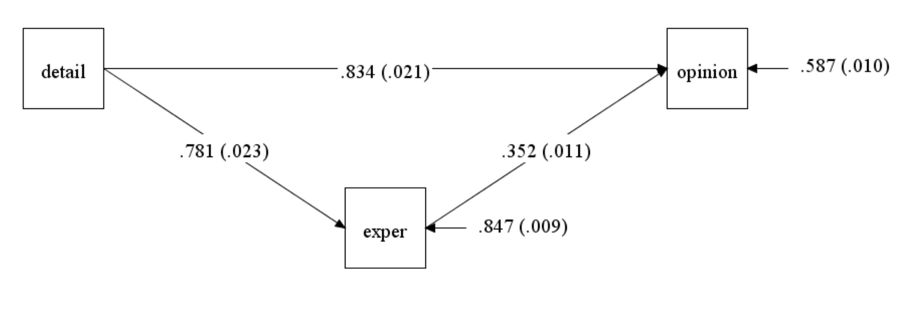
Diagram of binary predictor with standardized coefficients

Slide 67
Multi-categorical predictor
Has more than two levels, ordered or unordered
Not recommended to categorize a continuous predictor
Useful to know how to create dummy variables in Mplus
Assign values to new variables in Define command
Use if statements in Define command to change values of new variables
Values at which the variable is determined by theory or descriptive statistics
Notice the two statements in the Model Indirect command
No big change to interpretation

Slide 68
Multi-categorical predictor – 1
title: simple mediation model with three-level predictor
! 3 level predictor variable - x: detail2 detail3
! mediator variable(s) - m: exper
! outcome variable - y: opinion
data:
file is intro_mediation.dat;
variable:
names are detail exper impact opinion ccovar bcovar;
usevariables = exper opinion detail2 detail3;
define: detail2 = 0;
if detail gt 76 then detail2 = 1;
if detail gt 91 then detail2 = 0;
detail3 = 0;
if detail gt 91 then detail3 = 1;

Slide 69
Question for audience
What do you think the Model Indirect command will look like?

Slide 70
Multi-categorical predictor – 2
analysis:
type = general;
estimator = ml;
bootstrap = 10000;
model:
opinion on detail2 detail3 exper;
exper on detail2 detail3;
model indirect:
opinion ind detail2;
opinion ind detail3;
output:
cint(bcbootstrap);

Slide 71
Mplus output from Model Indirect - 1
TOTAL, TOTAL INDIRECT, SPECIFIC INDIRECT, AND DIRECT EFFECTS
Two-Tailed
Estimate S.E. Est./S.E. P-Value
Effects from DETAIL2 to OPINION
Total 15.382 0.439 35.067 0.000
Total indirect 3.395 0.202 16.806 0.000
Specific indirect 1
OPINION
EXPER
DETAIL2 3.395 0.202 16.806 0.000
Direct
OPINION
DETAIL2 11.987 0.423 28.344 0.000

Slide 72
Mplus output from Model Indirect - 2
Effects from DETAIL3 to OPINION
Total 31.335 0.559 56.042 0.000
Total indirect 6.696 0.321 20.869 0.000
Specific indirect 1
OPINION
EXPER
DETAIL3 6.696 0.321 20.869 0.000
Direct
OPINION
DETAIL3 24.639 0.569 43.339 0.000

Slide 73
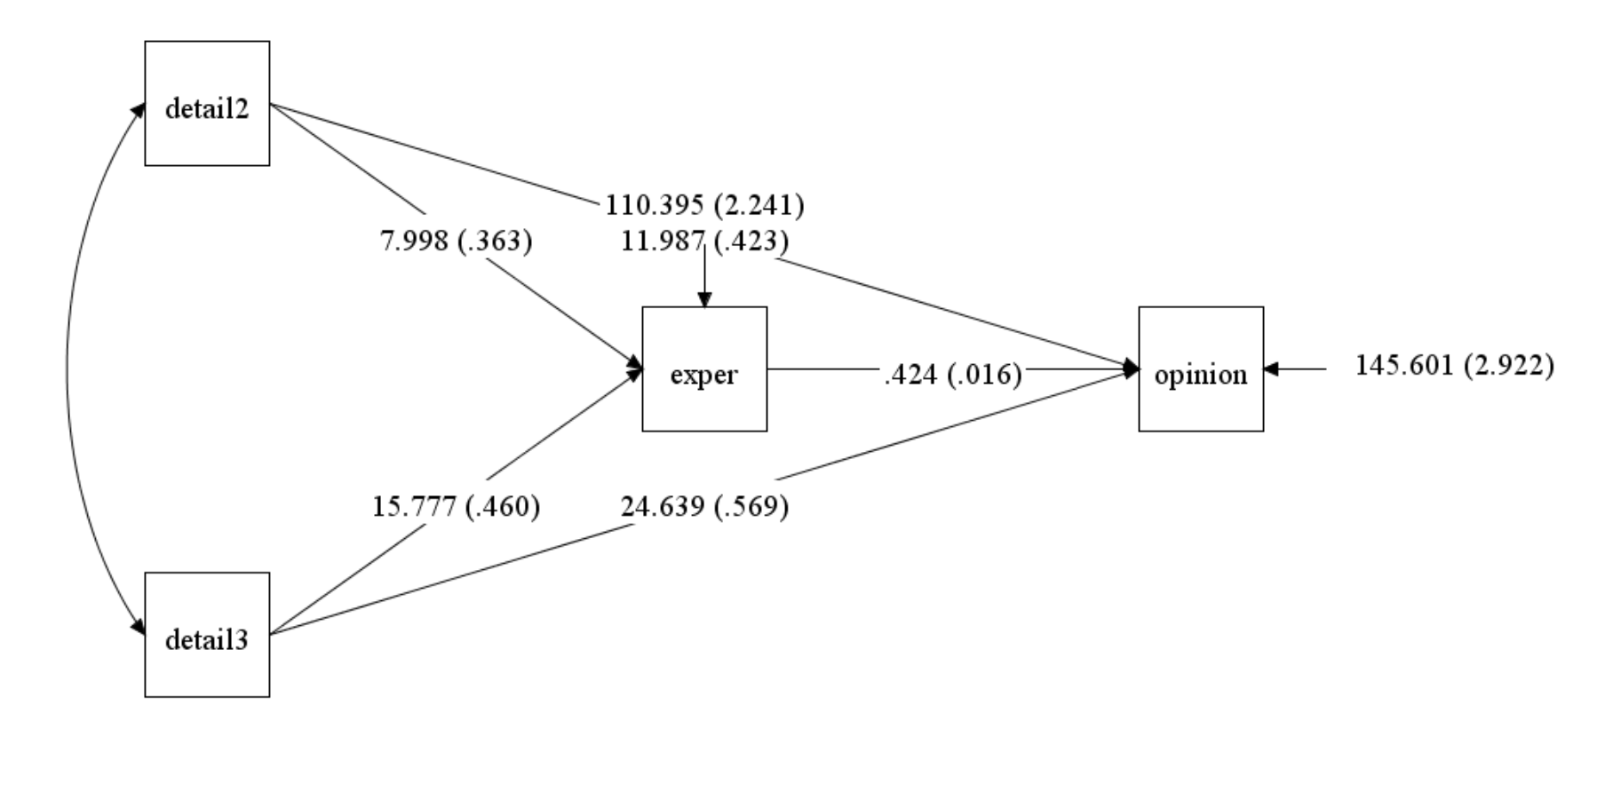
Diagram of mediation moel with multi-categorical predictor

Slide 74
Relationship between levels of predictor
Double-headed arrow between detail2 and detail3, but no coefficient
The covariance is estimated but not reported on diagram or in output
It is not included in the count of free parameters
It is not set to 0; doing so will generate a warning message

Slide 75
Interpretation of relative effects
The path for a1 is the mean of M1 – the mean of M0
the path for a2 is the mean of M2 – the mean of M0
The interpretation of the single coefficient from M to Y does not change even though there are multiple paths from X to M.

Slide 76
Omnibus test of multi-categorical predictor
Remove Boostrap statement from the Analysis command
Remove the Output command and replace with the Model Test command
Look for the Wald Test of Parameter Constraints in the output just before the Model Results
model test:
0 = d2;
0 = d3;

Slide 77
Mplus syntax for omnibus test - 1
title: simple mediation model with three-level predictor
! 3 level predictor variable - x: detail3
! mediator variable(s) - m: exper
! outcome variable - y: opinion
! model test does not work with bootstrap
data:
file is intro_mediation.dat;
variable:
names are detail exper impact opinion ccovar bcovar;
usevariables = exper opinion detail2 detail3;
define: detail2 = 0;
if detail gt 76 then detail2 = 1;
if detail gt 91 then detail2 = 0;
detail3 = 0; if detail gt 91 then detail3 = 1;
analysis:
type = general;
estimator = ml;

Slide 78
Mplus syntax for omnibus test - 2
model:
opinion on detail2 (d2)
detail3 (d3)
exper;
exper on detail2 detail3;
model indirect:
opinion ind detail2;
opinion ind detail3;
model test:
0 = d2;
0 = d3;

Slide 79
Output of omnibus test
MODEL FIT INFORMATION
Number of Free Parameters 9
Loglikelihood
Information Criteria
Chi-Square Test of Model Fit
RMSEA (Root Mean Square Error Of Approximation)
CFI/TLI
Chi-Square Test of Model Fit for the Baseline Model
Wald Test of Parameter Constraints
Value 1760.538
Degrees of Freedom 2
P-Value 0.0000

Slide 80
Any questions?

Slide 81
Simple mediation model with covariates
Covariates can be added to any mediation model.
Covariates are just other predictors in the model.
The covariates can be either continuous or binary.
Covariates should be added to both equations.
This is necessary for the direct effect and indirect effect(s) to sum to the total effect. CRITICAL POINT!!

Slide 82
Covariates with model constraint - 1
title: simple mediation model with covariates
! predictor variable - x: detail
! mediator variable(s) - m: exper
! outcome variable - y: opinion
! covariates: bcovar and ccovar
data:
file is intro_mediation.dat;
variable:
names are detail exper impact opinion ccovar bcovar;
usevariables = detail exper opinion ccovar bcovar;
analysis:
type = general;
estimator = ml;
bootstrap = 10000;

Slide 83
Covariates with model constraint - 2
model:
opinion on bcovar ccvoar exper (b1);
opinion on bcovar ccvoar detail (cprime);
exper on bcovar ccovar detail (a1);

Slide 84
Covariates with model constraint - 3
model constraint:
new(a1b1 total);
a1b1 = a1*b1;
total = a1*b1 + cprime;
output:
cint(bcbootstrap);

Slide 85
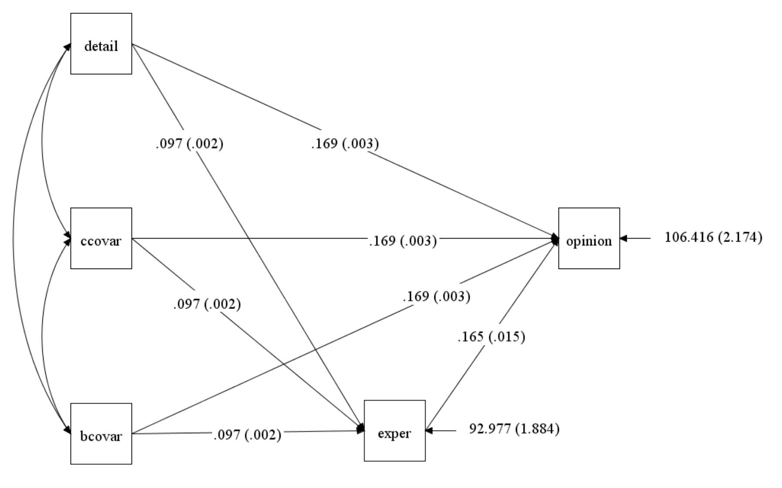
Path diagram of model with two covariates

Slide 86
Any questions?

Slide 87
Parallel mediation
Two (or more) mediators, both of which are between the predictor and outcome
In this example, there is no causal path between the two mediators, but one could be added if theory predicted a path to be there.
Two sets of indirect effects: the indirect effect going through the first mediator (exper), and the indirect effect going through the second mediator (impact)

Slide 88
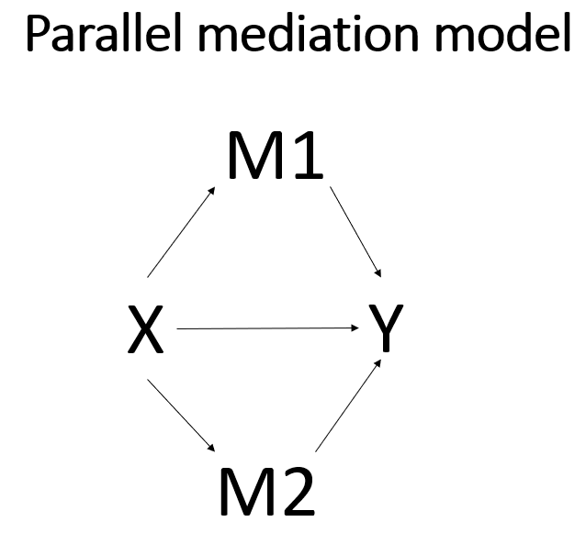
Generic path diagram of parallel mediation

Slide 89
Mplus syntax for parallel mediation using model constraint - 1
title: parallel mediation model with all continuous variables
! predictor variable - x: detail
! mediator variable(s) m1: exper, m2: impact
! outcome variable - y: opinion
data: file is intro_mediation.dat;
variable: names are detail exper impact opinion ccovar bcovar;
usevariables = detail exper impact opinion;
analysis:
type = general;
estimator = ml;
bootstrap = 10000;

Slide 90
Mplus syntax for parallel mediation using model constraint - 2
model:
opinion on exper (b1);
opinion on impact (b2);
opinion on detail (cprime);
exper on detail (a1);
impact on detail (a2);

Slide 91
Mplus syntax for parallel mediation using model constraint - 3
model constraint:
new(a1b1 a2b2 totalind total);
a1b1 = a1*b1;
! specific indirect effect of x on y via m1
a2b2 = a2*b2;
! specific indirect effect of x on y via m2
totalind = a1*b1 + a2*b2;
! total indirect effect of x on y via m1, m2
total = a1*b1 + a2*b2 + cprime;
! total effect of x on y

Slide 92
Mplus syntax for parallel mediation using model constraint - 4
output:
cint(bcbootstrap);

Slide 93
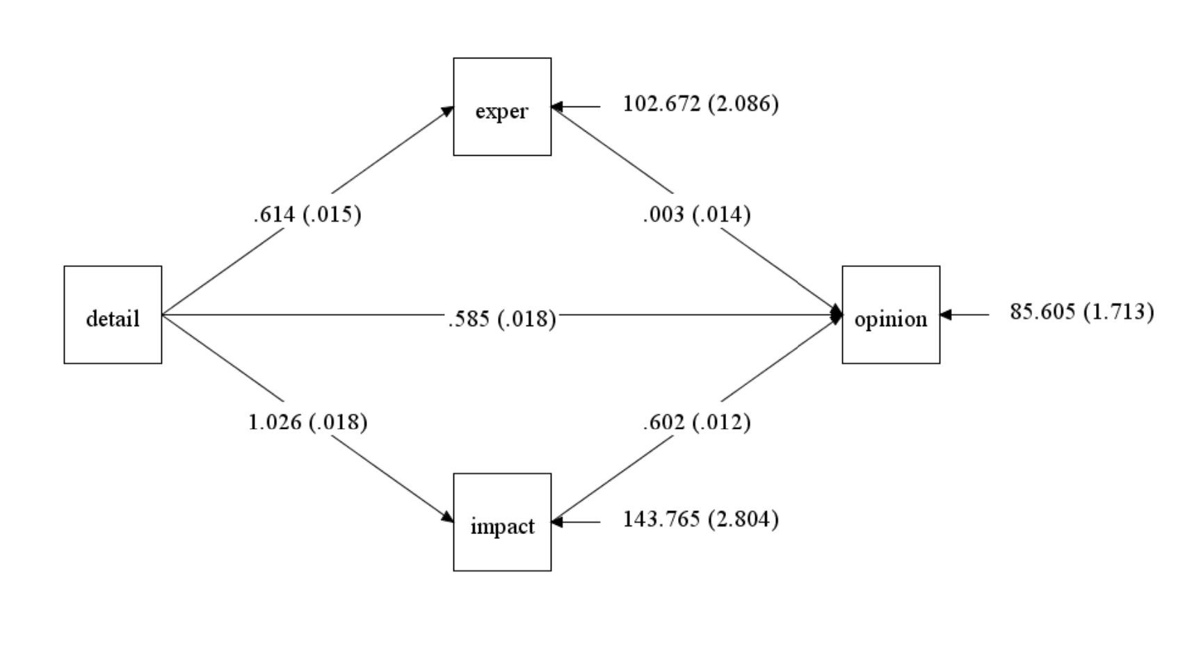
Path diagram of parallel mediation results

Slide 94
Any questions?

Slide 95
Serial mediation
The mediators are ordered between the predictor and the outcome.
There can be more than two mediators.

Slide 96
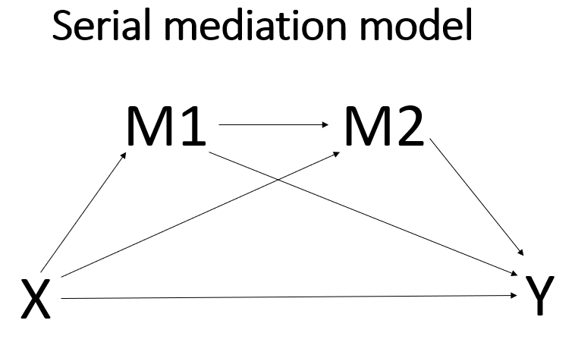
Generic serial mediation path diagram

Slide 97
Mplus syntax for serial mediation using model indirect - 1
title: serial mediation model with all continuous variables
! predictor variable - x: detail
! mediator variable(s) - m1: exper, m2: impact
! outcome variable - y: opinion
data:
file is intro_mediation.dat;
variable: names are detail exper impact opinion ccovar bcovar;
usevariables = detail exper impact opinion;
analysis:
type = general;
estimator = ml;
bootstrap = 10000;

Slide 98
Question for audience
How many indirect effects are there?
What are they?

Slide 99
Mplus syntax for serial mediation using model indirect - 2
model:
opinion on detail exper impact;
exper impact on detail;
impact on exper;
model indirect:
opinion ind impact exper detail;
opinion ind exper detail;
opinion ind impact detail;
output:
cint(bcbootstrap);

Slide 100
Mplus output for indirect effects
TOTAL, TOTAL INDIRECT, SPECIFIC INDIRECT, AND DIRECT EFFECTS
Two-Tailed
Estimate S.E. Est./S.E. P-Value
Effects from DETAIL to OPINION
Sum of indirect 0.619 0.016 39.180 0.000
Specific indirect 1
OPINION
IMPACT
EXPER
DETAIL 0.191 0.008 23.015 0.000
Specific indirect 2
OPINION
EXPER
DETAIL 0.002 0.009 0.184 0.854
Specific indirect 3
OPINION
IMPACT
DETAIL 0.427 0.014 30.605 0.000

Slide 101
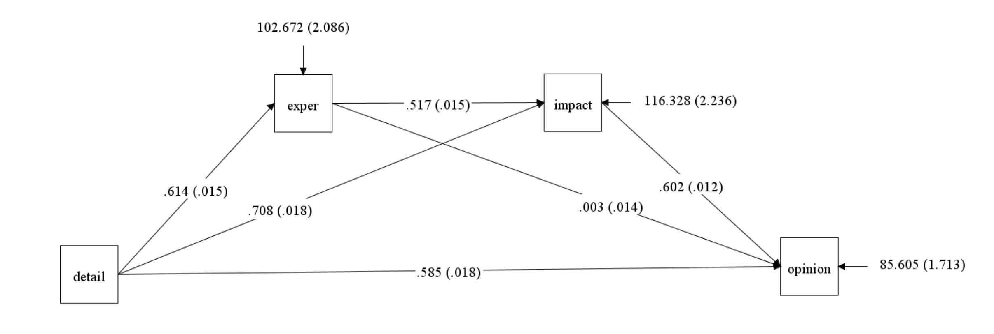
Path diagram of serial mediation

Slide 102
Any questions?

Slide 103
MCAR missing data
The following examples assume that the data are missing completely at random (MCAR).
By default, Mplus will use Full Information Maximum Likelihood (FIML) to handle the missing data on outcome variables.
The observations with missing values will still be used in the analysis.
When the independent variable has missing values, add a line in the Model command with the name of the independent variable given in square brackets.
This requests that Mplus calculate the mean of the independent variable, thus treating it as an outcome.

Slide 104
Missing on DV, MV or both DV and MV - 1
data:
file is intro_mediation_DV_missing.txt;
variable:
names are detail exper impact opinion ccovar bcovar;
usevariables = detail exper opinion;
missing are all (-9999);
analysis:
type = general;
estimator = ml;
bootstrap = 10000;

Slide 105
Missing on DV, MV or both DV and MV - 2
model:
opinion on exper (b1);
opinion on detail (cprime);
exper on detail (a1);
model indirect:
opinion ind detail;
output:
cint(bcbootstrap);

Slide 106
Some output
SUMMARY OF ANALYSIS
Number of groups 1
Number of observations 5000
Number of dependent variables 2
Number of independent variables 1
Number of continuous latent variables 0
Observed dependent variables
Continuous
EXPER OPINION
Observed independent variables
DETAIL

Slide 107
Missing data on IV - 1
title: missing data on IV only;
data:
file is intro_mediation_IV_missing.txt;
variable:
names are detail exper impact opinion ccovar bcovar;
usevariables = detail exper opinion;
missing are all (-9999);
analysis:
type = general;
estimator = ml;
bootstrap = 10000;

Slide 108
Missing data on IV - 2
model:
opinion on exper;
opinion on detail;
exper on detail;
[detail];
model indirect:
opinion ind detail;
output:
cint(bcbootstrap);

Slide 109
Some output - 1
SUMMARY OF ANALYSIS
Number of groups 1
Number of observations 5000
Number of dependent variables 2
Number of independent variables 1
Number of continuous latent variables 0
Observed dependent variables
Continuous
EXPER OPINION
Observed independent variables
DETAIL

Slide 110
Some output - 2
MODEL RESULTS
Two-Tailed
Estimate S.E. Est./S.E. P-Value
OPINION ON
EXPER 0.311 0.016 19.025 0.000
DETAIL 1.009 0.020 50.378 0.000
EXPER ON
DETAIL 0.618 0.015 40.163 0.000
Means
DETAIL 82.866 0.140 592.031 0.000
Intercepts
EXPER 80.672 1.273 63.356 0.000
OPINION 102.453 1.899 53.941 0.000
Variances
DETAIL 90.002 1.917 46.942 0.000
Residual Variances
EXPER 102.179 2.112 48.386 0.000
OPINION 128.239 2.718 47.186 0.000

Slide 111
Any questions?

Slide 112
Criteria for making causal claims - 1
The criteria for making causal claims has changed greatly in the last 10-15 years.
Gone are the days of Baron and Kenny and the causal steps approach.
Hayes provides a thoughtful explanation of why this method, that was so widely used for 20 years, is no longer acceptable.
The work of Judea Pearl and Tyler VanderWeele have been very influential in this change.
A complete discussion of the current set of criteria needed to claim causality is beyond the scope of this workshop, but:
The cause must come before the effect.
This means that cross-sectional data are usually inappropriate for mediation analysis, because all of the data (for X, M and Y) are collected at the same time, so there is no way to guarantee that the cause happened before the effect.

Slide 113
Criteria for making causal claims - 2
Second, just because you used a particular variable as the mediator does not mean that it is the only mediator.
Perhaps another variable is the real mediator, and the variable you are using is just correlated with the real mediator.
Or perhaps a variable that is not in your model, and maybe not even in your dataset, causes both the mediator and the outcome.
When thinking about experiments and causality, most researchers immediately think of randomly assigning subjects to experimental groups or conditions; however, such assignment does not mean that mediator causes the outcome.

Slide 114
Some assumptions that should be discussed
In his paper Mediation Analysis: A Practitioner’s Guide (2016), VanderWeele lists four assumptions that need to be assessed so that the direct and indirect effects are interpretable.
no confounding between X and Y
no confounding between M and Y
no confounding between X and M
no confounding between M and Y that is itself affected by X.

Slide 115
Any questions?

Slide 116
References
Geiser, Christian. (2013). Data Analysis with Mplus. New York: Guilford Press.
Hayes, Andrew F. (2022). Introduction to Mediation, Moderation and Conditional Process Analysis: A Regression-Based Approach, Third Edition. New York: Guildford Press.
Muthen, Bengt O., Muthen, Linda K. and Asparouhov, Tihomir. (2016). Regression and Mediation Analysis Using Mplus. Los Angeles, CA: Muthen & Muthen.
VanderWeele, Tyler (2016). Mediation Analysis: A Practitioner’s Guide. Annual Review of Public Health. 37:17-32.
Chris Stride: Figure It Out https://www.figureitout.org.uk/

