Slide 1
Applied Survey Analysis using SPSS version 29
Presented by Christine R. Wells, Ph.D.
Statistical Methods and Data Analytics
UCLA Office of Advanced Research Computing

Slide 2
What we will cover in this workshop
Define complex survey data and its elements
How to use most of the commands in the SPSS Complex Samples module to analyze complex survey data
Discuss interpretation of the results

Slide 3
What we will not cover in this workshop
The cscoxreg command
The csselect command
Weighted multilevel models
Weighted propensity scores
Methods for handling missing data
Graphing raw data or results

Slide 4
Common questions
What are complex survey data?
How are those data different from other types of data?

Slide 5
Answers
Do not assume simple random sampling (SRS)
Simple random sampling: each element in the population has an equal chance of being selected into the sample
Different from convenience sampling
Know the probability of being selected into the sample
This information is contained in a sampling weight variable, which must be included in the dataset
Have strata and/or clustering

Slide 6
More questions
What is stratification?
What is clustering?
Why do we care about these?

Slide 7
Difference between stratified and clustered sampling

Slide 8
Why does any of this matter?
Sampling weight is used in the calculation of the point estimate (e.g., mean, regression coefficient, etc.)
Stratification and/or cluster variable(s) used in the calculation of the standard error
The results from analyses that do not incorporate the sampling weight and the variance correction variable(s) can only be generalized to the sample, NOT the population from which the sample was drawn

Slide 9
Replicate weights
Replicate weights are a different way of correcting the standard errors for the sampling plan
There are about half a dozen different types of replicate weights
As of version 29, SPSS does not handle any type of replicate weight

Slide 10
The important points to remember
The sampling weight is used in the math used to calculate the point estimate (e.g., mean, regression coefficient, etc.)
The clustering (AKA PSU) and/or stratification variable(s) are used to correct the standard errors (AKA variance estimates)
If the sampling weight is not used, the results can be generalized only to the sample, not the population from which the sample was drawn
Replicate weights do the same job that the cluster/stratification variable(s) do
The current version of SPSS does not handle replicate weights

Slide 11
Example dataset
Example dataset used in this workshop is called NHANES2f
Shorten and cleaned version of NHANES2 data
This dataset is NOT available from the NHANES website
It is an example dataset from another statistical software package that is useful for teaching purposes

Slide 12
First things first
Read the documentation for the dataset
Need the name of the sampling weight variable
Need to know the method of variance correction, as well as the names of those variable(s)
For NHANES data, go to https://www.cdc.gov/nchs/nhanes/index.htm and then click on Survey Data and Documentation
Make sure that Complex Samples is licensed on your installation of SPSS (next slide)
Look at the SPSS Syntax Guide for the procedures you want to use
Click on Help -> Command Syntax Reference

Slide 13
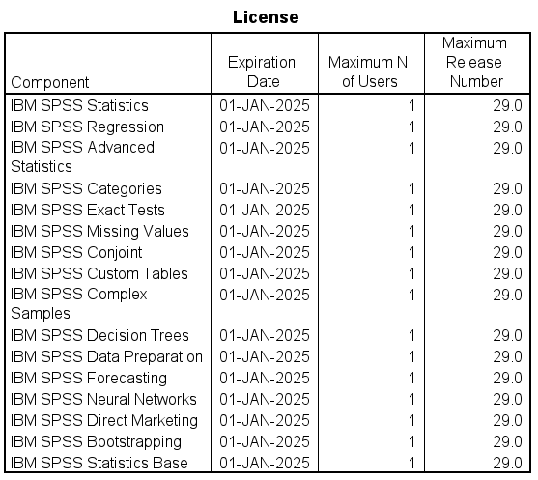
SPSS is a series of modules
Be sure that the Complex Samples module is installed
SPSS command:
show license.

Slide 14
Cannot use the weight or split file commands
The weight command in SPSS (not in the Complex Samples module) is used for frequency weights
Three types of weights:
Frequency, sampling (AKA probability), analytic
Instead of using the split file command, analyses by groups can be done with either the subpop or the domain subcommand

Slide 15
Creating a plan file
Must have a plan file
Can use point-and-click or syntax
Recommend using point-and-click and saving the syntax

Slide 16
Echo syntax in output file
In SPSS 29, the default is to NOT echo the syntax in the output file
To change this:
Edit – Options – Viewer tab – lower left – check box

Slide 17
Echo syntax in output file

Slide 18
Open data file
get file='D:\data\Seminars\nhanes2f.sav’.
The sampling plan for these data was a stratified cluster sampling
Need the name of the following:
Sampling weight: finalwgt
Stratification variable: stratid
Cluster variable: psuid

Slide 19
Point-and-click creation of plan file
Analyze – Complex samples – prepare for analysis
Follow the prompts

Slide 20
Step 1

Slide 21
Step 2

Slide 22
Step 3

Slide 23
Step 4

Slide 24
Step 5

Slide 25
Step 6

Slide 26
The output

Slide 27
Working with your data before analyzing
Get the mean, minimum and maximum of the sampling weight variable
Check for numbers of missing cases
Ensure that the sampling weight, cluster and stratification variables have no missing values
Data management tasks:
Create new variables
Recode variables
Label new variables and add value labels as appropriate

Slide 28
Looking at the sampling weight variable
desc var = finalwgt.
graph
/histogram = finalwgt.

Slide 29
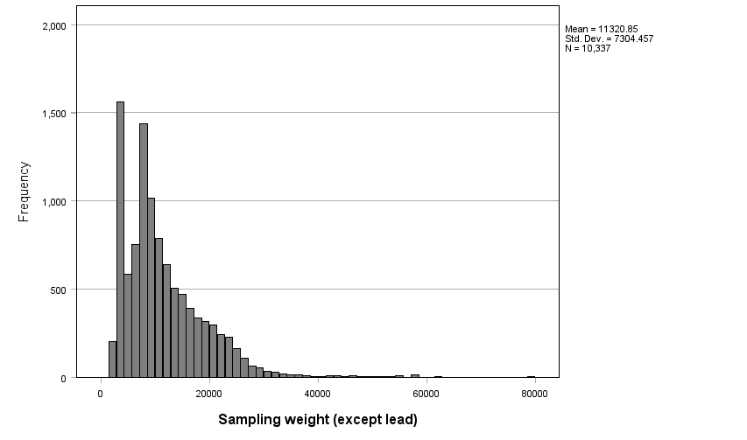
Histogram of sampling weight

Slide 30
Descriptives for continuous variables
The csdescriptives command is used to get descriptive statistics for continuous variables
Must include the plan subcommand and one of the following subcommands:
Mean
Sum
Ratio

Slide 31
The mean of the variable “age”
csdescriptives
/plan file = 'D:\data\nhanes2f_plan.csaplan'
/summary variables = age
/mean
/statistics se count popsize cin(95).

Slide 32
Missing values on some variables
csdescriptives
/plan file = 'D:\data\nhanes2f_plan.csaplan'
/summary variables = copper
/mean
/statistics se count popsize cin(95).

Slide 33
The mean of the variable “hct”
csdescriptives
/plan file = 'D:\data\nhanes2f_plan.csaplan'
/summary variables = hct
/mean
/statistics se count popsize cin(95).

Slide 34
What happens when you use those variables in the same call?
csdescriptives
/plan file = 'D:\data\nhanes2f_plan.csaplan'
/summary variables = age copper hct
/mean
/statistics se count popsize cin(95).

Slide 35
Different ways to handle missing data
* the default is scope = analysis.
* these results are the same as above.
csdescriptives
/plan file = 'D:\data\nhanes2f_plan.csaplan'
/summary variables = age copper hct
/mean
/statistics se count popsize cin(95)
/missing scope = analysis.

Slide 36
Listwise deletion
* using listwise deletion.
csdescriptives
/plan file = 'D:\data\nhanes2f_plan.csaplan'
/summary variables = age copper hct
/mean
/statistics se count popsize cin(95)
/missing scope = listwise.

Slide 37
Side note about missing data
Do not delete all cases with missing data to create a dataset that has only complete cases!
Messes up inference population

Slide 38
What is a design effect?
A ratio of two variances
Numerator: the variance estimate from the current sample (including all of its design elements)
Denominator: the variance from a hypothetical sample of the same size drawn as an SRS
Indicates how efficient your sample is compared to an SRS of equal size
If the design effect is less than 1, your sample is more efficient than SRS
Usually the design effect is greater than 1

Slide 39
Design effect
* getting the design effect.
csdescriptives
/plan file = 'D:\data\nhanes2f_plan.csaplan'
/summary variables = age copper hct
/mean
/statistics se count popsize cin(95) deff.

Slide 40
The sum of the variable “female”
* getting a sum.
csdescriptives
/plan file = 'D:\data\nhanes2f_plan.csaplan'
/summary variables = female
/sum
/statistics se count popsize cin(95).

Slide 41
The ratio of copper to hemocrit
* getting a ratio.
csdescriptives
/plan file = 'D:\data\nhanes2f_plan.csaplan'
/summary variables = copper hct
/ratio numerator = copper denominator = hct
/statistics se count popsize cin(95).

Slide 42
Question
How could you get the ratio of females to males?

Slide 43
Answer
Create a new variable that is coded 0 for females and 1 for males
* create new variable called male.
recode female (0 = 1) (1 = 0) into male.
* check to see that the new variable is correct.
crosstabs
/tables = female by male.

Slide 44
Answer continued
Use that new variable (probably called “male”) and the variable “female” on the ratio subcommand
csdescriptives
/plan file = 'D:\data\nhanes2f_plan.csaplan'
/summary variables = female male
/ratio numerator = female denominator = male
/statistics se count popsize cin(95).

Slide 45
Is the mean of hemocrit different from 40?
* t-test comparing mean to a user-specified value.
csdescriptives
/plan file = 'D:\data\nhanes2f_plan.csaplan'
/summary variables = hct
/mean ttest = 40
/statistics se count popsize cin(95).

Slide 46
Descriptives with a binary variable
* the mean of a binary variable is the proportion of 1s
csdescriptives
/plan file = 'D:\data\nhanes2f_plan.csaplan'
/summary variables = female
/mean
/statistics se count popsize cin(95).

Slide 47
Descriptives for categorical variables
Main command is cstabulate
Creates one-way frequency tables and two-way crosstabulations
Only the plan and table subcommands are required
Probably want other subcommands to add more information to the output

Slide 48
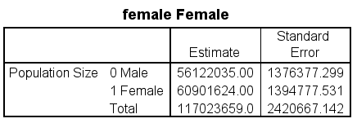
Frequencies for the variable “female”
cstabulate
/plan file = 'D:\data\nhanes2f_plan.csaplan'
/tables variables = female.
* defaults:
/cells popsize
/statistics se.

Slide 49
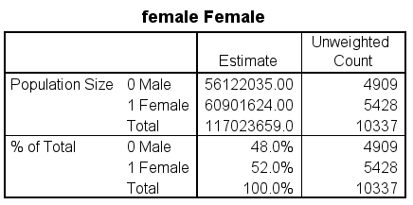
Let’s add some subcommands
cstabulate
/plan file = 'D:\data\nhanes2f_plan.csaplan'
/tables variables = female
/cells popsize tablepct
/statistics count.

Slide 50
Notice what is not in the output now
When you specify options on a subcommand, the default is overwritten
If you want the default output to be included, you need to use those options on the subcommand
Example:
The default for the statistics subcommand is “se”, but the SE is not included in the output when only the “count” option is used

Slide 51
Test for homogeneity of proportions
* homogeneity test available only for one-way tables.
cstabulate
/plan file = 'D:\data\nhanes2f_plan.csaplan'
/tables variables = female
/cells popsize tablepct
/statistics se cin(95) count
/test homogeneity.

Slide 52
Two output tables

Slide 53
Crosstabulation or two-way table
cstabulate
/plan file = 'D:\data\nhanes2f_plan.csaplan'
/tables variables = female by rural.

Slide 54
Let’s add some options
cstabulate
/plan file = 'D:\data\nhanes2f_plan.csaplan'
/tables variables = female by rural
/cells rowpct colpct tablepct
/statistics se cin(95) count.

Slide 55
Lots of output

Slide 56
Making multiple two-way tables at once
cstabulate
/plan file = 'D:\data\nhanes2f_plan.csaplan'
/tables variables = female health by rural
/cells popsize tablepct
/statistics se cin(95) count.

Slide 57
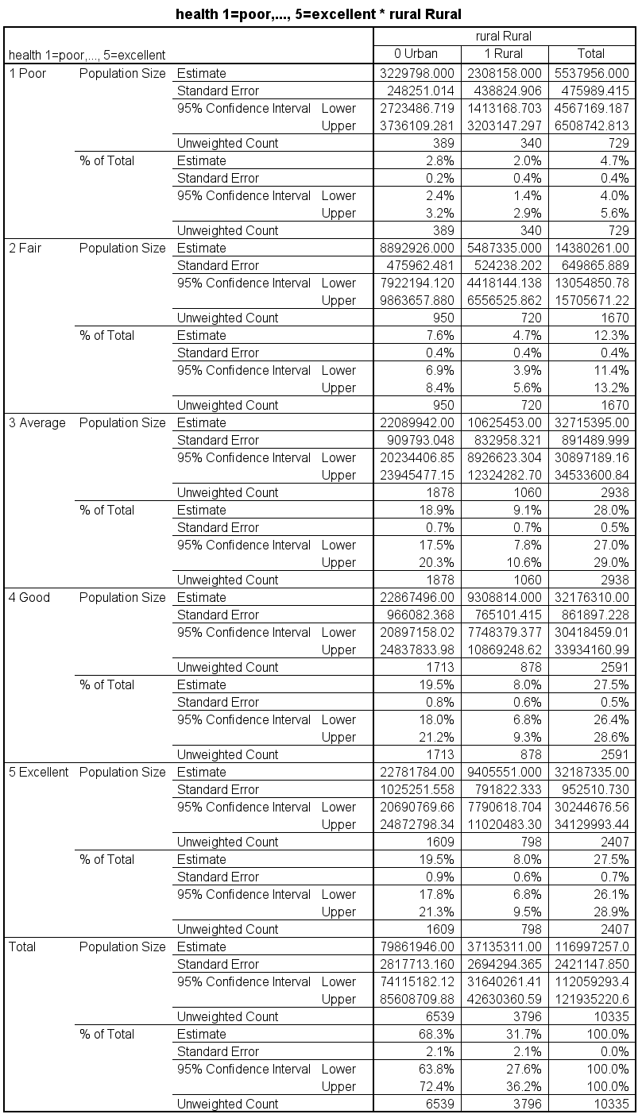
Two tables

Slide 58
Chi-square test of independence
* expected option only works with a two-way table.
* must have the tablepct option on the cells subcommand.
cstabulate
/plan file = 'D:\data\nhanes2f_plan.csaplan'
/tables variables = female by rural
/cells popsize tablepct
/statistics count expected
/test independence.

Slide 59
Two output tables

Slide 60
Try it yourself!
Get the means for the variables “iron” and “hgb”; include the weighted (population) and unweighted size and 95% confidence intervals in the output
Get a frequency table for the variable "sex"; include both the weighted (population) and unweighted size and the design effect.
Is there a relationship between the variables “sex” and “agecat”?

Slide 61
Let’s take a short break!

Slide 62
Analyses of subpopulations
Difference between the anlaysis of experimental and complex survey data
With complex survey data, you (almost) never get to delete any cases from the data set, even if you will never use them in any of your analyses
When the subpop (or domain) subcommand is used, only the cases defined by the subpopulation are used in the calculation of the estimate, but all cases are used in the calculation of the standard errors.
Use subpop subcommand with descriptive procedures and domain subcommand with regression procedures

Slide 63
No subpopulation – using all data
* remember this anlaysis.
csdescriptives
/plan file = 'D:\data\nhanes2f_plan.csaplan'
/summary variables = age
/mean.

Slide 64
Analyzing only a subpopulation
csdescriptives
/plan file = 'D:\data\Seminars\nhanes2f_plan.csaplan'
/summary variables = age
/subpop table = female display = layered
/mean.

Slide 65
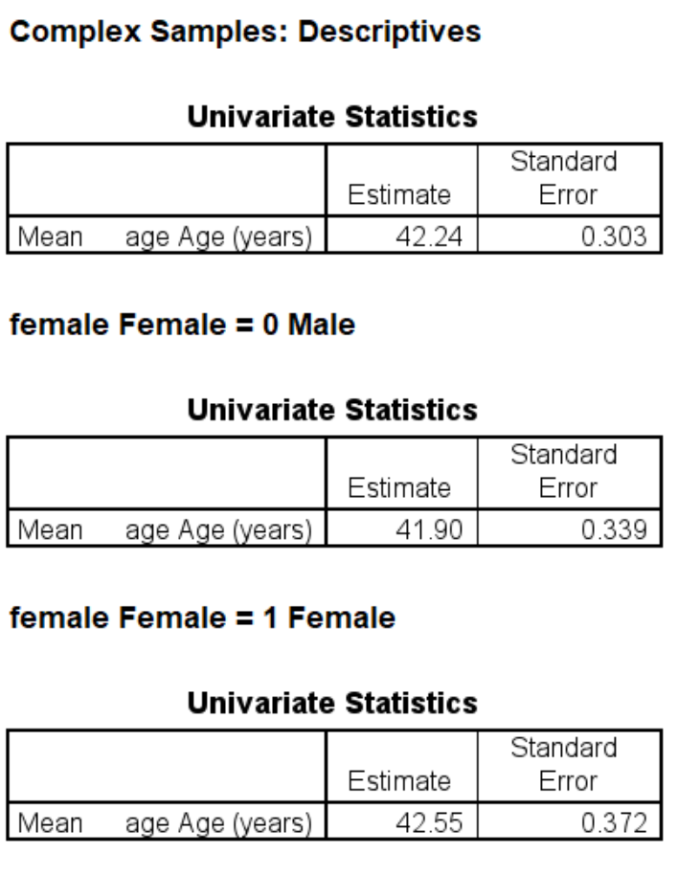
Displaying the output in a different way
csdescriptives
/plan file = 'D:\data\nhanes2f_plan.csaplan'
/summary variables = age
/subpop table = female display = separate
/mean.

Slide 66
Two categorical variables listed on the subpop subcommand
csdescriptives
/plan file = 'D:\data\nhanes2f_plan.csaplan'
/summary variables = copper
/subpop table = health by female display = layered
/mean.

Slide 67
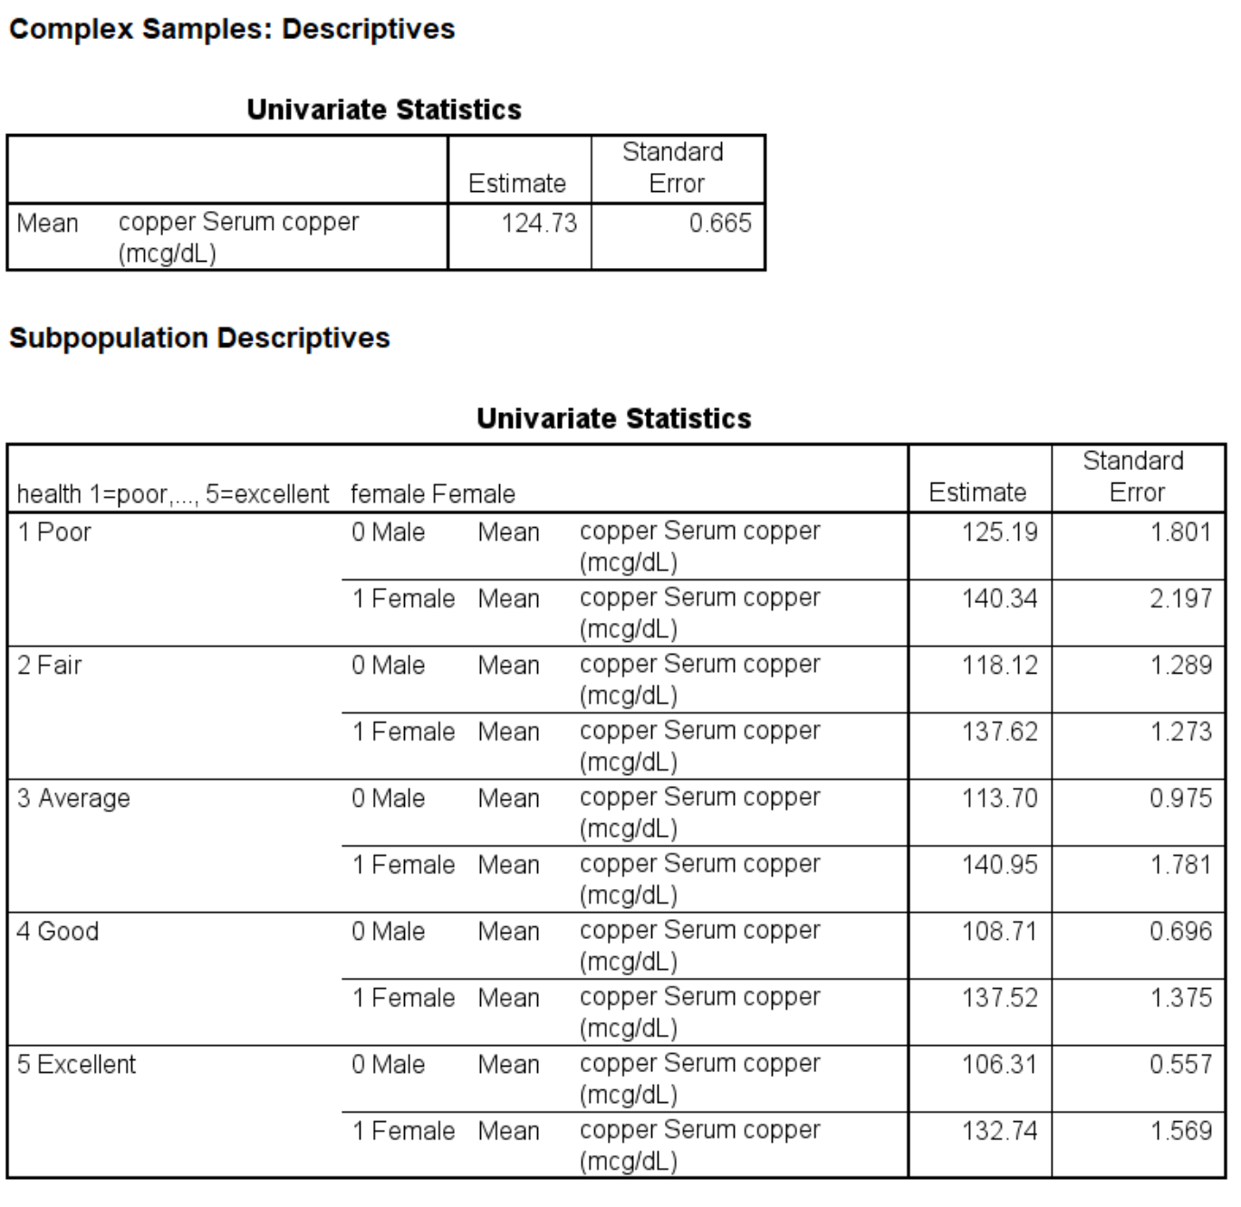
Output

Slide 68
Adding more categorical variables to the subpop subcommand
* up to 17 variables can be added to the subpop subcommand. csdescriptives
/plan file = 'D:\data\nhanes2f_plan.csaplan'
/summary variables = copper
/subpop table = female by race by region display = layered
/mean
/statistics count popsize.

Slide 69
Output part 1

Slide 70
Output part 2

Slide 71
Subpopulations for cstabulate
cstabulate
/plan file = 'D:\data\nhanes2f_plan.csaplan'
/tables variables = female by region
/cells popsize tablepct
/statistics se cin(95) count expected
/subpop table = rural.

Slide 72
Output part 1

Slide 73
Output part 2

Slide 74
Output part 3

Slide 75
Cannot get a chi-square test with a subpopulation
cstabulate
/plan file = 'D:\data\nhanes2f_plan.csaplan'
/tables variables = female by region
/cells popsize tablepct
/statistics count expected
/test independence
/subpop table = rural.

Slide 76
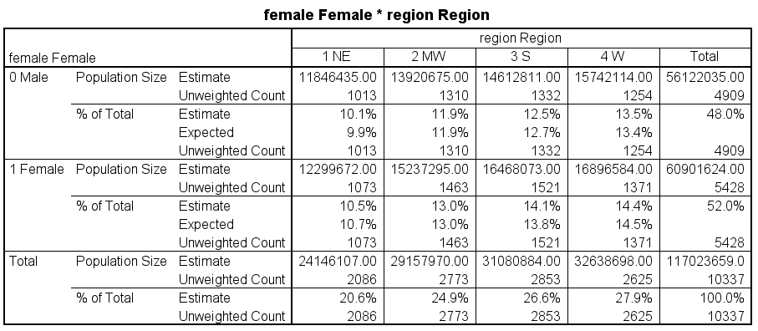
Output part 1

Slide 77
Output part 2

Slide 78
Getting a sum with a subpopulation
csdescriptives
/plan file = 'D:\data\nhanes2f_plan.csaplan'
/summary variables = diabetes
/subpop table = female display = layered
/sum
/statistics count popsize.

Slide 79
Output

Slide 80
Linear regression
Use the csglm command to run a linear regression
Has many of the same features as the glm command (used for unweighted data)
Use when the outcome variable is continuous
Helpful if the outcome variable is approximately normally distributed

Slide 81
Question
What do you call a linear regression with a single dichotomous predictor?

Slide 82
Answer
A t-test!
Why is it important to realize this?
Because there is no csttest command

Slide 83
Same subcommands for regression models
The csglm, cslogistic and csordinal commands have the following subcommands that are the same for these commands:
Domain
Intercept
Jointprob
Missing
Plan
Outfile
Test
The model and the save subcommands are similar across these commands

Slide 84
Linear regression with single predictor
* remember that the highest numbered category is the reference category.
csglm copper by female
/plan file = 'D:\data\nhanes2f_plan.csaplan'
/model female
/statistics parameter cinterval ttest
/test type = adjf.

Slide 85
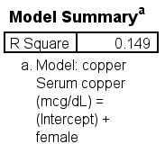
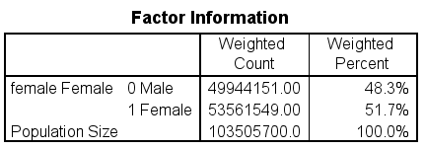
Regression output

Slide 86
How are the denominator degrees of freedom calculated?
Number of clusters (AKA PSUs) – number of strata
In this dataset, there are 62 PSUs and 31 strata
62 -31 = 31

Slide 87
Using the emmeans subcommand
* using the emmeans subcommand.
csglm copper by female
/plan file = 'D:\data\nhanes2f_plan.csaplan'
/model female
/statistics parameter cinterval ttest
/test type = adjf
/emmeans tables = female compare = female.
* -24.774*-24.774 = 613.753 with some rounding error.

Slide 88
Output from emmeans subcommand
Estimated Marginal Means: female Female
-24.774*-24.774 = 613.753 with some rounding error.

Slide 89
Using the compare and contrast options
* using the contrast keyword with the deviation option (each level compared to the grand mean).
csglm copper by female
/plan file = 'D:\data\nhanes2f_plan.csaplan'
/model female
/statistics parameter cinterval ttest
/test type = adjf
/emmeans tables = female compare = female contrast = deviation.

Slide 90
Output from emmeans
Estimated Marginal Means: female Female

Slide 91
Another way to specify variables on the emmeans subcommand
csglm copper by female diabetes with age
/plan file = 'D:\data\nhanes2f_plan.csaplan'
/model female diabetes age female*diabetes
/statistics parameter cinterval ttest
/test type = adjf
/emmeans tables = female by diabetes compare = diabetes.

Slide 92
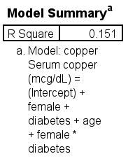
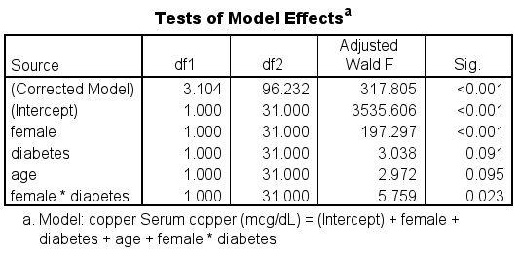
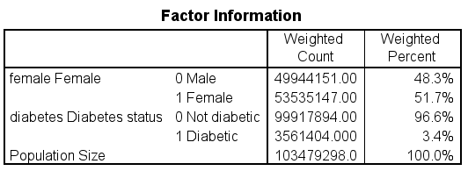
Output part 1

Slide 93
Output part 2

Slide 94
Output part 3
Estimated Marginal Means: female Female* diabetes Diabetes status

Slide 95
Using multiple emmeans subcommands
csglm copper by female diabetes
/plan file = 'D:\data\nhanes2f_plan.csaplan'
/model female diabetes
/statistics parameter cinterval ttest
/test type = adjf
/emmeans tables = female
/emmeans tables = diabetes.

Slide 96
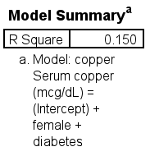
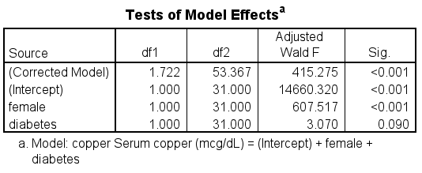
Output part 1

Slide 97
Output part 2
Estimated Marginal Means 1: female Female

Slide 98
Output part 3
Estimated Marginal Means 2: diabetes Diabetes status

