Slide 1
Specifying the value of a covariate
csglm bpsystol by female with height
/plan file = 'D:\data\nhanes2f_plan.csaplan'
/model female female*height
/statistics parameter cinterval ttest
/test type = adjf
/emmeans tables = female other = [height (150)]
/emmeans tables = female other = [height (160)].

Slide 2
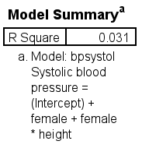
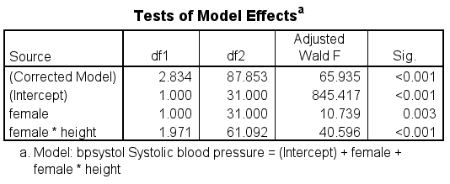
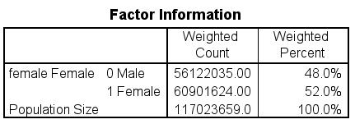
Output part 1

Slide 3
Output part 2

Slide 4
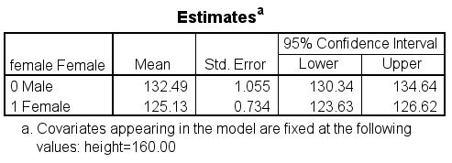
Output part 3
Estimated Marginal Means 1: female Female
Estimated Marginal Means 2: female Female

Slide 5
Including an interactin term with an astrisk
csglm copper by female diabetes with age
/plan file = 'D:\data\nhanes2f_plan.csaplan'
/model female diabetes age female*diabetes
/statistics parameter cinterval ttest
/test type = adjf
/emmeans tables = female by diabetes.

Slide 6
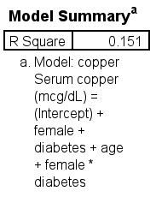
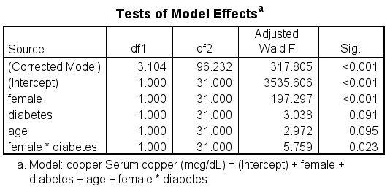
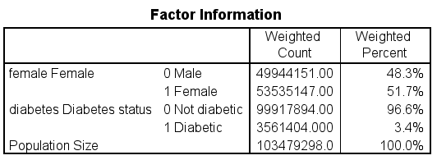
Output part 1

Slide 7
Output part 2

Slide 8
Output part 3
Estimated Marginal Means: female Female* diabetes Diabetes status

Slide 9
Including an interaction term with the keyword by
csglm copper by female diabetes with age
/plan file = 'D:\data\nhanes2f_plan.csaplan'
/model female diabetes age female by diabetes
/statistics parameter cinterval ttest
/test type = adjf
/emmeans tables = female by diabetes.

Slide 10
The output is exactly the same!

Slide 11
Creating a squared term
* making a squared term - can only be done with continuous variables.
csglm copper by female diabetes with age
/plan file = 'D:\data\nhanes2f_plan.csaplan'
/model female diabetes age age*age
/statistics parameter ttest cinterval
/test type = adjf.

Slide 12
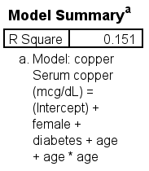
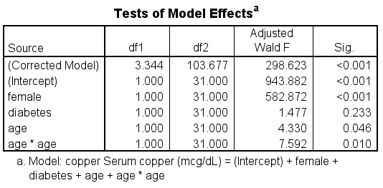
Output part 1

Slide 13
Output part 2

Slide 14
Using the domain subcommand
* using a domain subcommand - the value in () is necessary.
csglm bpsystol by female with height
/plan file = 'D:\data\nhanes2f_plan.csaplan'
/model female female*height
/statistics parameter cinterval ttest
/test type = adjf
/domain variable = region (1).

Slide 15
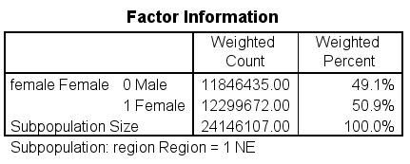
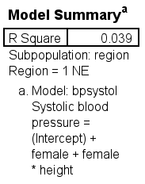
Output part 1

Slide 16
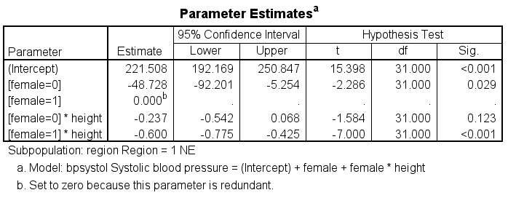
Output part 2

Slide 17
The custom subcommand
The custom subcommand allows users to create custom tests
The lmatrix is the contrast coefficient matrix and is used with contrast coefficients (which must sum to 0)
The kmatrix is the contast results matrix and is used to test results in the output (e.g., multi-degree-of-freedom tests)

Slide 18
Using the custom subcommand
* the first row on the lmatrix tests the difference between levels 1 and 3 for race.
* the second row on the lmatrix tests the difference between levels 2 and 3 for race.
csglm bpsystol by race smsa
/plan file = 'D:\data\Seminars\nhanes2f_plan.csaplan'
/model race smsa race*smsa
/statistics parameter cinterval ttest
/test type = adjf
/custom label = "race"
lmatrix = race 1 0 -1
race*smsa 1/3 1/3 1/3
0 0 0
-1/3 -1/3 -1/3;
race 0 1 -1
race*smsa 0 0 0
1/3 1/3 1/3
-1/3 -1/3 -1/3.

Slide 19
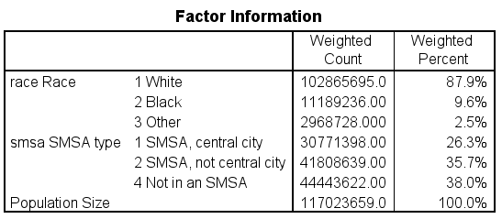
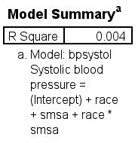
Output part 1

Slide 20
Output part 2

Slide 21
Output part 3

Slide 22
Output part 4
Custom Hypothesis Tests : race

Slide 23
Output part 5

Slide 24
Using both lmatrix and kmatrix
* lmatrix tests race 1 v 3 and race 1 v 2.
* tests whether simple effect of race=1 vs race=2 is different between smsa=1 and smsa=2.
csglm bpsystol by race smsa
/plan file = 'D:\data\Seminars\Applied Survey Data Analysis SPSS 29\nhanes2f_plan.csaplan'
/model race smsa race*smsa
/statistics parameter cinterval ttest
/test type = adjf
/custom label = "race"
lmatrix = race 1 -1 0
race*smsa 1 0 0
-1 0 0
0 0 0;
race 1 -1 0
race*smsa 0 1 0
0 -1 0
0 0 0
kmatrix = 1; -1.

Slide 25
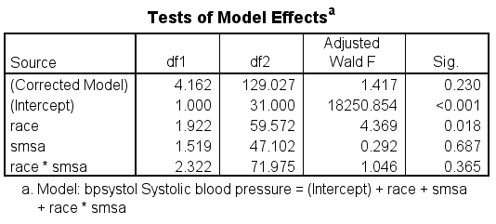
Output part 1

Slide 26
Output part 2

Slide 27
Output part 3
Custom Hypothesis Tests : race

Slide 28
Try it yourself!
Run a t-test with the variable “heartatk” as the predictor and the variable “vitaminc” as the outcome
Is the result statistically significant?
Run a regression model with “vitaminc” as the outcome and one continuous and one categorical predictor of your choice. Include the regression coefficients, test statistics and 95% confidence intervals in the output
How are the degrees of freedom for the model calculated?
Rerun your regression using data from females only

Slide 29
Let’s take a short break!

Slide 30
Logistic regression
Can use logistic regression when the outcome variable is binary
Use the cslogistic command
Must be coded 0, 1 or missing
Modeling of predictors exactly the same as in linear regression

Slide 31
Logistic regression – the outcome variable
Let’s start by looking at the distribution of the binary outcome variable
cstabulate
/plan file = 'D:\data\nhanes2f_plan.csaplan'
/tables variables = highbp
/cells popsize tablepct
/statistics se cin(95) count.

Slide 32
Logistic regression – the outcome and categorical predictor variables
Let’s look at the crosstabulation of the binary outcome and a categorical predictor
cstabulate
/plan file = 'D:\data\nhanes2f_plan.csaplan'
/tables variables = health by highbp
/cells popsize tablepct
/statistics se count.

Slide 33
Output

Slide 34
Logistic regression with categorical and continuous predictors
cslogistic highbp(low) by health with age
/plan file = 'D:\data\Seminars\nhanes2f_plan.csaplan'
/model health age
/statistics parameter exp cinterval ttest
/test type = adjf.

Slide 35
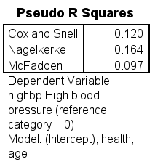
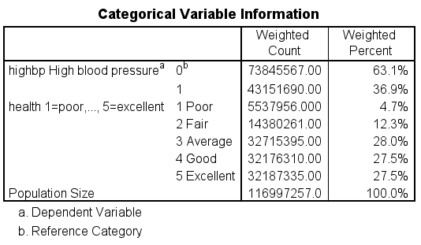
Output part 1

Slide 36
Output part 2

Slide 37
The cslogistic command without a model subcommand
* if no model subcommand is used, SPSS will run a model with only main effects.
cslogistic highbp(low) by health with age
/plan file = 'D:\data\Seminars\nhanes2f_plan.csaplan'
/statistics parameter exp cinterval ttest
/test type = adjf.

Slide 38
The output is exactly the same!

Slide 39
Creating an interaction term with an astrisk
* logistic with interaction with asterisk.
cslogistic highbp(low) by health with age
/plan file = 'D:\data\nhanes2f_plan.csaplan'
/model health age health*age
/statistics parameter exp cinterval ttest
/test type = adjf.

Slide 40
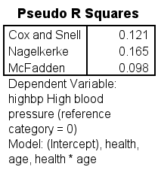
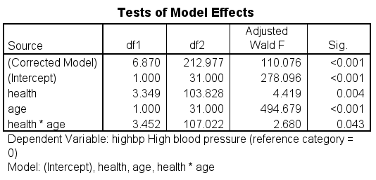
Output part 1

Slide 41
Output part 2

Slide 42
Creating an interaction term with the keyword by
* logistic with interaction with keyword by.
cslogistic highbp(low) by health with age
/plan file = 'D:\data\Seminars\nhanes2f_plan.csaplan'
/model health age health by age
/statistics parameter exp cinterval ttest
/test type = adjf.

Slide 43
The output is exactly the same!

Slide 44
The oddsratio subcommand
The oddsratio subcommand is used to compute model-based ORs for factors and covariates
* logistic with the oddratios subcommand.
cslogistic highbp(low) by health female with age
/plan file = 'D:\data\nhanes2f_plan.csaplan'
/model health female health*female age
/statistics parameter exp cinterval ttest
/test type = adjf
/oddsratios factor = [female] control=[health(3)]
/oddsratios factor = [health] control=[female(1)]
/oddsratios covariate = [age(30 50 70)].

Slide 45
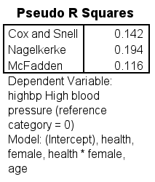
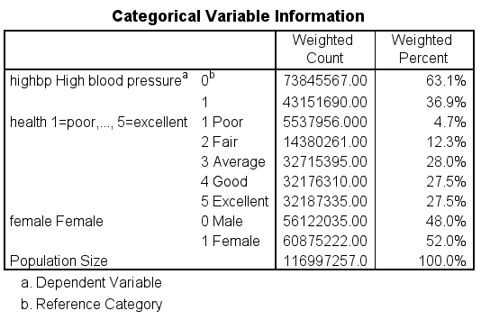
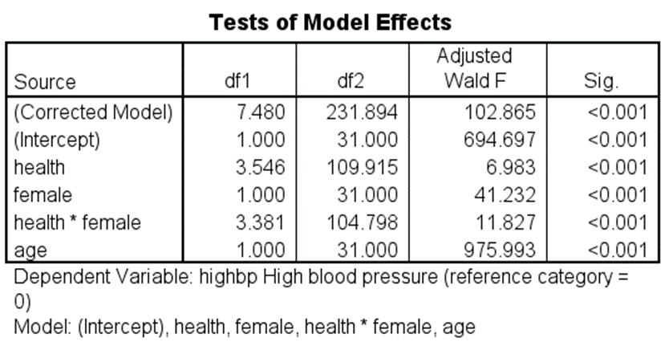
Output part 1

Slide 46
Output part 2

Slide 47
Output part 3

Slide 48
Output part 4

Slide 49
Using a domain subcommand
* using a domain subcommand to get urban.
cslogistic highbp(low) by health with age
/plan file = 'D:\data\nhanes2f_plan.csaplan'
/model health age health by age
/statistics parameter exp cinterval ttest
/test type = adjf
/domain variable = rural (0).

Slide 50
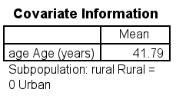
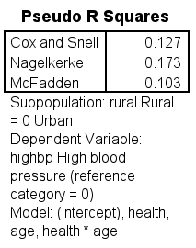
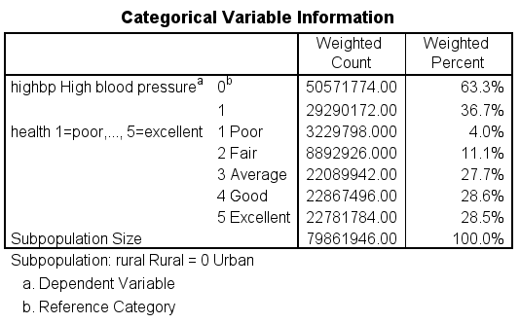
Output part 1

Slide 51
Output part 2

Slide 52
Output part 3

Slide 53
Multinomial logistic regression
cslogistic health(low) by highbp with age
/plan file = 'D:\data\Seminars\nhanes2f_plan.csaplan'
/model highbp age
/statistics parameter exp cinterval ttest
/test type = adjf.

Slide 54
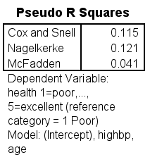
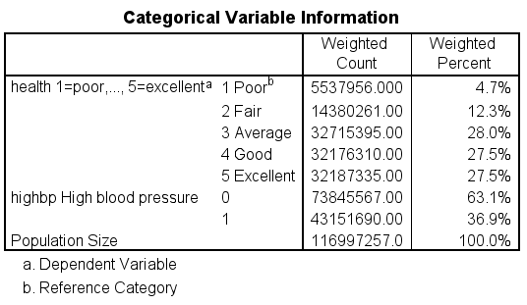
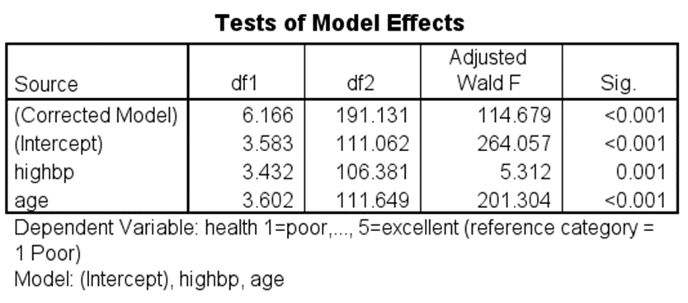
Output part 1

Slide 55
Output part 2

Slide 56
Ordinal logistic regression
Used when the outcome variable has more than two levels, and the levels have a natural ordering
Often used when the scale is too compressed to be considered continuous
Not recommended when there are too many levels in the outcome
Examples:
Small – medium – large
None – some – lots
0 – 1 – 2

Slide 57
More on ordinal logistic regression
Is a series of logistic regressions
The levels of the outcome are collapsed going from lowest to highest or vice versa
The coefficients in the logistic regressions are constrained to be equal
Important to test that these constraints are reasonable
Can use generalized ordinal logistic regression when the assumption of parallel lines is violated

Slide 58
The csordinal command
* this is a logistic regression model using the csordinal command.
* getting threshold instead of intercept.
csordinal highbp(descending) by health with age
/plan file = 'D:\data\Seminars\nhanes2f_plan.csaplan'
/model health age health*age
/statistics parameter exp cinterval ttest
/test type = adjf.

Slide 59
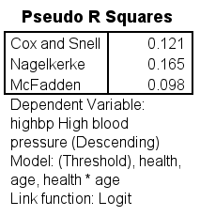
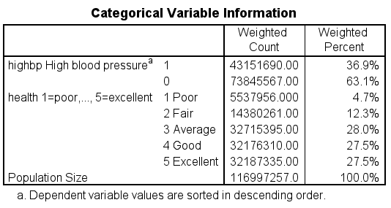
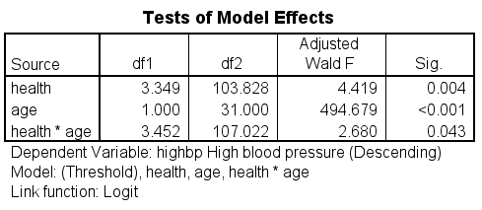
Output part 1

Slide 60
Output part 2 – compare to next slide

Slide 61
Output from cslogistic command

Slide 62
Default output from csordinal command
* not so helpful without the coefficients.
csordinal health(descending) by female region with age
/plan file = 'D:\data\nhanes2f_plan.csaplan'.

Slide 63
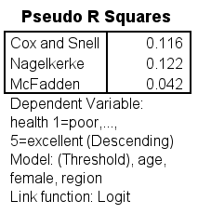
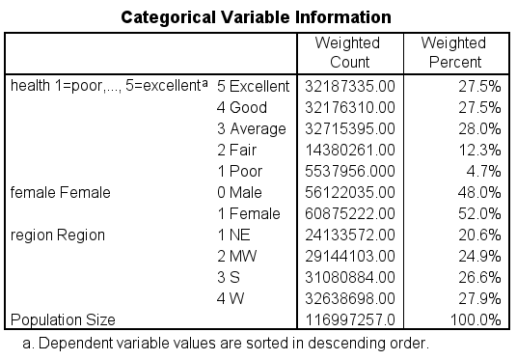
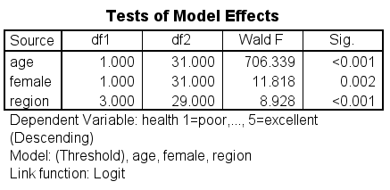
Output

Slide 64
Adding useful subcommands to csordinal
* getting the parameters and the adjusted tests.
* notice that no model subcommand is used.
csordinal health(ascending) by highbp with age
/plan file = 'D:\data\Seminars\nhanes2f_plan.csaplan'
/statistics parameter exp cinterval ttest
/test type = adjf.

Slide 65
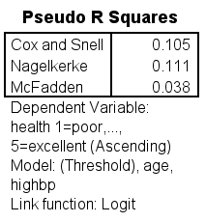
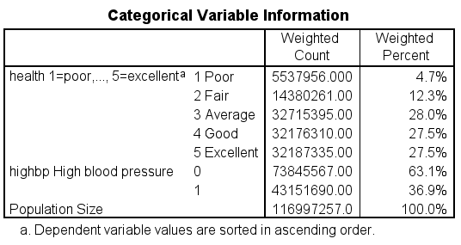
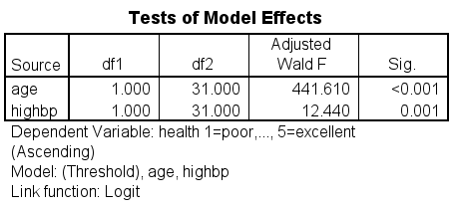
Output part 1

Slide 66
Output part 2

Slide 67
Using a domain subcommand
* using a domain subcommand to get rural.
csordinal health(ascending) by highbp with age
/plan file = 'D:\data\nhanes2f_plan.csaplan'
/model highbp age highbp*age
/statistics parameter exp cinterval ttest
/test type = adjf
/domain variable = rural (1).

Slide 68
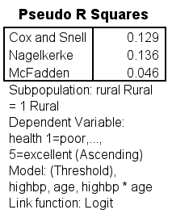
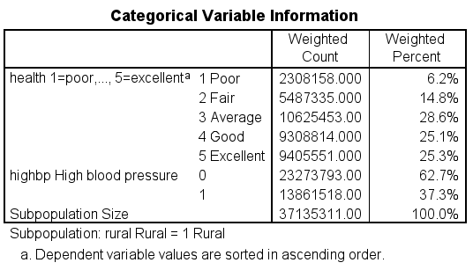
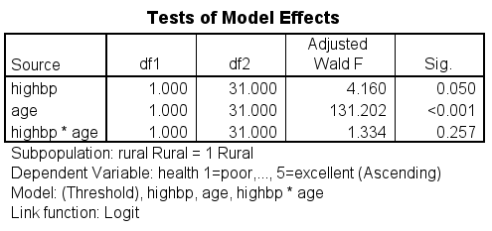
Output part 1

Slide 69
Output part 2

Slide 70
Generalized ordinal logistic regression
csordinal health(ascending) by female region with age
/plan file = 'D:\data\nhanes2f_plan.csaplan'
/model female region age
/statistics parameter exp cinterval ttest
/nonparallel test parameter.

Slide 71
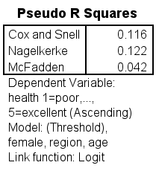
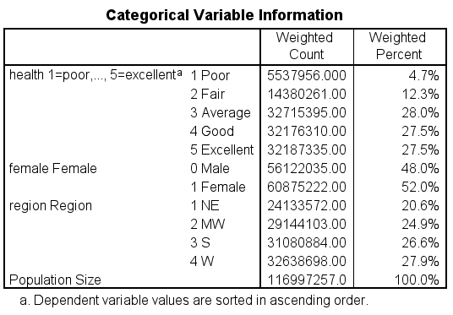
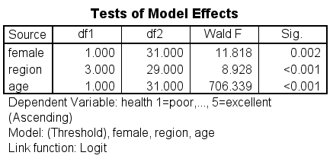
Output part 1

Slide 72
Output part 2

Slide 73
Output part 3
Generalized Cumulative Model

Slide 74
Output part 4

Slide 75
Generalized ordinal logistic regression with a domain subcommand
csordinal health(ascending) by diabetes with age
/plan file = 'D:\data\nhanes2f_plan.csaplan'
/model diabetes age
/statistics parameter exp cinterval ttest
/test type = adjf
/domain variable = rural (1)
/nonparallel test parameter.

Slide 76
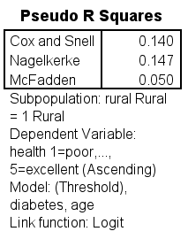
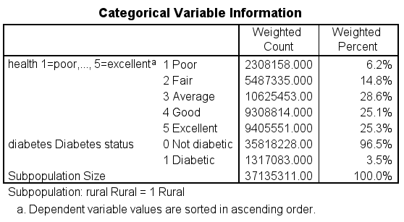
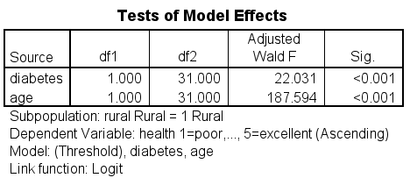
Output part 1

Slide 77
Output part 2

Slide 78
Output part 3
Generalized Cumulative Model

Slide 79
Output part 4

Slide 80
Probit regression
Used when the outcome variable is binary
Assumes that the probability of a positive outcome is determined by the standard normal cumulative distribution function
Coefficients do not have a easy or natural interpretation
Usually just look at the sign of the coefficient and statistical significance
Has different statistical properties than logit
More commonly used in economics; not often used in social or medical sciences

Slide 81
Probit regression using the csordinal command
csordinal highbp(descending) with age
/plan file = 'D:\data\nhanes2f_plan.csaplan'
/model age
/statistics parameter cinterval ttest
/link function = probit
/test type = adjf.

Slide 82
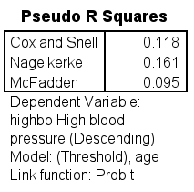
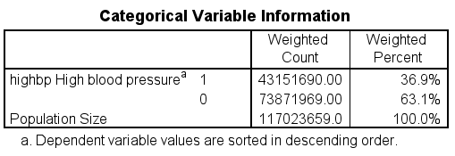
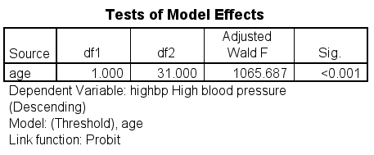
Output part 1

Slide 83
Output part 2

Slide 84
Any questions??

Slide 85
Try it yourself!
Create a three-level variable from the variable “iron”; try to keep the number of unweighted cases similar across the levels
Run an ordinal logistic regression with this new variable as the outcome variable and three predictors of your choice
Test the parallel lines assumption
What would you do if the assumption was not met?

Slide 86
References
Image on slide 7: https://www.voxco.com/blog/stratified-sampling-vs-cluster-sampling
Applied Survey Data Analysis, Second Edition by Steven G. Heeringa, Brady T. West, and Patricia A. Berglund
A survey of survey statistics: What is done and can be done in Stata by Frauke Kreuter and Richard Valliant, The Stata Journal (2007), Volume 7, Number 1, pages 1-21.
Goodness-of-fit test for a logistic regression model fitted using survey sample data by Kellie J. Archer and Stanley Lemeshow, The Stata Journal (2006), Volume 6, Number 1, pages 97-105.
Analysis of Health Surveys by Edward L. Korn and Barry I. Graubard
Sampling of Populations: Methods and Applications, Fourth Edition by Paul Levy and Stanley Lemeshow
Analysis of Survey Data Edited by R. L. Chambers and C. J. Skinner
Sampling Techniques, Third Edition by William G. Cochran
Stata 17 Manual: Survey Data
StatNews #73: Overlapping Confidence Intervals and Statistical Significance, October 2008 by the Cornell Statistical Consulting Unit
Why Overlapping Confidence Intervals Mean Nothing about Statistical Significance

Slide 87
For more information on using the NHANES data sets
There are helpful resources for learning how to analyze the NHANES data sets correctly.
One is a listserv at http://www.cdc.gov/nchs/nhanes/nhanes_listserv.htm .
There are also online tutorials at http://www.cdc.gov/nchs/tutorials/index.htm

Slide 88
Thank you!

