Slide 1
Using the SPSS Mixed Command
Presented by Christine R. Wells, Ph.D.
Statistical Methods and Data Analytics
UCLA Office of Advanced Research Computing

Slide 2
Content of workshop
What we will cover
What we will not cover
Some linear statistical models
Two types of data
Most subcommands
Most options
Lot of examples
All syntax
General introduction to MLM
No point-and-click
Interpretation
In-depth discussion of many important issues in MLM
No non-linear models

Slide 3
Introduction

Slide 4
Type of models
Single level
Multilevel
Fixed-effects ANOVA/regression model
Randomized complete blocks design
Split-plot design
Purely random-effects model
Multilevel model
Unconditional linear growth model
Linear growth model with a person-level covariate
Repeated measures analysis
Repeated measures analysis with a time-dependent covariate

Slide 5
Questions for the audience
What SPSS commands could you use to run a single-level linear model in SPSS?
Why would you use the mixed command to run a single-level linear model in SPSS?

Slide 6
Answers
Question 1: At least 17 commands!
  anova
  areg
  bayesanova
  bayesindependent
  bayesregression
  csglm
  genlin
  genlinmixed
  glm
  linear
  linear_elastic_net
  linear_lasso
  manova
  mixed
  oneway
  regression
  unianova
Question 2: Options

Slide 7
Different types of multilevel data
Repeated Measures data
Cluster data
Time nested in person
  Level 1: time
  Level 2: person
People or things nested in clusters
  Students in classrooms
  Patients in hospitals
Level 1: students/patients
Level 2: classrooms/hospitals

Slide 8
Data structure
Single level models
Multilevel models
Wide format
One row per subject
Missing data
Long format
Multiple rows per subject
  Need level 2 identifier
Missing data

Slide 9
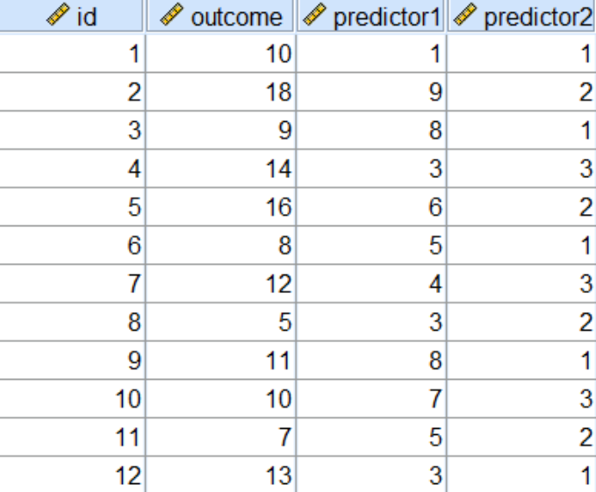
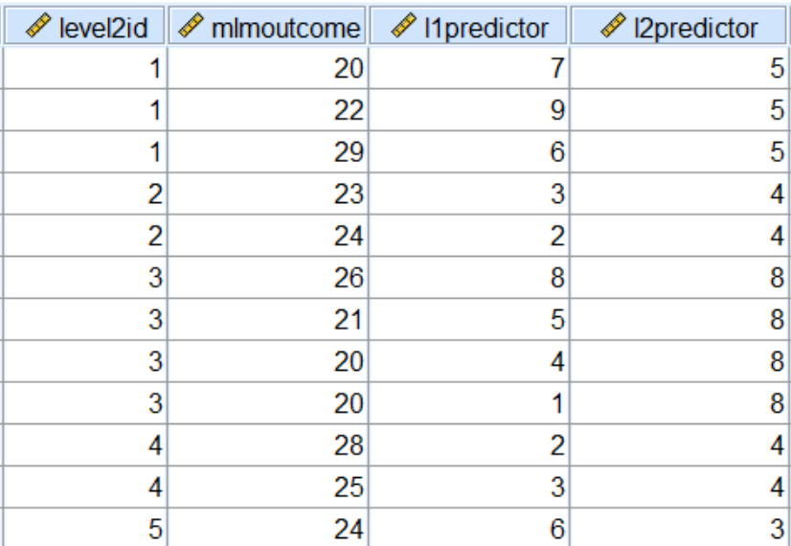
Data structure
Single level models
Multilevel models

Slide 10
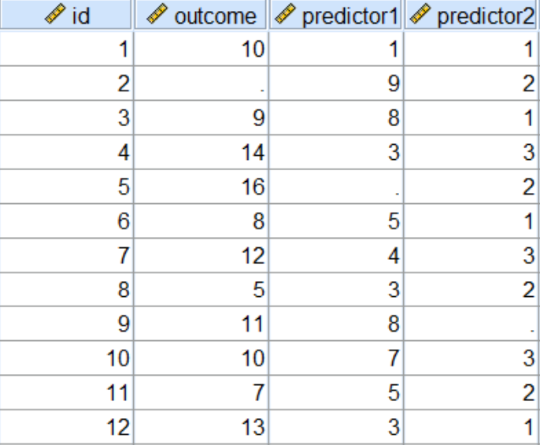
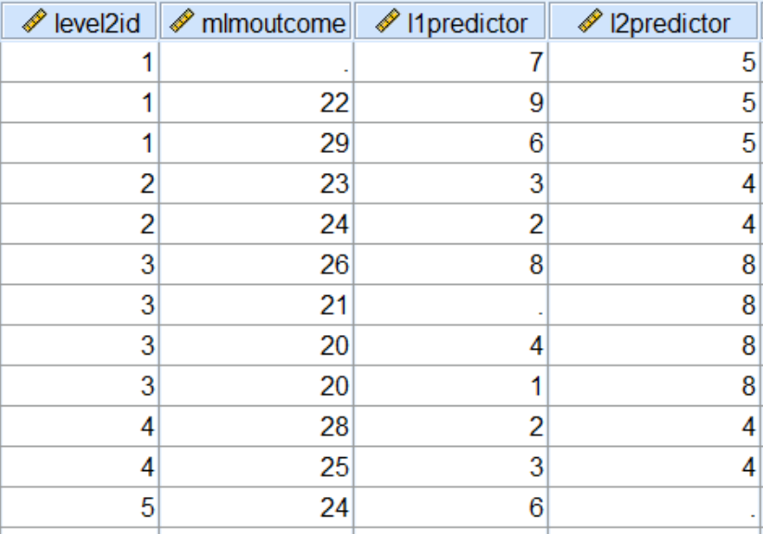
Data structure with missing data
Single level models
Multilevel models

Slide 11
Repeated measures data
Wide format
Long format

Slide 12
Restructuring data
Super easy in SPSS!
Wide to long: varstocases
Long to wide: casestovars

Slide 13
Comparing wide and long form
Data in wide form
Data in long form
id exertype diet time1 time2 time3
1 1 1 85 85 88
2 1 1 90 92 93
3 1 1 97 97 94
4 1 1 80 82 83
5 1 1 91 92 91
id exertype diet time bp
1 1 1 1 85
1 1 1 2 85
1 1 1 3 88
2 1 1 1 90
2 1 1 2 92
2 1 1 3 93
3 1 1 1 97
3 1 1 2 97
3 1 1 3 94
4 1 1 1 80
4 1 1 2 82
4 1 1 3 83
5 1 1 1 91
5 1 1 2 92
5 1 1 3 91

Slide 14
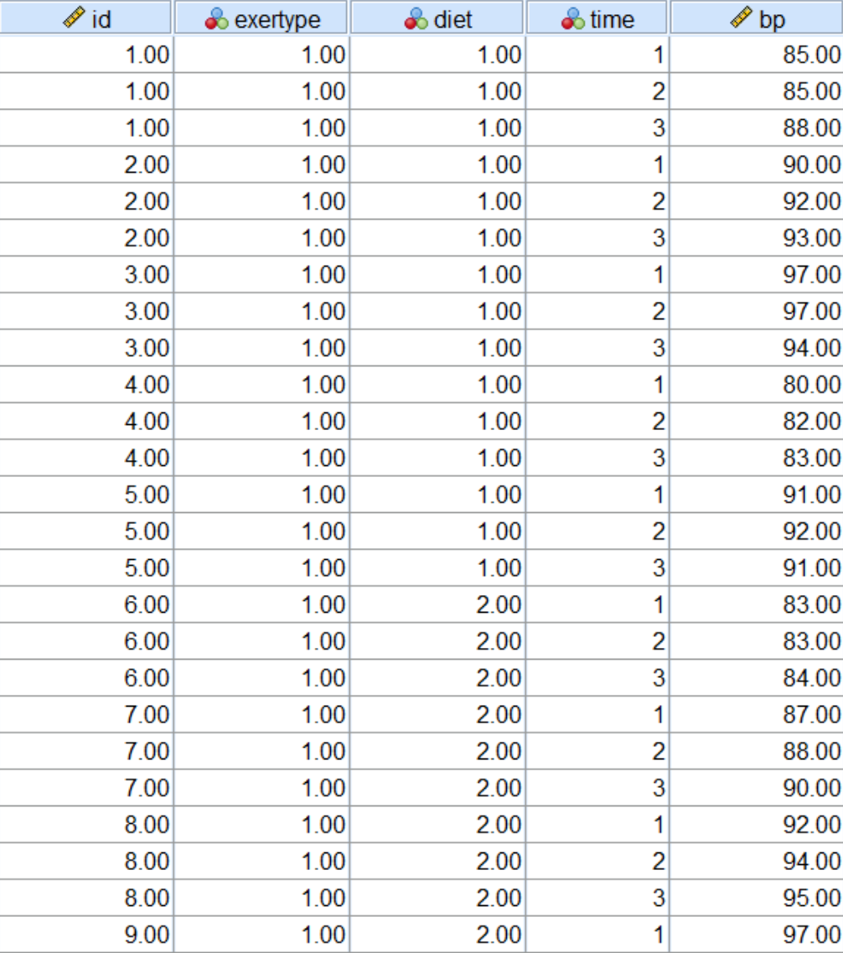
Varstocases example
varstocases
/make bp from time1 time2 time3
/index = time.

Slide 15
Question to audience
When would a wide data structure not make sense?

Slide 16
Answers
Uneven number of time points
100s of time points or more
Point: not all datasets make sense in both wide and long form

Slide 17
A few housekeeping things
Add echo of syntax to output
  Edit -> Options -> Viewer tab -> lower left corner -> check box
SPSS keywords
  By: categorical predictors (fixed factors)
  With: continuous predictors (covariates)
Not case sensitive
Period!

Slide 18

Do you have any questions?

Slide 19
Repeated measures

Slide 20
Question to audience
Why would you use a multilevel model rather than repeated measures ANOVA?

Slide 21
Answers
Special case of MLM
  Evenly-spaced time points
  Everyone measured at same time
  Covariance structure (compound symmetry)
  Interactions with covariates
Missing data

Slide 22
The mixed command with the repeated subcommand
mixed bp by time diet
/fixed diet time
/repeated time | subject(id) covtype(ar1)
/print = solution.
Default reference group
Time points covary
The print subcommand

Slide 23
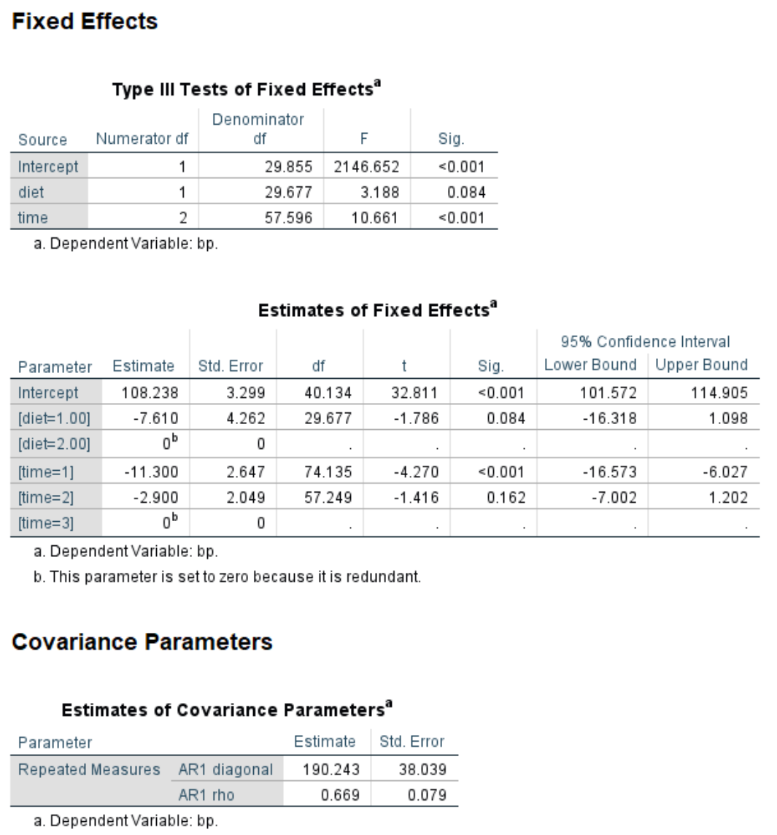
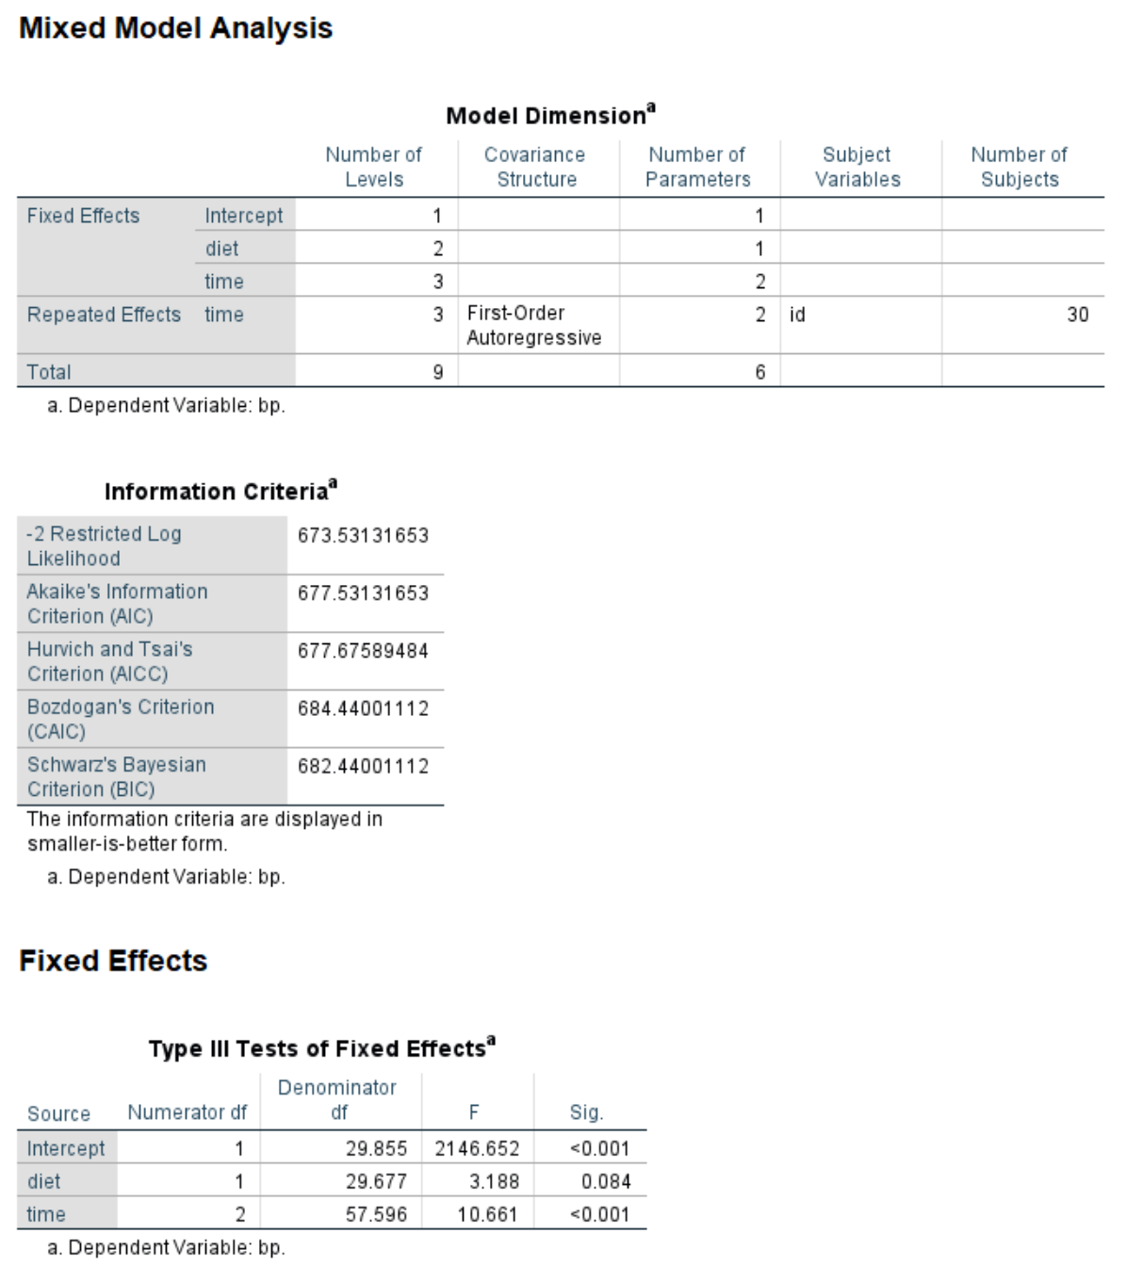
The mixed command with the repeated subcommand - output

Slide 24
Covariance structures – Quoted from SPSS Command Syntax Reference Guide – partial list
Default is diagonal: diagonal structure with heterogenous variance
AR1: First-order autoregressive.
ARH1: Heterogenous first-order autoregressive.
ARMA11: Autoregressive moving average (1,1).
CS: Compound symmetry. This structure has constant variance and constant covariance.
CSH: Heterogenous compound symmetry. This structure has non-constant variance and constant correlation.
CSR: Compound symmetry with correlation parameterization. This structure has constant variance and constant covariance.

Slide 25
Covariance structures – Quoted from SPSS Command Syntax Reference Guide – partial list (continued)
TP: Toeplitz
UN_AR1: UN@AR1. Specifies the Kronecker product of one unstructured matrix and the other first-order auto-regression covariance matrix.
UN: Unstructured. This is a completely general covariance matrix.
VC: Variance components. This is the default covariance structure for random effects. When the variance components structure is specified on a RANDOM subcommand, a scaled identity (ID) structure is assigned to each of the effects specified on the subcommand. If the variance components structure is specified on the REPEATED subcommand, it is replaced by the diagonal (DIAG) structure.

Slide 26
Choosing a covariance matrix
Use theory to assist
Compare AICs or BICs
Likelihood ratio test (ML only)
Sensitivity analyses

Slide 27
Do you have any questions?

Slide 28
Clustered data

Slide 29
New example dataset
Using hsbdemo
  Students nested in classrooms
  Level 2 identifier: cid
Continuous outcome: write
Test scores (continuous)
Demographic variables (categorical)

Slide 30
Questions to audience
What part or parts of the results change if the clustering in the data is ignored?
Is the analysis still valid?
Does the level 2 identifier ever change between analyses (using the same dataset, of course)?

Slide 31
Answers
Everything changes
  Point estimates
  Standard errors/confidence intervals
  Degrees of freedom
Usually not valid
No – the structure of the dataset does not change between analyses

Slide 32
Comparing the syntax
Ignoring clustering
Accounting for clustering
mixed write with read female
/fixed read female
/print = solution.
mixed write with read female
/fixed read female
/random intercept | subject(cid)
/print = solution.

Slide 33
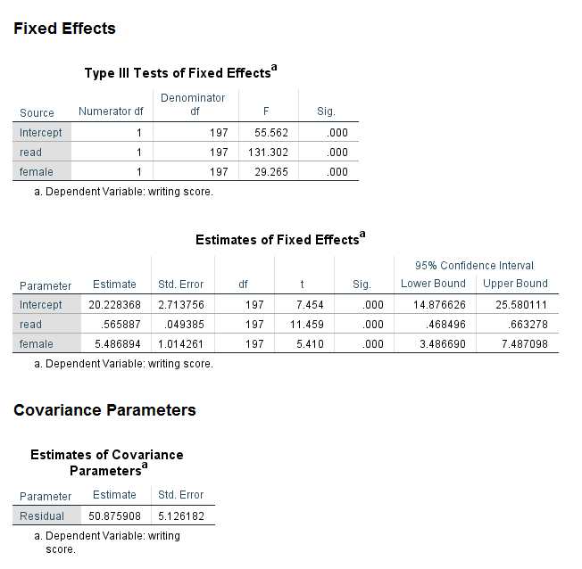
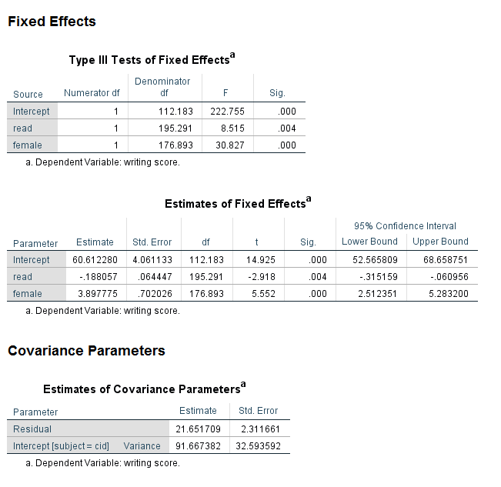
Comparing the results
Ignoring clustering
Accounting for clustering

Slide 34
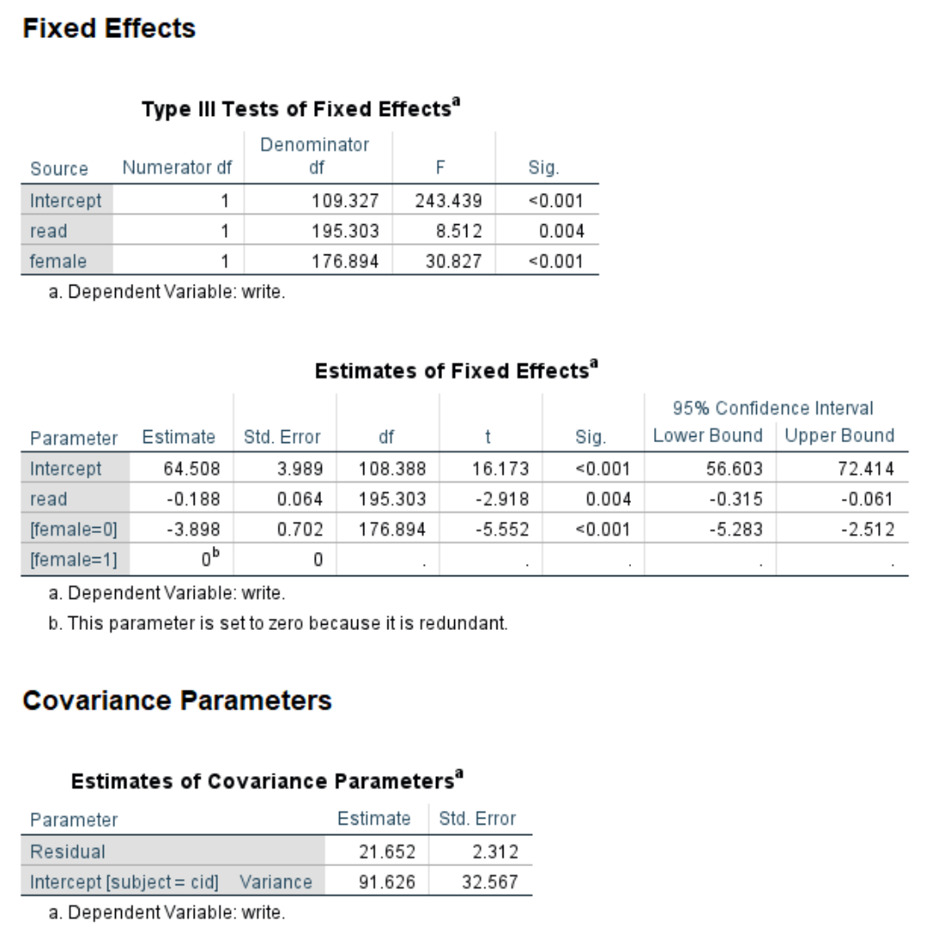
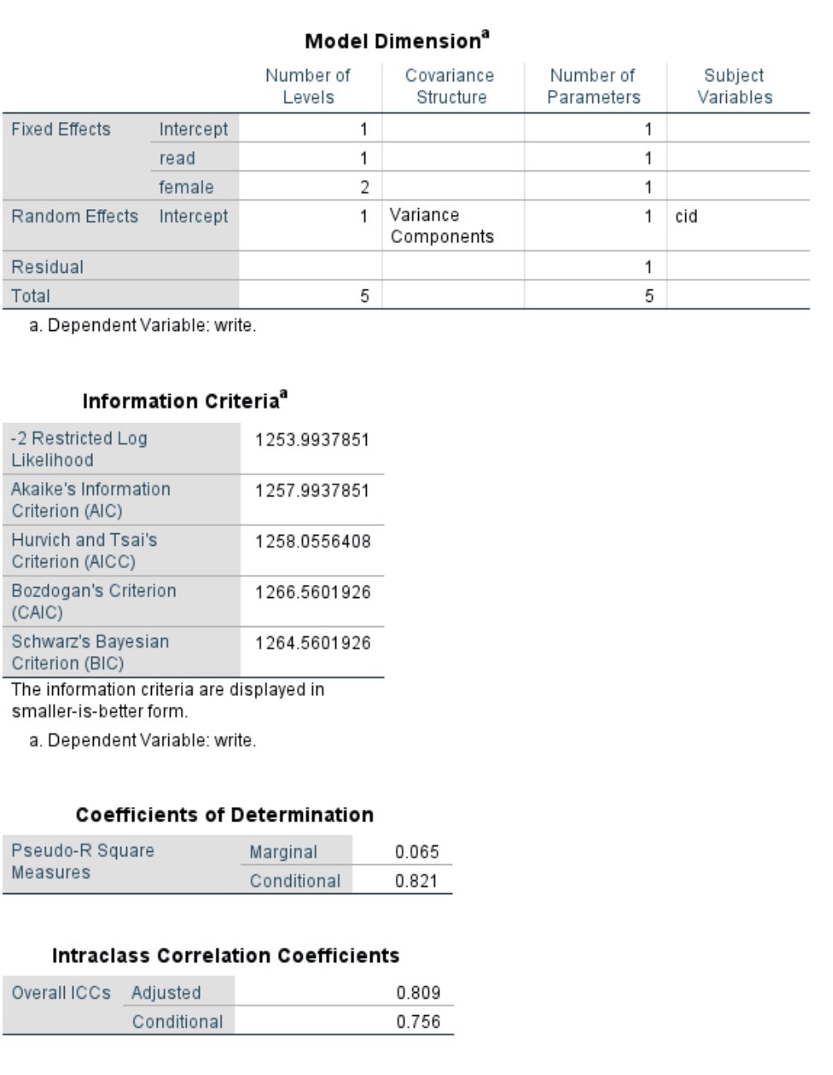
Complete output

Slide 35
Measuring the extent of the clustering
Design effect
1 + (average_cluster_size – 1)*ICC
  Average cluster size: means or descriptives command
  ICC: already in output
Rule of thumb: greater than 2

Slide 36
Getting a little more information: emmeans
Estimated marginal means
Descriptive values based on the model being run
Adds one or more tables to bottom of output
Useful in understanding and describing results

Slide 37
Adding the emmeans subcommand
mixed write with read by female
/fixed read female
/random intercept | subject(cid)
/print = solution
/emmeans = tables(female).

Slide 38
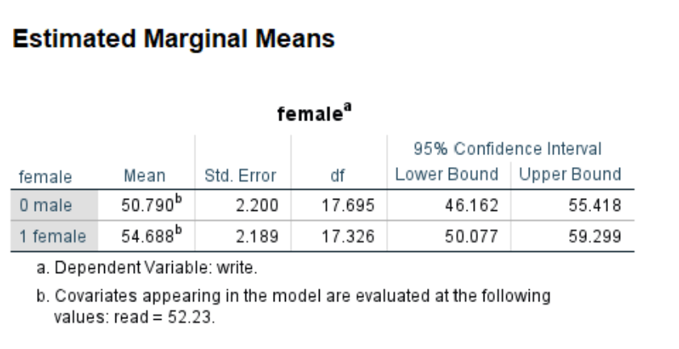
Results using the emmeans subcommand

Slide 39
Adding more predictors
mixed write with read socst by female prog
/fixed read socst female prog
/random intercept | subject(cid)
/print = solution
/emmeans = tables(female)
/emmeans = tables(prog).

Slide 40
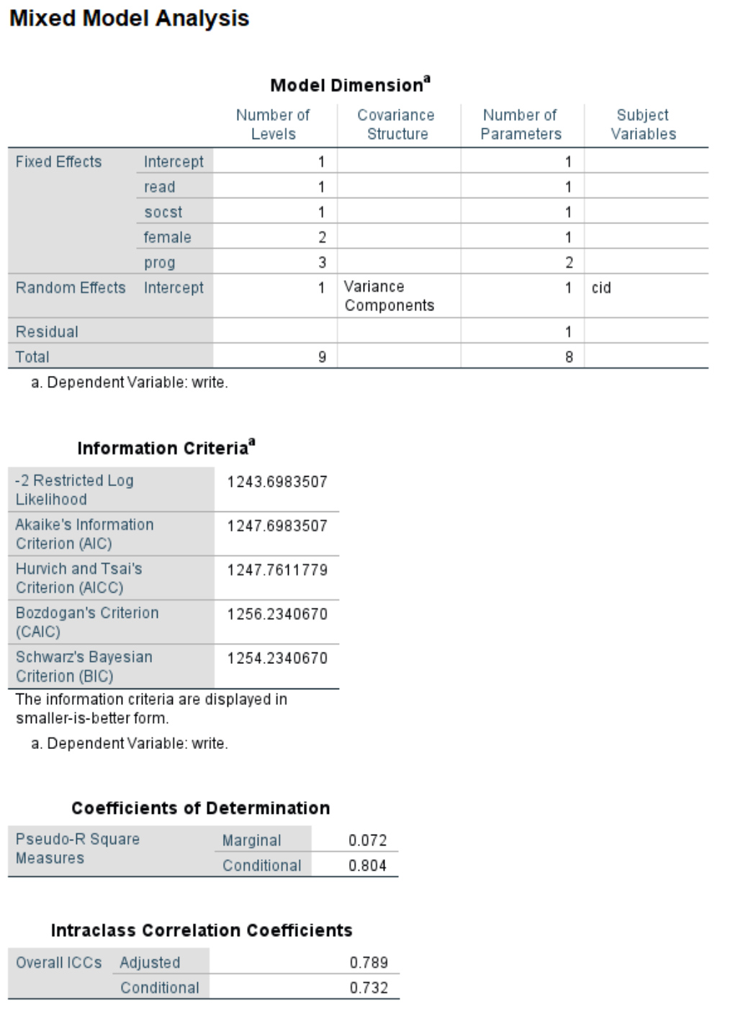
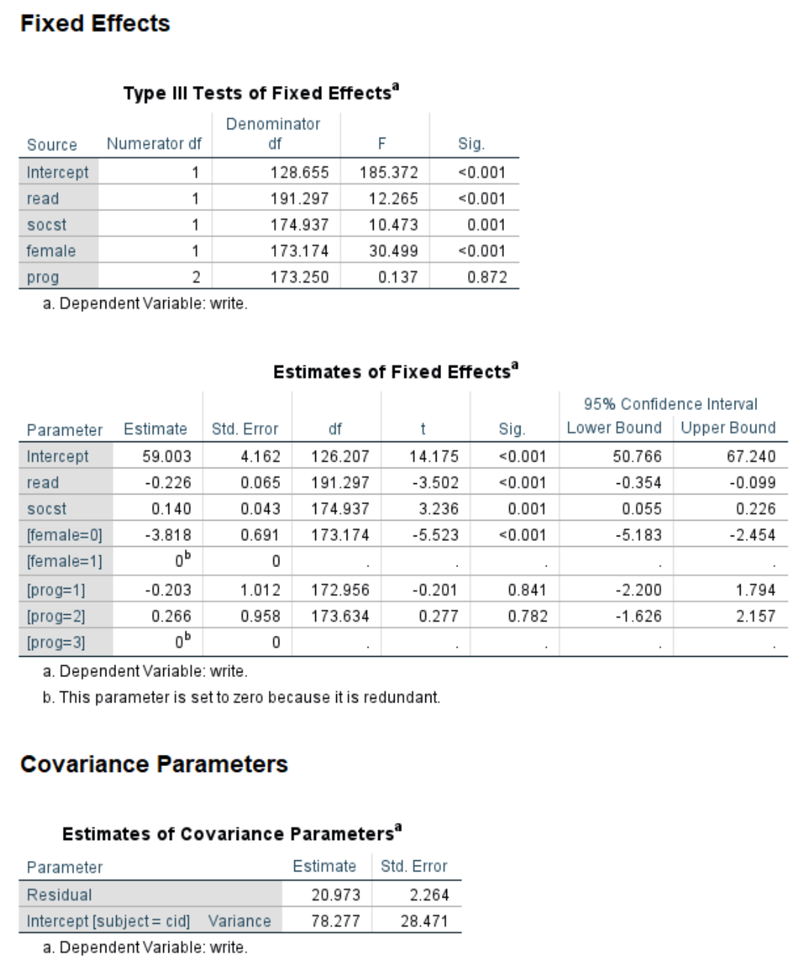
Output

Slide 41
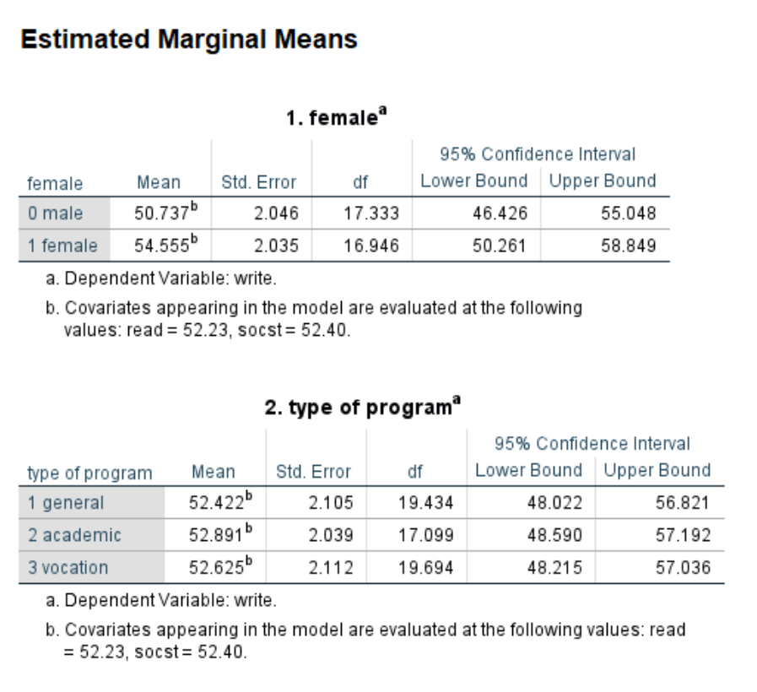
Output - continued

Slide 42
Do you have any questions?

Slide 43
Random slopes

Slide 44
Questions to audience
Why do we use a random intercept?
Why would we use a random slope?
Is a random slope required?

Slide 45
Answers
Account for clustering
Theory or data
No

Slide 46
Adding a random slope
mixed write with read socst by female prog
/fixed read socst female prog
/random intercept read | subject(cid) cov(un)
/print = solution.

Slide 47
Watch for warning messages!
Warnings
“Iteration was terminated but convergence has not been achieved. The MIXED procedure continues despite this warning. Subsequent results produced are based on the last iteration. Validity of the model fit is uncertain.”
Results are still shown
  May be useful to see what went wrong
May need to scroll up
Fatal error more than warning!

Slide 48
Choosing a covariance structure
Only necessary if using a random slope
Add covtype option to random subcommand
See SPSS Command Syntax Reference Guide for complete list of covariance structures

Slide 49
Try it yourself
Without covtype option
With covtype option
mixed write with read by female
/fixed read female
/random intercept | subject(cid)
/print = solution.
mixed write with read by female
/fixed read female
/random intercept | subject(cid) covtype(un)
/print = solution.

Slide 50
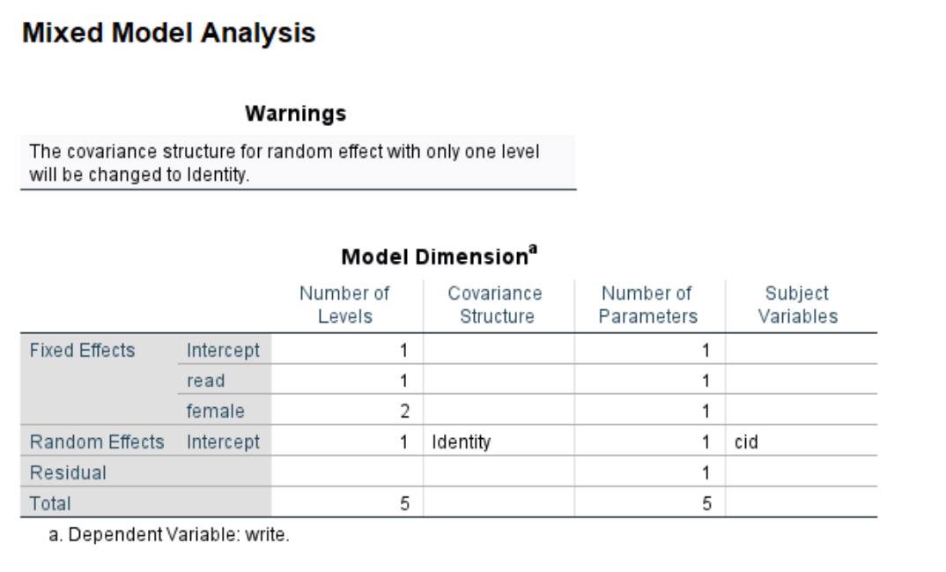
Warning added to output

Slide 51
Comparing covariance structures
Variance components (default)
Unstructured
mixed write with read socst by female prog
/fixed read socst female prog
/random intercept socst | subject(cid) cov(vc)
/method = ml
/print = solution.
mixed write with read socst by female prog
/fixed read socst female prog
/random intercept socst | subject(cid) cov(un)
/method = ml
/print = solution.

Slide 52
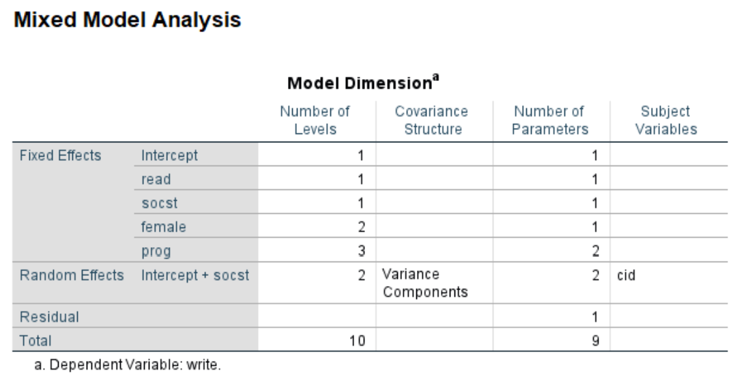
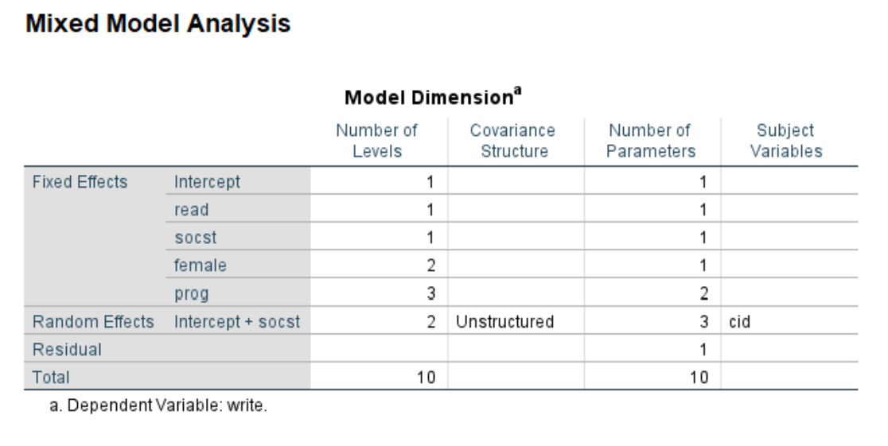
Output - Model dimension
Variance components (default)
Unstructured

Slide 53
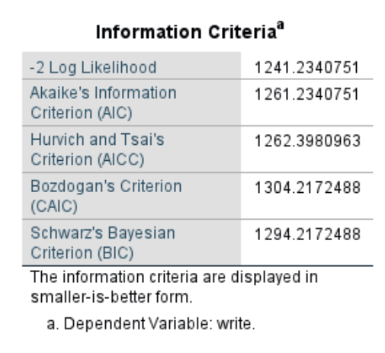
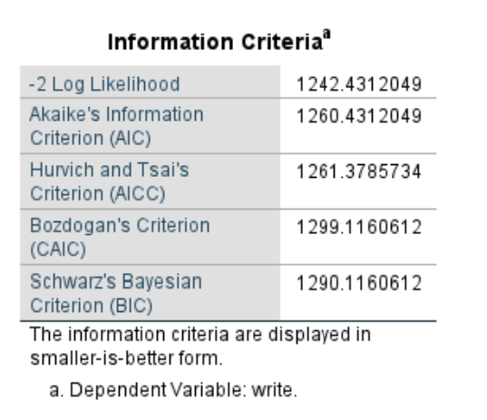
Output – Information criteria
Variance components (default)
Unstructured

Slide 54
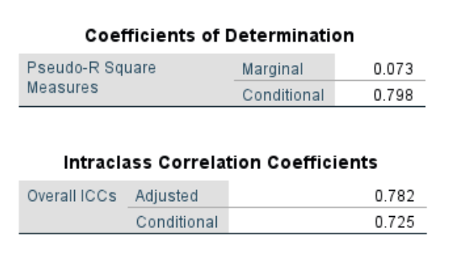
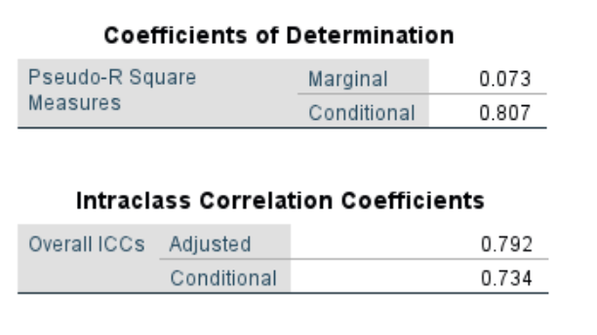
Output – CD and ICC
Variance components (default)
Unstructured

Slide 55
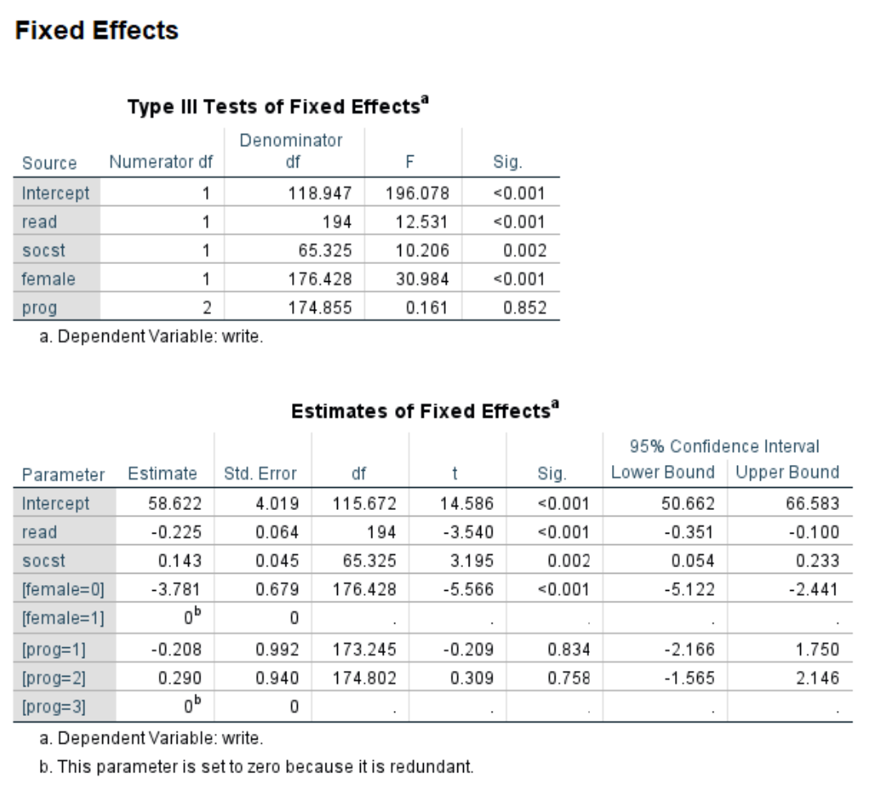
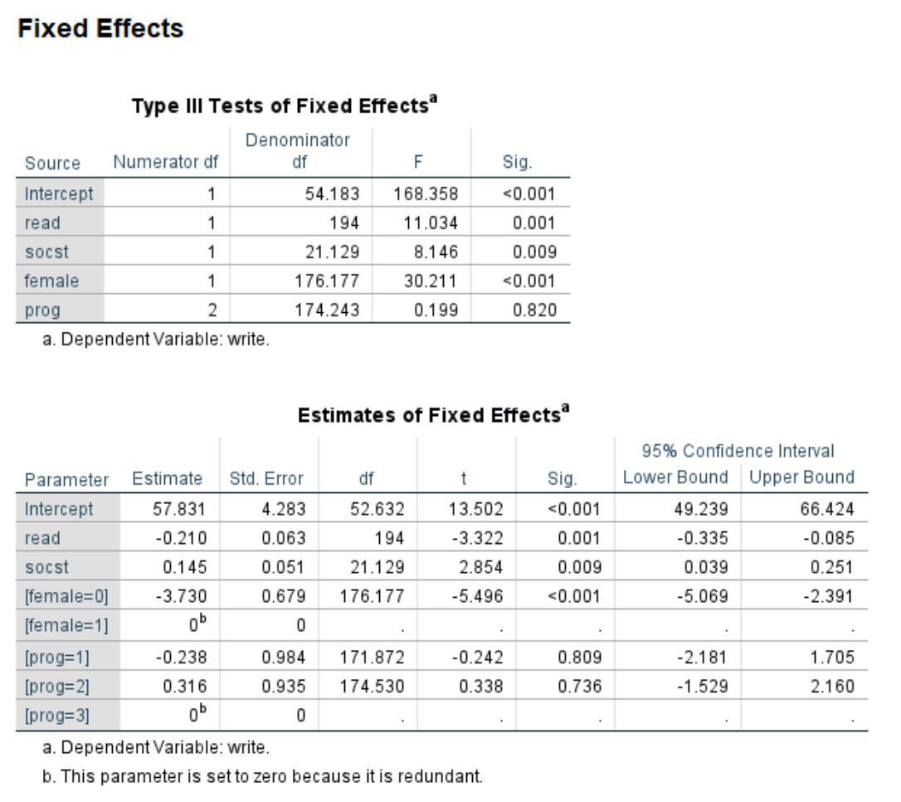
Output – Fixed effects
Variance components (default)
Unstructured

Slide 56
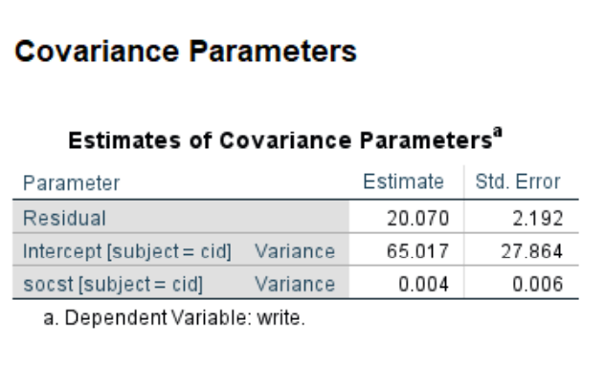
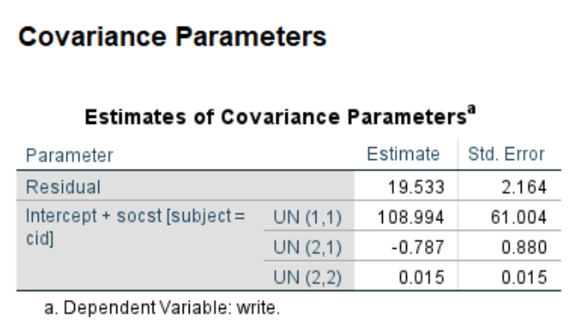
Output – Covariance parameters
Variance components (default)
Unstructured

Slide 57
Tests of random effects
covtest option on print subcommand
Questionable validity
  On boundary of parameter space
  Not required to report

Slide 58
Changing the confidence intervals
Use the cin(value) option on the criteria subcommand
Example:
mixed write with read by female
/fixed read female
/random intercept | subject(cid)
/criteria cin(90)
/print = solution.

Slide 59
Denominator degrees of freedom (ddf)
Use the dfmethod option on the criteria subcommand
Three options
  Satterthwaite (default)
    Small N
    Unbalanced
    Complicated covariance structure
  Residual
    Large N
    Balanced
    Simple covariance structure
  Kenwardroger
    Small N
    Approximate ddf for t-tests and F-tests

Slide 60
Denominator degrees of freedom – (continued)
mixed write with read by female
/fixed read female
/random intercept | subject(cid)
/criteria dfmethod(kenwoodroger)
/print = solution.

Slide 61
ML v. REML
REML is default
Sample size
  What is “small”? It’s a BIG question!
Model comparison
Use ml option on method subcommand

Slide 62
Question to audience
What rules of thumbs have you heard?
On what assumptions do these “rules” depend?

Slide 63
ML v. REML - continued
mixed write with read by female
/fixed read female
/random intercept | subject(cid)
/method ml
/print = solution.

Slide 64
Do you have any questions?

Slide 65

Let’s take a short break!

