Slide 1
Disaggregating level 1 and level 2 effects

Slide 2
Effects at both levels
Effects at level 2
Easier to interpret
Values within cluster constant
Effects at level 1
Change at level 1 and level 2
Need two coefficients
Aggregate level 1 variable to make a level 2 variable
Protential problems (discussed later)

Slide 3
Using the aggregate command
aggregate
/break = cid
/mread= mean(read).
* Centering read at level 2.
means var = read.
compute cread = read - 52.23.
execute.

Slide 4
The mixed command
mixed write with mread cread
/fixed mread cread
/random intercept | subject(cid)
/print = solution.

Slide 5
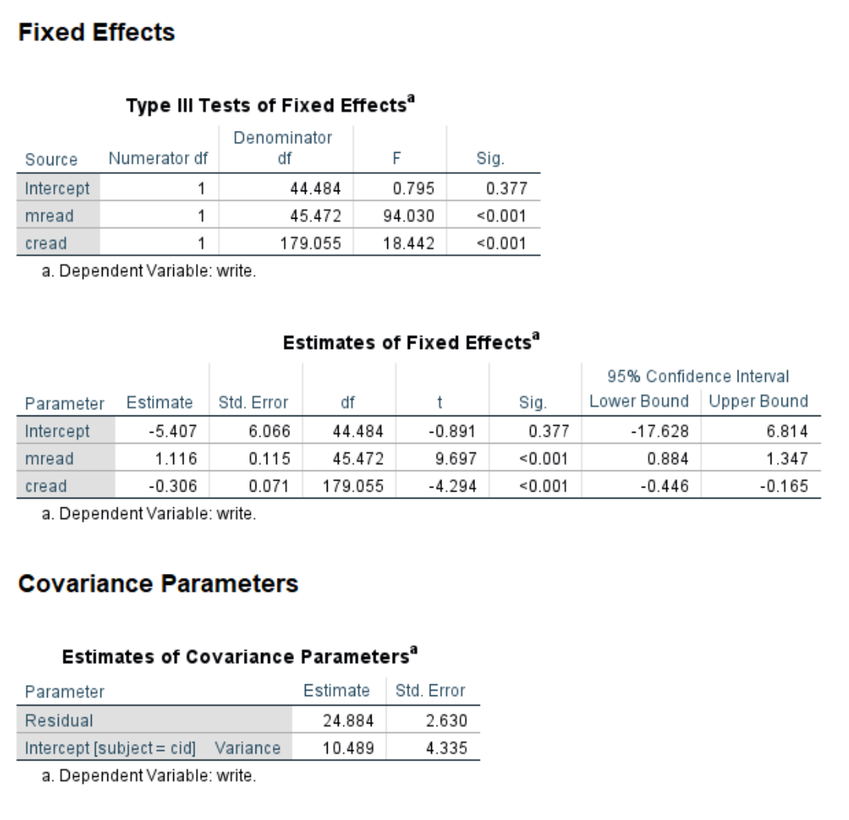
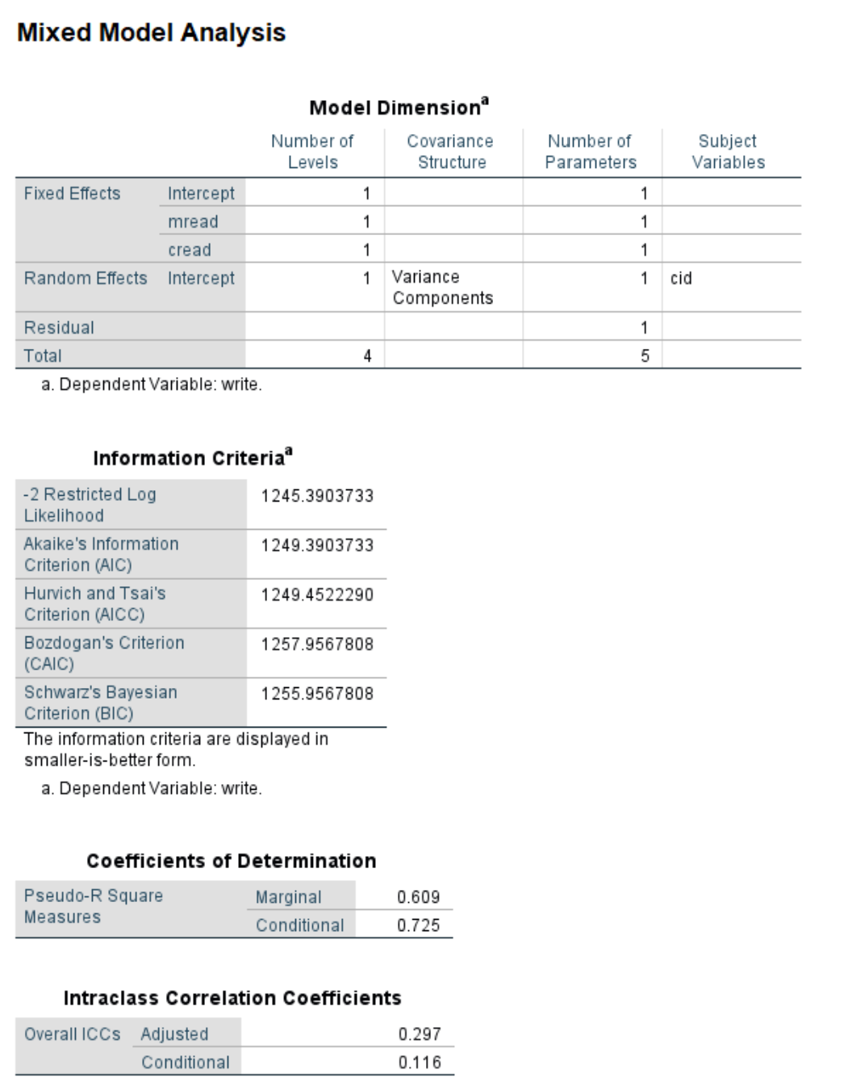
Output

Slide 6
Potential problems with aggregating
Small Ns within clusters
Measurement error
Ideal: Measure variable at both levels when collecting data
See Lüdtke, et. al. (2008) and Schunck (2016) for more information

Slide 7

Do you have any questions?

Slide 8
Interactions

Slide 9
Adding interaction terms
Any level
Level 1 by level 1
Level 2 by level 2
Level 1 by level 2
Any predictor
Continuous by continuous
Categorical by categorical
Continuous by categorical
Let theory be the guide!

Slide 10
Adding interaction terms - continued
Add to fixed subcommand (along with lower-order effects)
Use SPSS keyword by or *
Can be added to random subcommand in some situations
Use SPSS keyword by or *
Can be used on emmeans subcommand (categorical by categorical)

Slide 11
Mixed command with categorical by categorical interaction
Predictors female and prog are both level 1
mixed write by female prog /fixed female prog female*prog /random intercept | subject(cid) /print = solution /emmeans = tables(female*prog).

Slide 12
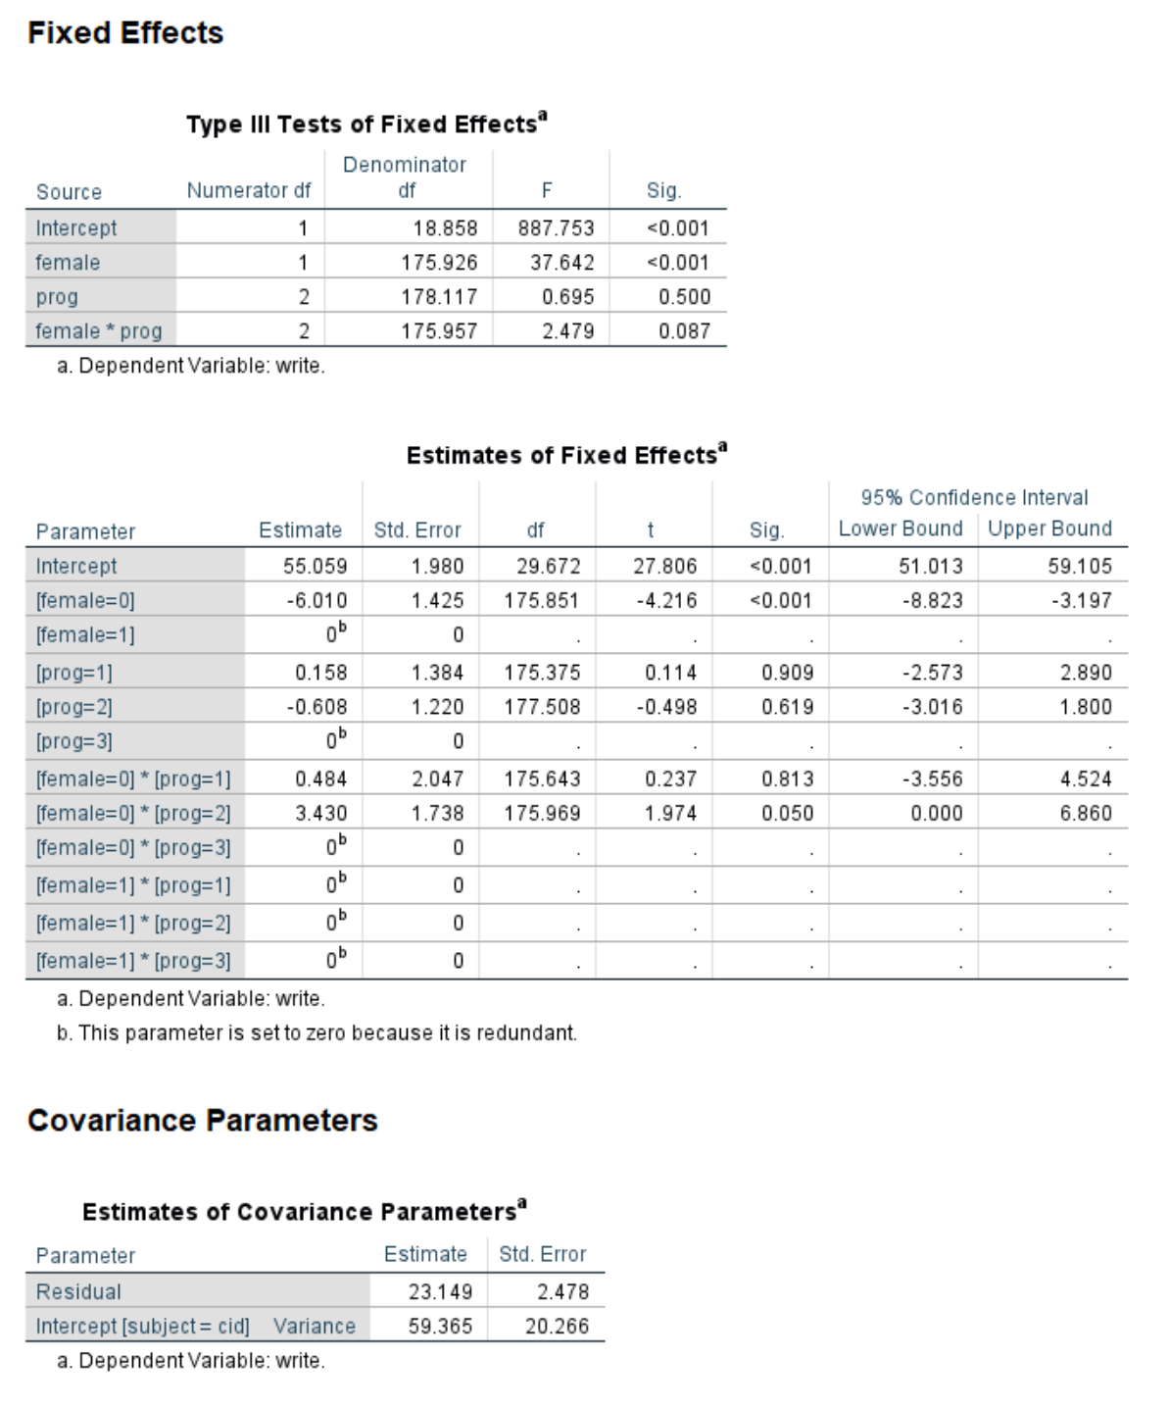
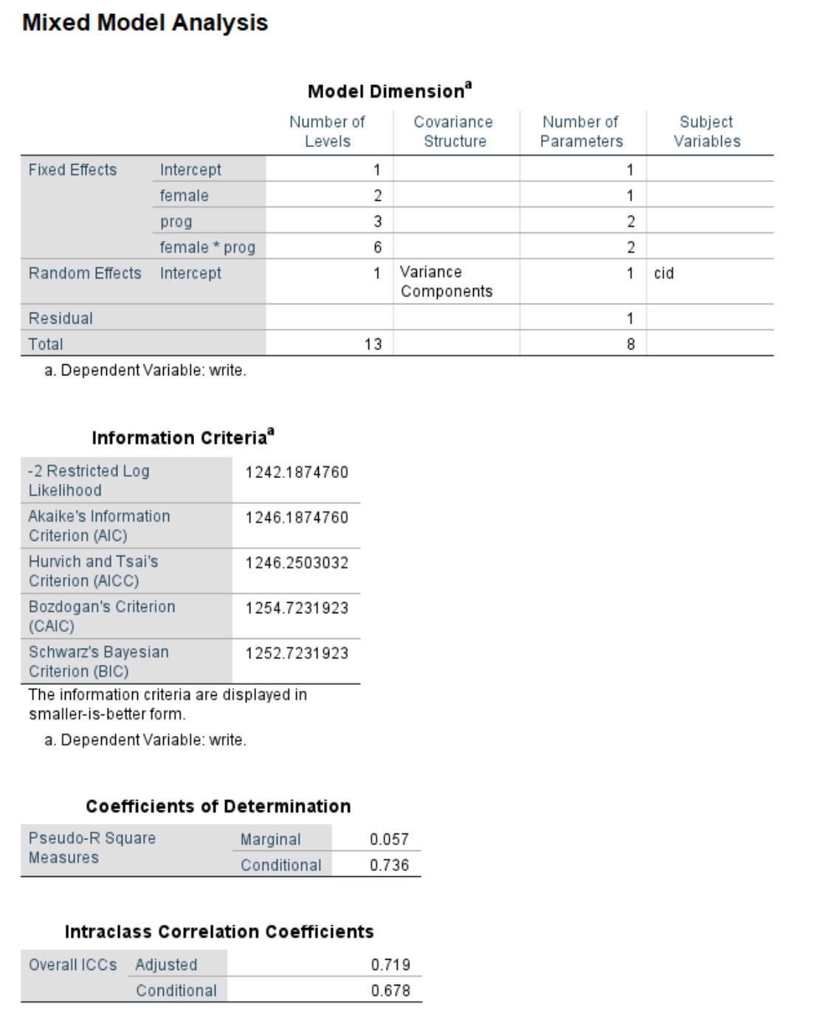
Output

Slide 13
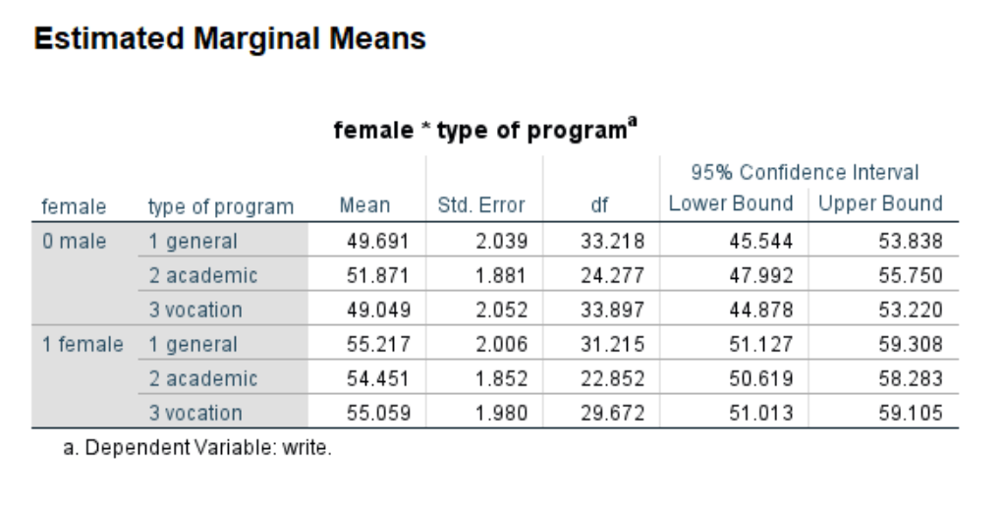
Output - continued

Slide 14
Level 1 and level 2 interaction
* Creating a level 2 predictor aggregate
/break = cid
/sum_honors = sum(honors).
mixed write by female with sum_honors
/fixed female sum_honors female*sum_honors
/random intercept | subject(cid)
/print = solution
/emmeans = tables(female) with (sum_honors = 2.67).

Slide 15
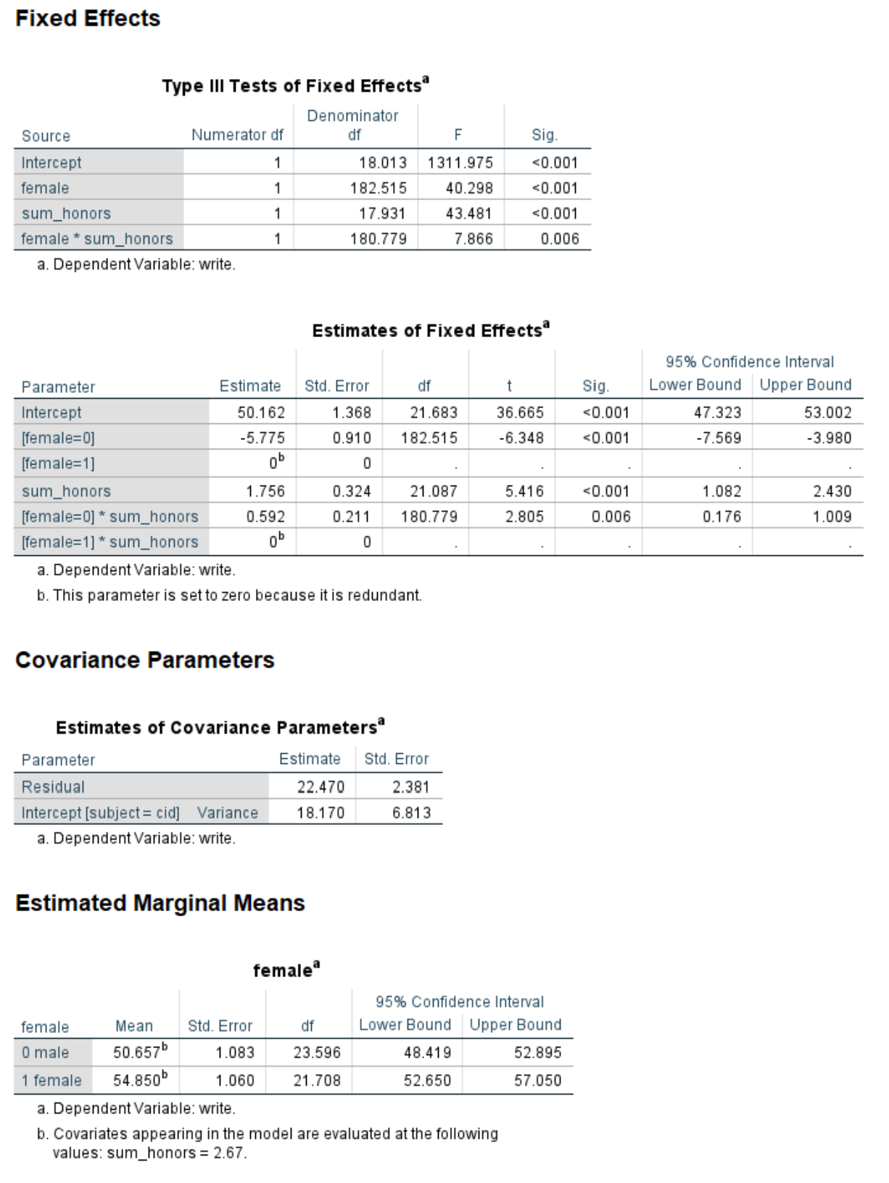
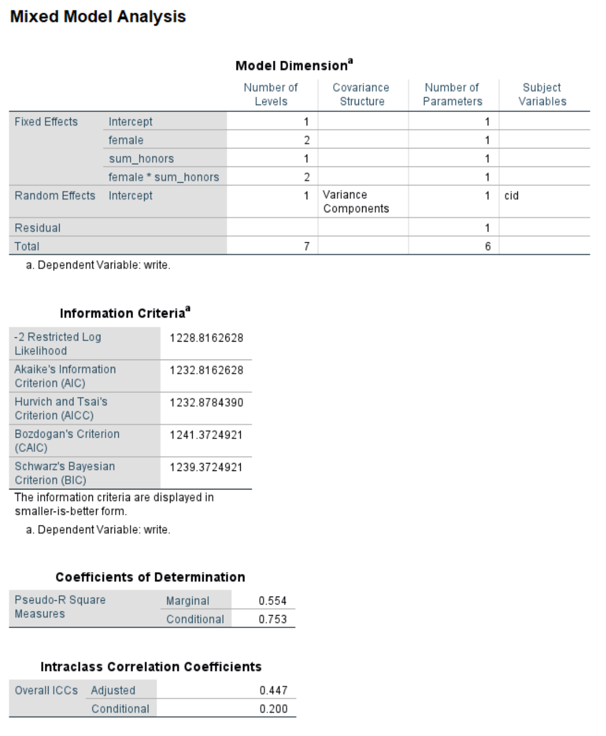
Output

Slide 16
Tests of simple main effects
Is the effect of one variable statistically significant at a given level of another variable?
Watch for alpha inflation
Use the compare option on the emmeans subcommand
mixed write by female prog /fixed female prog female*prog /random intercept | subject(cid) /print = solution /emmeans = tables(female*prog) compare(prog).

Slide 17
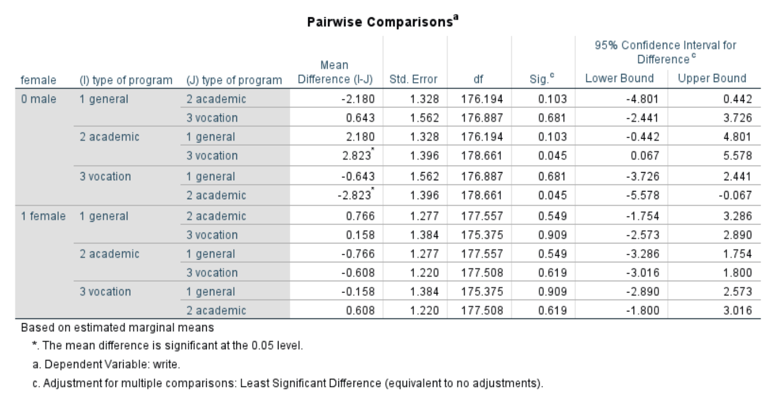
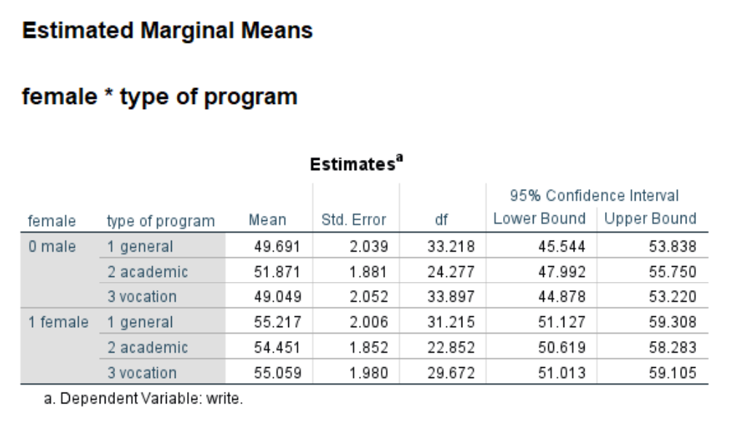
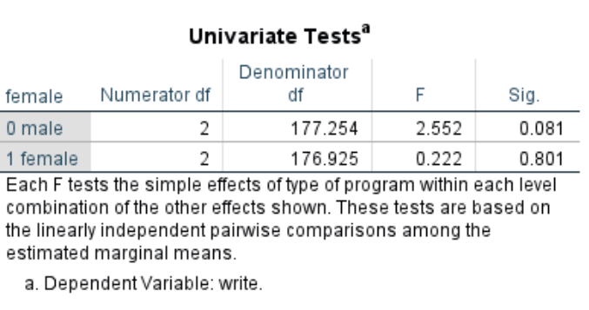
Output

Slide 18
Other options on the emmeans subcommand
mixed write by female prog with read
/fixed female prog female*prog read
/random intercept | subject(cid)
/print = solution
/emmeans = tables(female*prog) with(read = mean) compare(prog) adj(bonferroni).

Slide 19
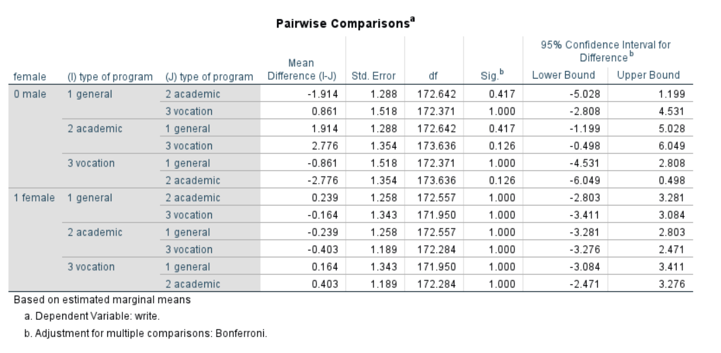
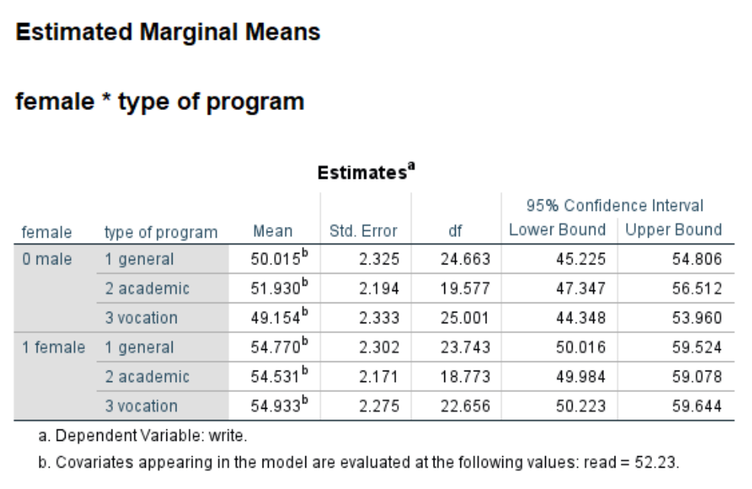
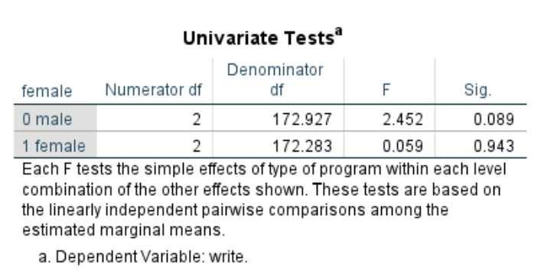
Output

Slide 20
Other options on the emmeans subcommand - continued
mixed write by female prog with read
/fixed female prog female*prog read
/random intercept | subject(cid)
/print = solution
/emmeans = tables(female*prog) with(read = mean) compare(prog) refcat(last) adj(bonferroni).

Slide 21
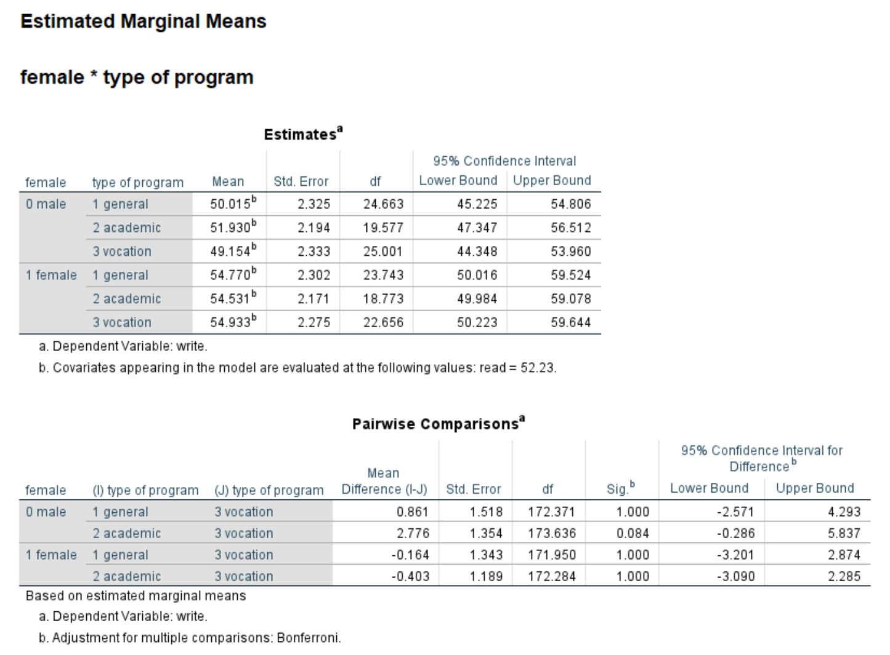
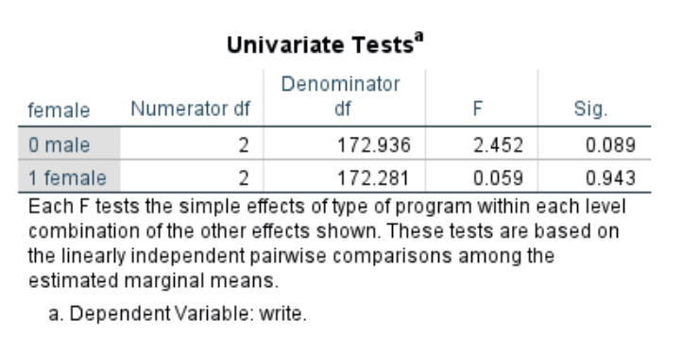
Output

Slide 22
Do you have any questions?

Slide 23
Custom hypothesis tests

Slide 24
Using the test subcommand
Use the test subcommand
mixed write by female /fixed female /random intercept | subject(cid) /print = solution /emmeans = tables(female) /test = 'using effect coding' female -1 1.

Slide 25
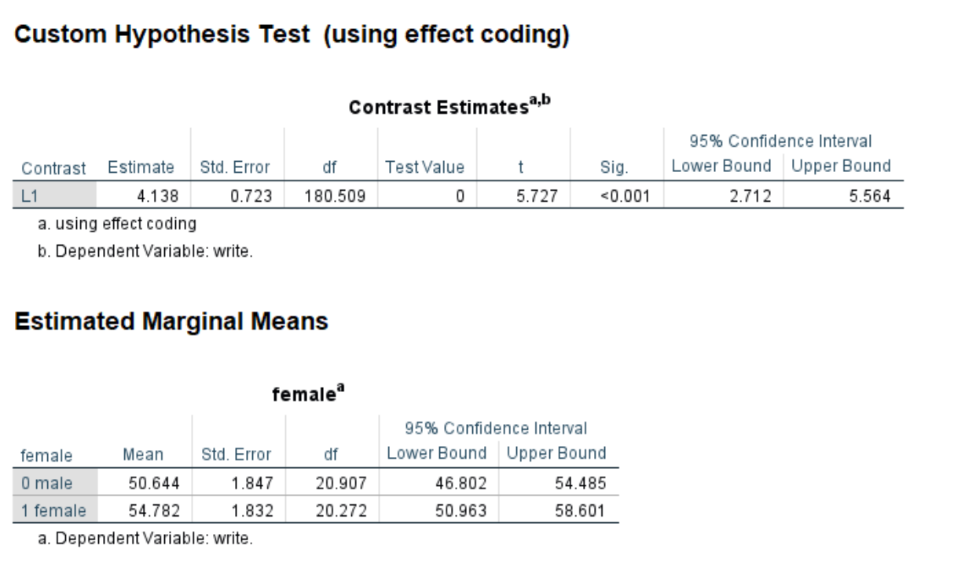
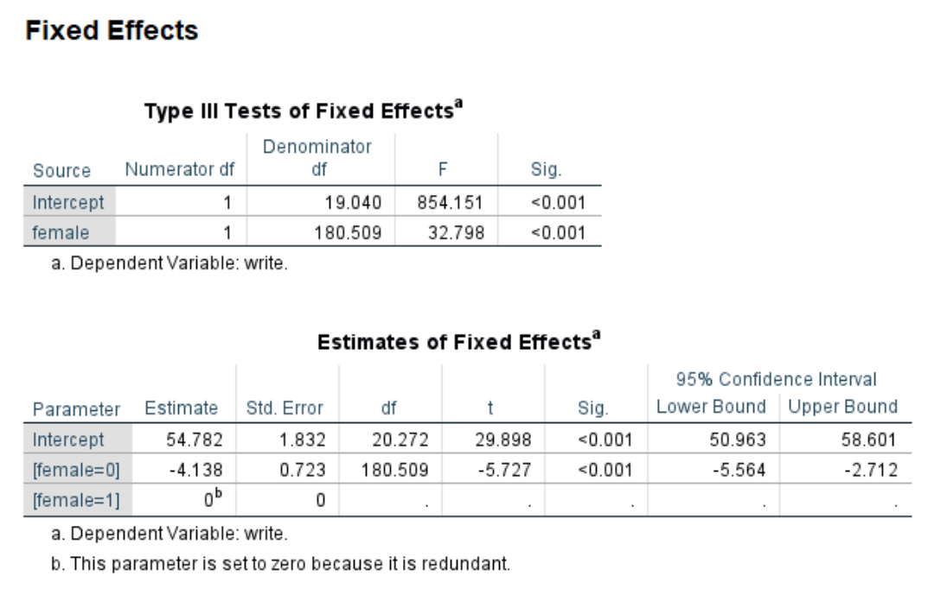
Output

Slide 26
Interaction contrasts
prog 1 = -.5 prog 2 = -.5 prog 3 = 1
female 0 = 1 -.5 -.5 1
female 1 = -1 .5 .5 -1

Slide 27
Test subcommand for interaction contrast
mixed write by female prog /fixed female prog female*prog /random intercept | subject(cid) /print = solution /emmeans = tables(female*prog) /test = 'prog12v3 & female 0v1' prog*female -.5 -.5 1 .5 .5 -1.

Slide 28
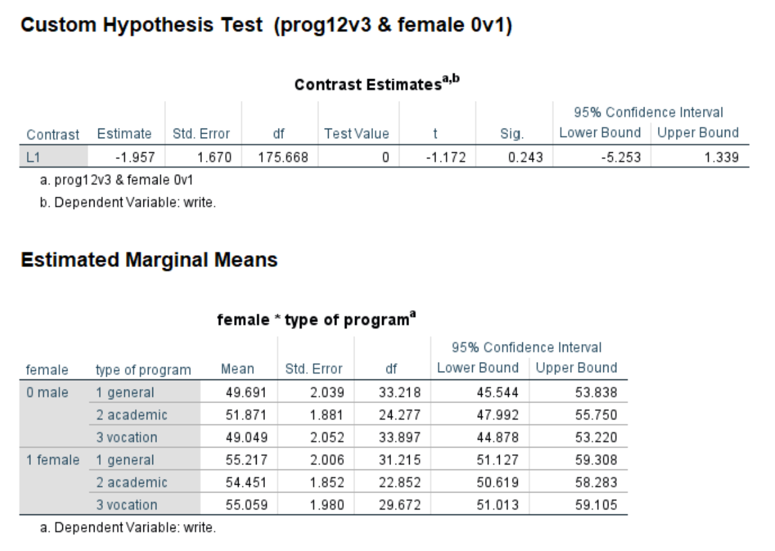
Output

Slide 29
Showing the divisor option
Predictor prog: 3 levels
compare level 1 with level 3
compare level 1 with level 2
compare level 2 with level 3

Slide 30
Showing the divisor option - continued
mixed write by prog /fixed prog /random intercept | subject(cid) /print = solution /emmeans = tables(prog) /test = 'contrasts of prog' prog 1 0 -1 divisor = 3; prog 1 -1 0 divisor = 3; prog 0 1 -1 divisor = 3.

Slide 31
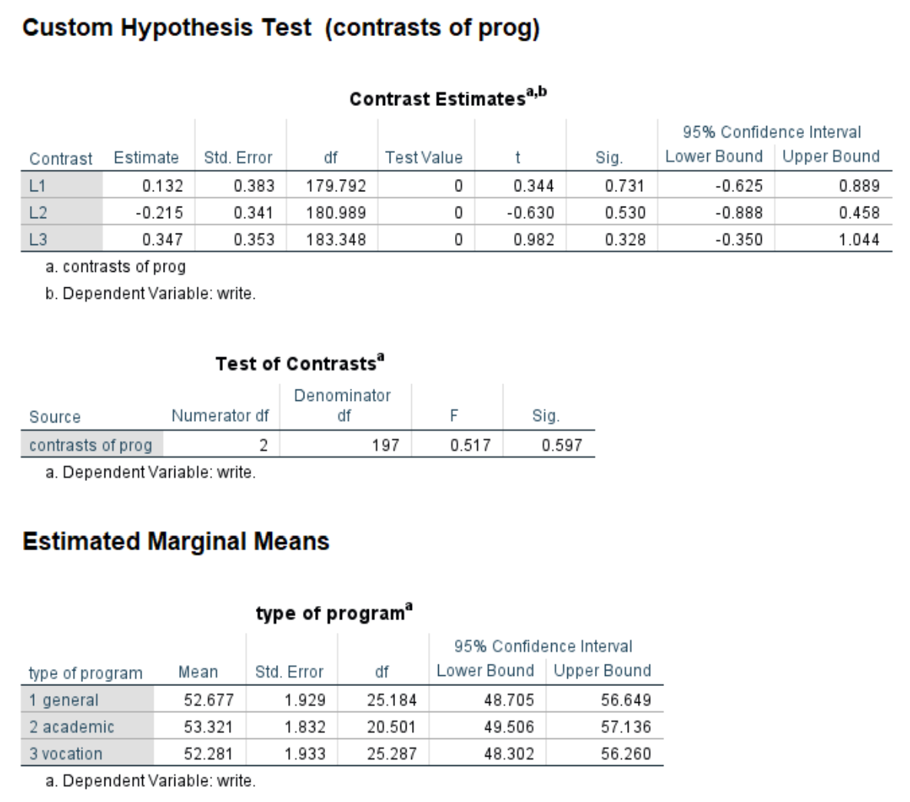
Output

Slide 32
Do you have any questions?

Slide 33
Saving variables to active dataset

Slide 34
Using the save subcommand
Use the save subcommand to include these in active dataset
Fixpred: fixed predicted values
Pred: predicted values
Resid: residuals
Sefixp: standard error of fixed predicted values
Sepred: standard error of predicted values
Dffixp: degrees of freedom of fixed predicted values
Dfpred: degrees of freed of predicted values

Slide 35
Using the save subcommand - continued
mixed write with read socst by female prog /fixed read socst female prog /random intercept socst | subject(cid) cov(un) /print = solution /save = fixpred(blue) pred(blup) sefixp(seblue) sepred(seblup) resid (resid1).
list cid id write blue blup seblue seblup resid1 /cases from 1 to 10.

Slide 36
Output
cid id write blue blup seblue seblup resid1
1 1 44 56.67 40.42 2.35 1.47 3.58
1 2 41 55.62 39.37 2.23 1.46 1.63
1 15 39 52.04 35.80 2.26 1.44 3.20
1 45 35 54.50 38.11 2.58 1.96 -3.11
1 51 36 54.45 38.18 2.22 1.64 -2.18
1 53 37 51.50 35.16 2.51 1.60 1.84
1 67 37 51.01 34.68 2.42 1.53 2.32
1 108 33 51.98 35.68 2.46 1.62 -2.68
1 133 31 48.12 31.77 2.30 1.77 -.77
1 153 31 53.35 37.19 2.24 1.99 -6.19
Number of cases read: 10 Number of cases listed: 10

Slide 37
Delete variables before rerunning model
Use delete variables before rerunning a different model with same variable names
delete variables blue blup seblue seblup resid1.
mixed write with read by female /fixed read female /random intercept socst | subject(cid) cov(un) /print = solution /save = fixpred(blue) pred(blup) sefixp(seblue) sepred(seblup) resid(resid1).

Slide 38
Do you have any questions?

Slide 39
Other topics

Slide 40
Amount of variance explained
No agreed upon method
See
Snijders and Bosker (2012) chapter 7
Singer and Willett (2003) pages 102-104
Rights and Sterba (2018)

Slide 41
Centering
Level 1: Group or grand
Level 2: Grand
Interpretation
More common in the past (HLM)
See Paccagnella (2006) for discussion

Slide 42
Testing model assumptions
Independence of observations (level 2)
Correct model specification – easier said than done!
Funtional form – linearity
Homoscedascity
Normality of residuals

Slide 43
More than two levels
Use multiple random subcommands showing nesting
mixed write with read by female
/fixed read female
/random intercept | subject(school)
/random intercept | subject(school*class)
/print = solution.

Slide 44
Imperfect hierarchies
Level 1 unit associated with more than one level 2 unit
Two level 2 identifiers that are not nested
mixed attain with vrq /fixed vrq /print = solution /random intercept | subject(pid) /random intercept | subject(sid).

Slide 45

Any questions??

Slide 46
References

Slide 47
References
De Leeuw, J. Centering in linear multilevel models. In Encyclopedia of Statistics in Behavioral Science. Everitt, B. S. and Howell, D. C., editors. volume 1, pages 247-249. http://onlinelibrary.wiley.com/doi/10.1002/0470013192.bsa085/pdf
Full ML v. Restricted ML http://www.ssicentral.com/hlm/help6/faq/Full_ML_vs_Restricted_ML.pdf
Gumedze, F. N. and Dunne, T. T. Paramter estimation and inference in the linear mixed model. Linear Algebra and its Applications, 435(8), 1920-1944. https://www.sciencedirect.com/science/article/pii/S002437951100320X
Harrell, Jr. F. E. Regression modeling strategies with applications to linear models, logistic and ordinal regression, and survival analysis, second edition. 2015. New York: Springer.
Heck, R. H., Thomas, S. L. and Tabata, L. N. (2014). Multilevel and Longitudinal Modeling with IBM SPSS, second edition. New York: Routledge.
Hedeker, D. Multilevel cross-classified and multi-membership models https://www.ihrp.uic.edu/files/CrossClassMultiMember-Hedeker2014.pdf
http://www.unc.edu/~dbauer/manuscripts/BauerSterba_appendix_SPSS.pdf
IBM Support: Denominator degrees of freedom for fixed effects in SPSS mixed
http://www.unc.edu/~dbauer/manuscripts/BauerSterba_appendix_SPSS.pdf
Lüdtke, O. Marsh, H. W., Robitzsch, A., Trautwein, U., Asparouhov, T., Muthén, B. (2008). The multilevel latent covariate model: a new, more reliable approach to group-level effects in contextual studies. Psychological Methods, 13(3):203-29. doi: 10.1037/a0012869.

Slide 48
References - continued
Kelly, J., Evans, M. D. R., Lowman, J. and Kykes, V. (2017). Group-mean-centering independent variables in multilevel models is dangerous. Quality and Quantity, 51(1), 261-283. https://link.springer.com/article/10.1007/s11135-015-0304-z
Kenny, D. A. and Judd, C. M. (1986). Consequences of violating the independence assumption in analysis of variance. Psychological Bulletin, 99(3), 422-431. http://psycnet.apa.org/record/1986-21031-001
Keselman, H. J., Algina, J., Kowalchuk, R. K. and Wolfinger, R. D. A comparison of two approaches for selecting covariance structures in the analysis of repeated measures. https://pdfs.semanticscholar.org/1d6c/f16816f05b6a80fa466111dea22b680f596c.pdf
Kincaid, C. Guidelines for Selecting the covariance structure in mixed model analysis. http://www2.sas.com/proceedings/sugi30/198-30.pdf
Koo, T. K. and Li, M. Y. (2016). A guideline for selecting and reporting intraclass correlation coefficients for reliability research. Journal of Chiropractic Medicine, 15(2), 155-163. https://www.ncbi.nlm.nih.gov/pmc/articles/PMC4913118/
Leyland, A. H. A review of multilevel modelling in SPSS (2004). https://www.bristol.ac.uk/media-library/sites/cmm/migrated/documents/reviewspss.pdf
Muthen, B. O. and Satorra, A. (1995). Complex sample data in structural equation modeling. Sociological Methodology, vol. 25, pages 267-316. http://www.jstor.org/stable/271070
Paccagnella, O. Centering or not centering in multilevel models? The role of the group mean and the assessment of group effects. (2006). Evaluation Review, 30(1), 66-85. https://www.ncbi.nlm.nih.gov/pubmed/16394187

Slide 49
References - continued
Raudenbush, S. W. and Bryk, A. S. Hierarchical Linear Models: Applications and Data Analysis Methods, Second Edition. (2002). Thousand Oaks, CA: Sage Publications.
Rights, J. D. and Sterba, S. K. (2019). Quantifying explained variance in multilevel models: An integrative framework for defining R-squared measures. Psycholocial Methods, 24(3), 309-338.
Robinson, G. K. That BUP is a good thing: The estimation of random effects. (1991). Statistical Science, 6(1), 152. https://projecteuclid.org/euclid.ss/1177011926
Scariano, S. M. and Davenport, J. M. The effects of violations of independence assumptions in the one-way ANOVA. (1987). The American Statistician, 41(2), 123-129. http://www.jstor.org/stable/2684223
Schunck, R. Cluster size and aggregated level 2 variables in multilevel models: A cautionary note. (2016). Methods, data ana analyses. Vol.10(1): 97-108. DOI: 10.12758/mda.2016.005
Singer, J. D. and Willett, J. B. Applied longitudinal data analysis: Modeling change and event occurrence. 2003. New York: Oxford University Press.
Snijders, T. A. B. and Bosker, R. J. Multilevel analysis: An introduction to basic and advanced multilevel modeling, second edition. 2012. Thousand Oaks, CA: Sage Publications.
Whittaker, T. A. and Furlow, Carolyn F. (2009). The Comparison of Model Selection Criteria When Selecting Among Competing Hierarchical Linear Models. Journal of Modern Applied Statistical Methods. 8(1), 173-193. https://pdfs.semanticscholar.org/8b74/fb3018a6d65d9fdb63c1326f4fa311ed35f3.pdf
The Unstructured Covariance Matrix: When It Does and Doesn’t Work https://www.theanalysisfactor.com/unstructured-covariance-matrix-when-it-does-and-doesn%E2%80%99t-work/

Slide 50

Thank you!

