Slide 1
Introduction to stata
UCLA OARC STATISTICAL METHODS AND DATA ANALYTICS

Slide 2
Purpose of the seminar
An introduction to using Stata for data analysis
Topics include
Stata as a data analysis software package
Navigating Stata
Data import
Exploring data
Data visualization
Data management
Basic statistical analysis
Outputting to Word and Excel

Slide 3
STATA

Slide 4
What is Stata?
Stata is an easy to use but powerful data analysis software package that features strong capabilities for:
Statistical analysis
Data management and manipulation
Data visualization
Stata offers a wide array of statistical tools that include both standard methods and newer, advanced methods, as new releases of Stata are distributed annually

Slide 5
Why use Stata?
Command syntax is very compact
Syntax is consistent across commands
Competitive with other software regarding variety of statistical tools
Excellent documentation
Exceptionally strong support for
Econometric models and methods
Complex survey data analysis tools

Slide 6
Versions of Stata *
Flavors of Stata are BE SE and MP
The main difference is the size of dataset allowed and speed of processing
BE ≤ SE ≤ MP
For more information click here https://www.stata.com/products/which-stata-is-right-for-me/
See our webpage for more information about using Stata at UCLA

Slide 7
Navigating Stata’s interface
cd change working directory

Slide 8
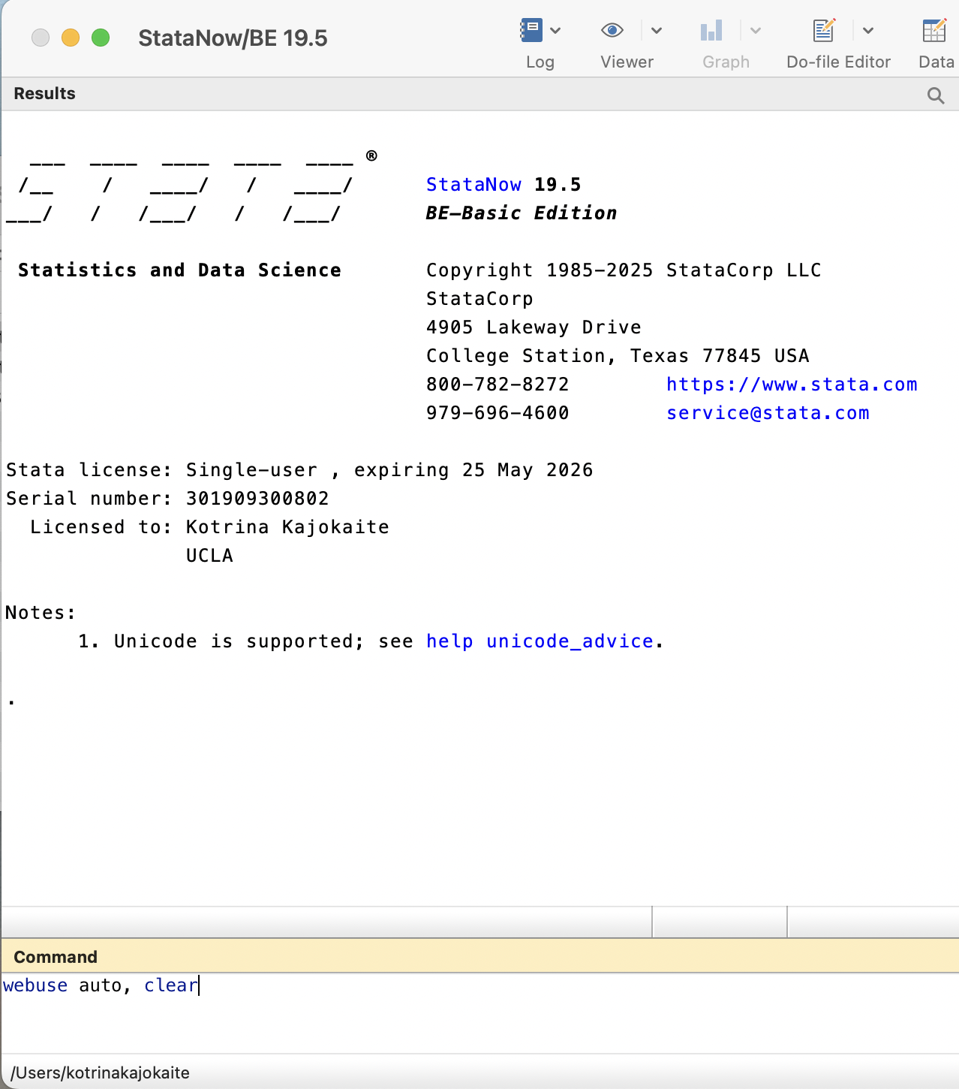
Command window
You can enter commands directly into the Command window
This command will load a Stata dataset over the internet
Go ahead and enter the command

Slide 9
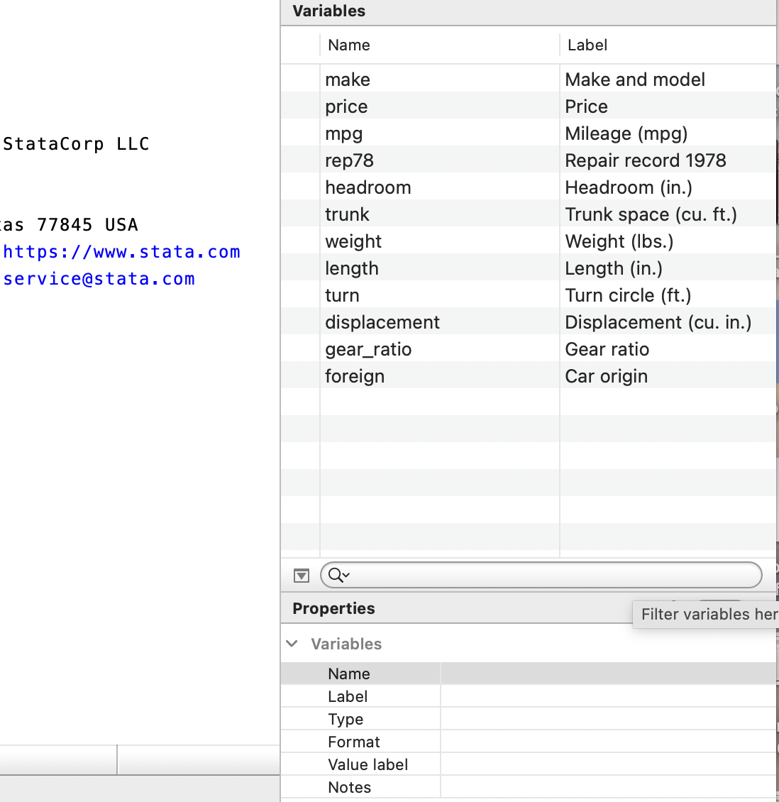
Variables window
Once data are loaded, variables and their labels appear in the Variable window
Clicking on a variable name will cause its description to appear in the Properties Window
Double-clicking a variable name will cause it to appear in the Command Window

Slide 10
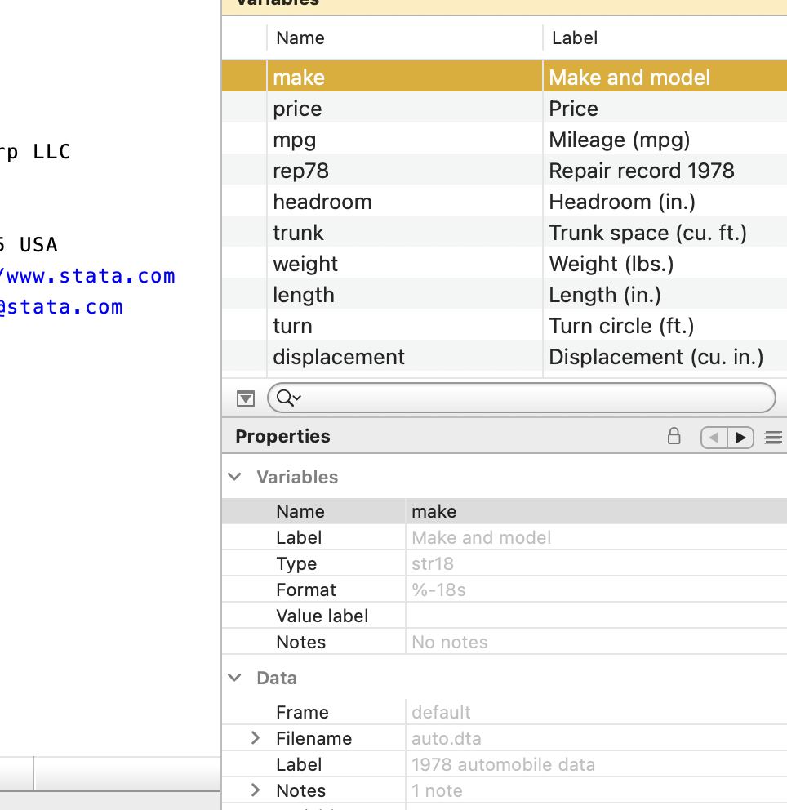
Properties window
The Variables section lists information about selected variable
The Data section lists information about the entire dataset

Slide 11
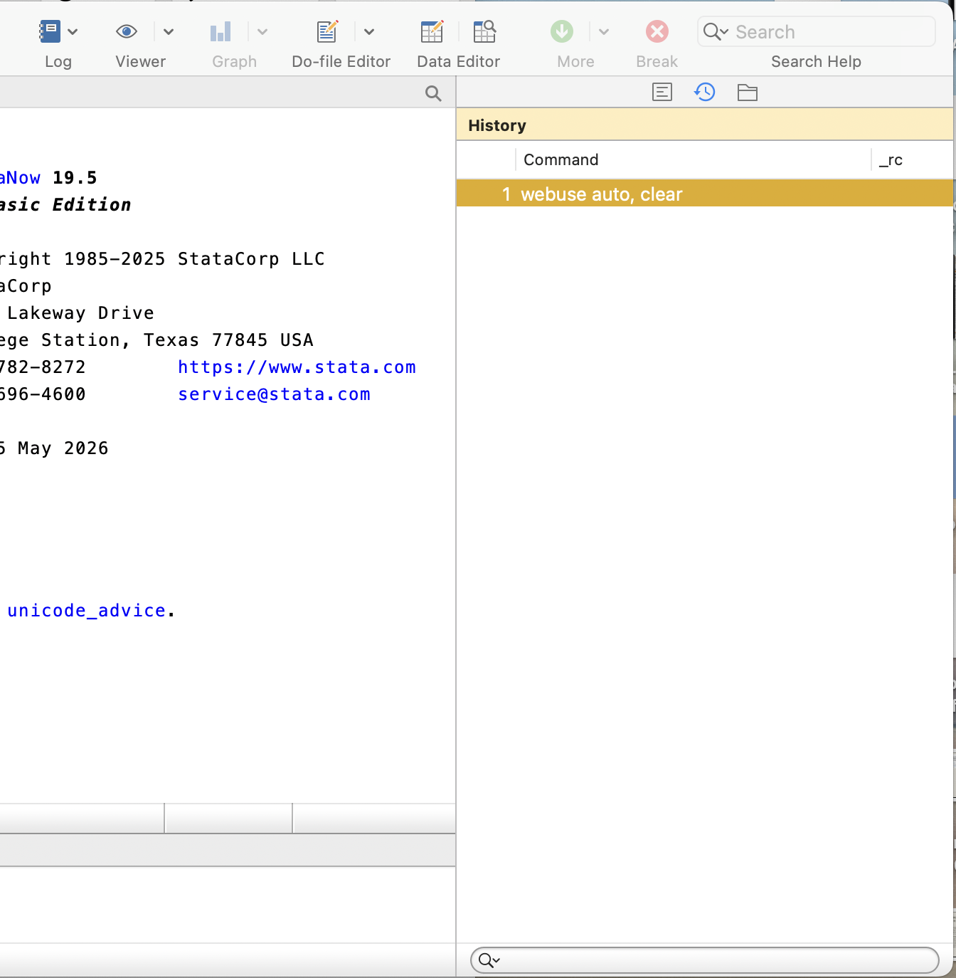
History window
The History window lists previously issued commands
Successful commands will appear black
Unsuccessful commands will appear red
Double-click a command to run it again
Hitting PageUp will also recall previously used commands (Fn + PageUp on a Mac)

Slide 12
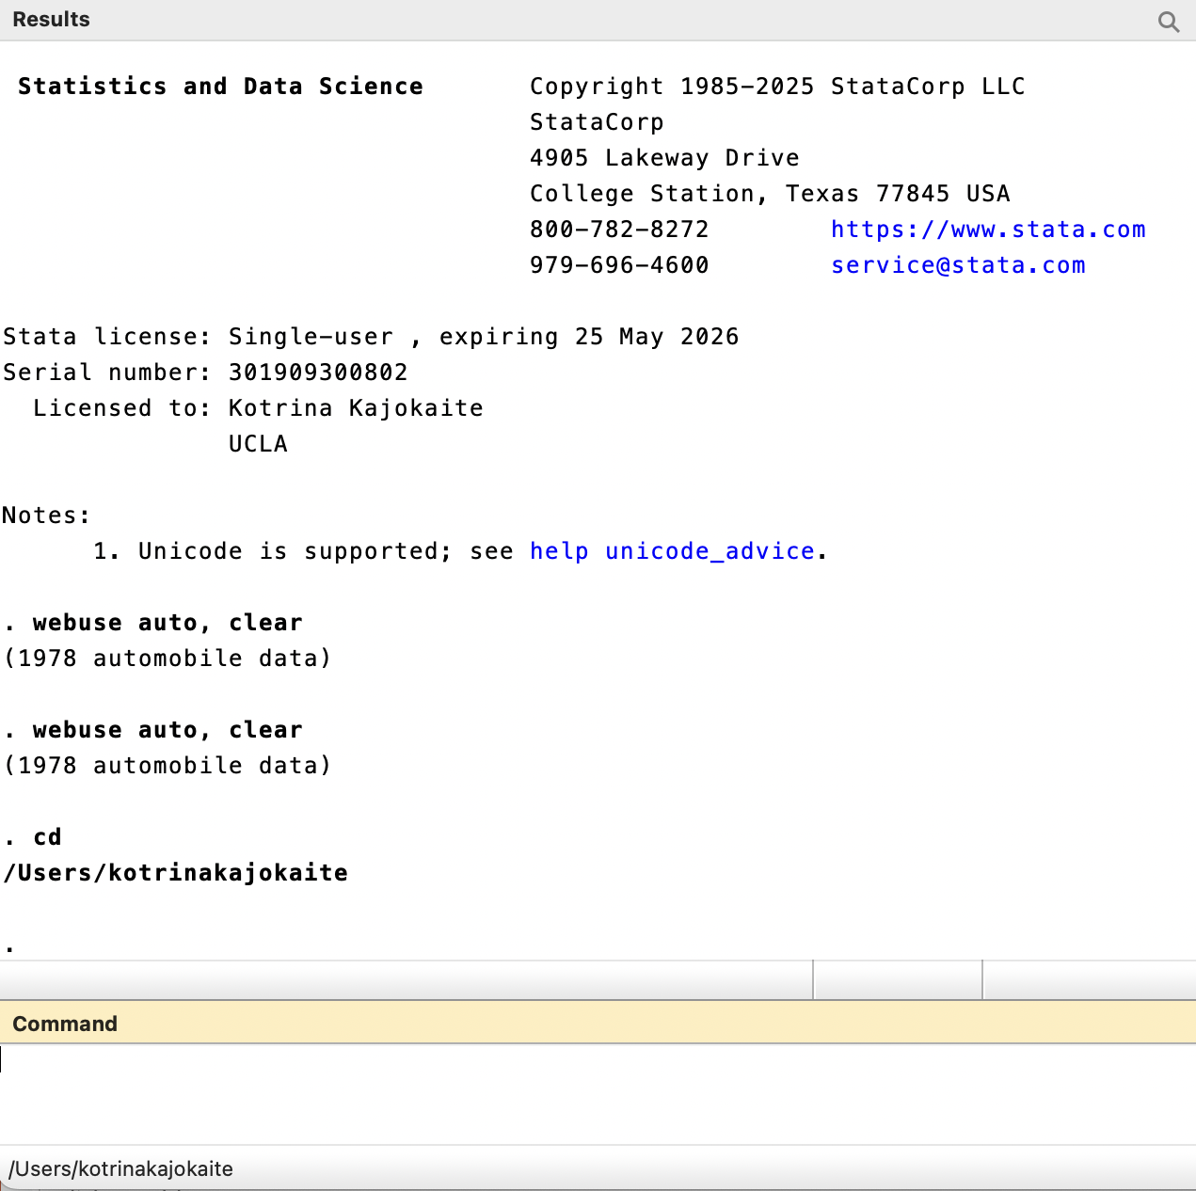
Working directory
At the bottom left of the Stata window is the address of the working directory
Stata will load from and save files to here, unless another directory is specified
Use the command cd to change the working directory

Slide 13
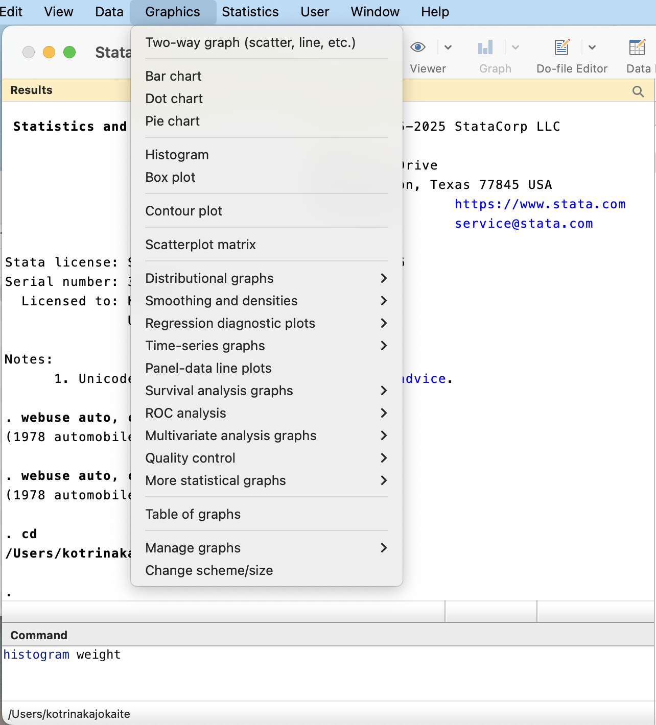
Stata menus
Typically Stata users use syntax to run commands rather than point-and-click menus
Nevertheless, Stata provides menus to run most of its data management, graphical, and statistical commands
Example: two ways to create a histogram

Slide 14
Do-files
doedit open do-file editor

Slide 15
Stata Do-files
Text files where users write, save, and run sequences of commands
Ensure reproducibility
Facilitate debugging and editing
We recommend always using a do-file when using Stata
The file extension .do is used for do-files

Slide 16
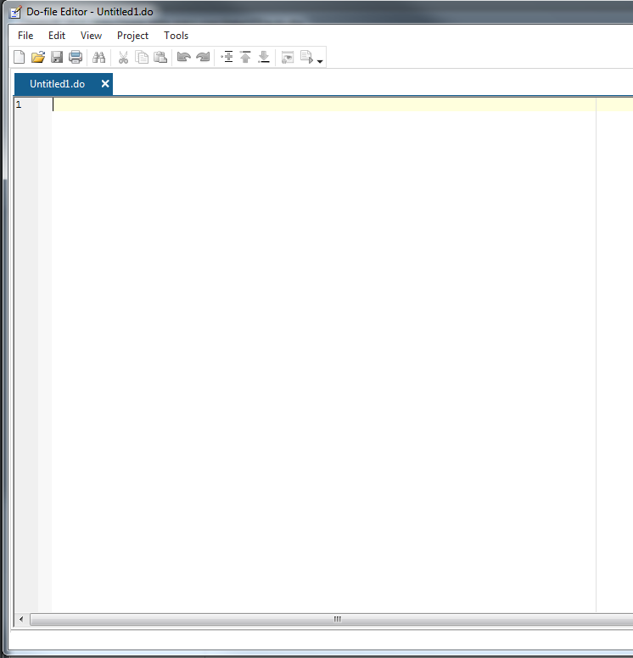
Opening the do-file editor
Use the command doedit to open the do-file editor
Or click on the pencil and paper icon on the toolbar

Slide 17
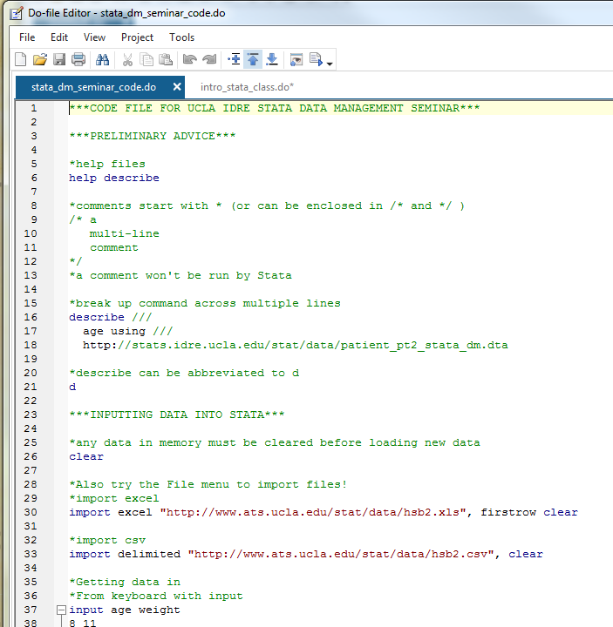
Syntax highlighting *
The do-file editor colors Stata commands blue
Comments, which are not executed, are usually preceded by * and are colored green
Words in quotes (file names, string values) are colored “red”
As of Stata 16, tab can be used to auto-complete Stata commands and previously typed words

Slide 18
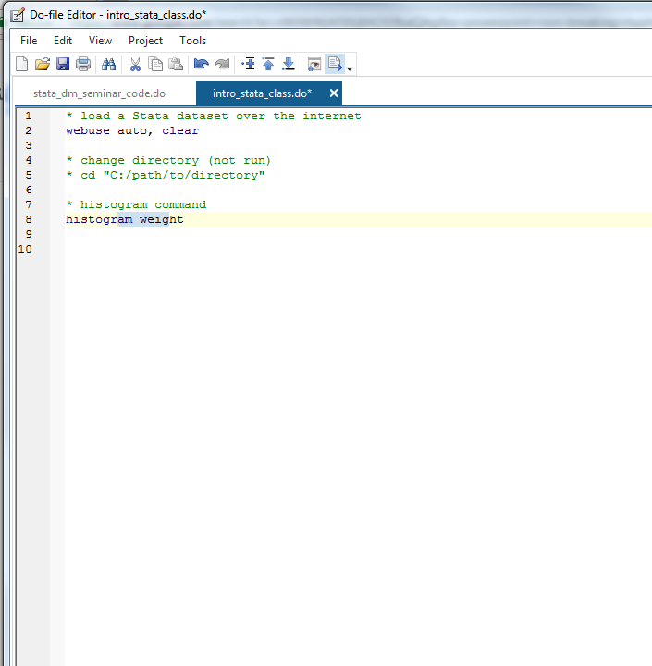
Running commands from the do-file
To run a command from the do-file:
Highlight part or all of the command,
Hit Ctrl‑D (Mac: Shift+Cmd+D) or click the “Execute(do)” icon, the rightmost icon on the do-file editor toolbar
Multiple commands can be selected and executed

Slide 19
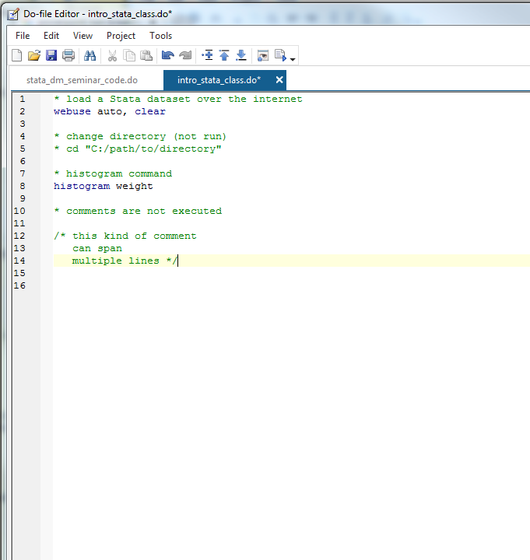
Comments
Comments are not executed, so provide a way to document the do-file
Comments are either preceded by * or surrounded by /* and */
Comments will appear in green in the do-file editor

Slide 20
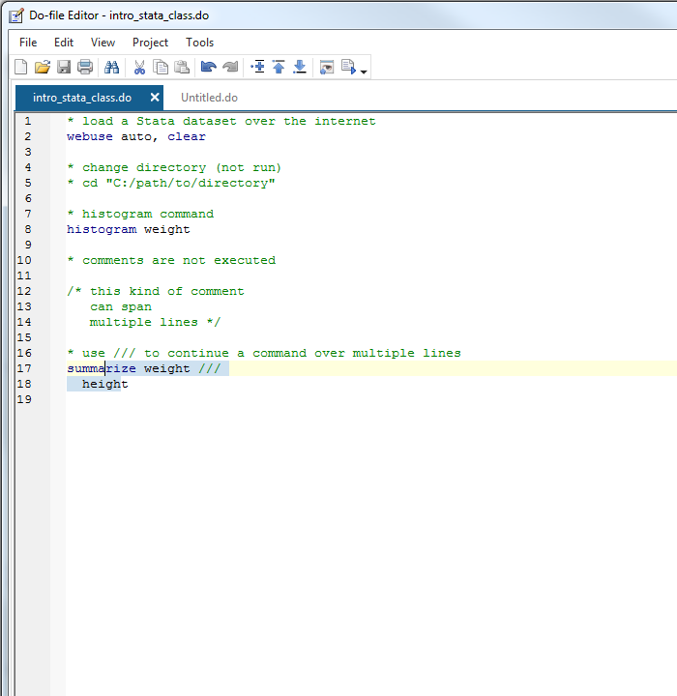
Long lines in do-files *
As of Stata 16 long commands automatically wrap
In older versions, to extend commands over multiple lines use /// at the end of each line except for the last
Make sure to put a space before ///
When executing, highlight each line in the command(s)

Slide 21
Importing data
use load Stata dataset
save save Stata dataset
clear clear dataset from memory
import import Excel dataset
excel
import import delimited data (csv)
delimited

Slide 22
Stata .dta files
Data files stored in Stata’s format use the extension .dta
Remember: code is written in “do-files,” which usually have a .do extension
Double clicking on a .dta file in Windows will open the data in a new instance of Stata (not in the current instance)
Be careful of having multiple Statas open

Slide 23
Loading and saving .dta files
use loads Stata .dta files
.dta files can be loaded from a hard drive or over the internet (using a web address)
save stores data in Stata’s .dta format
The replace overwrites an existing file with the same name (without replace, Stata won’t save if the file exists)
The extension .dta can be omitted when using use and save
* read from hard drive; do not execute
use "C:/path/to/myfile.dta“
* load data over internet
use https://stats.idre.ucla.edu/stat/data/hs0
* save data, replace if it exists
save hs0, replace

Slide 24
Clearing memory
By default, Stata will only hold one data set in memory at a time.
If the data are altered it in any way, we must clear these data from memory before loading in new data.
All data import commands have a clear option that clears memory before loading the new dataset.
* clear data from memory
clear
* load data but clear memory first
Use https://stats.idre.ucla.edu/stat/data/hs0, clear

Slide 25
Frames *
As of Stata 16, multiple datasets can be loaded simultaneously with the frame suite of commands.
frame create newframename creates a location in memory called newframename to store a dataset.
frame newframename: command can then be used to perform command on the data stored in newframename.
frame dir lists the current data frames.
Commands not preceded by frame newframename: will be performed on the data in the default frame.
* create data frame called data2
frame create data2
* load nhanes2 data into data2 frame
frame data2: webuse nhanes2
* describe height and weight in nhanes2 data
frame data2: describe height weight
* look at data frames
frame dir

Slide 26
Importing Excel data sets *
Stata can read in data sets stored in many other formats
The command import excel is used to import Excel data
An Excel filename is required (with path, if not located in working directory) after the keyword using
Use the sheet() option to open a particular sheet
Use the firstrow option if variable names are on the first row of the Excel sheet
* import excel file; change path below before executing
import excel using "C:\path\myfile.xlsx", sheet(“mysheet") firstrow clear

Slide 27
Importing .csv data sets *
Comma-separated values (.csv) files are also commonly used to store data
Use import delimited to read in .csv files (and files delimited by other characters such as tab or space)
Syntax and options are very similar to import excel
But no need for firstrow option (first row is assumed to be variable names in .csv files)
* import csv file; change path below before executing
import delimited using "C:\path\myfile.csv", clear

Slide 28
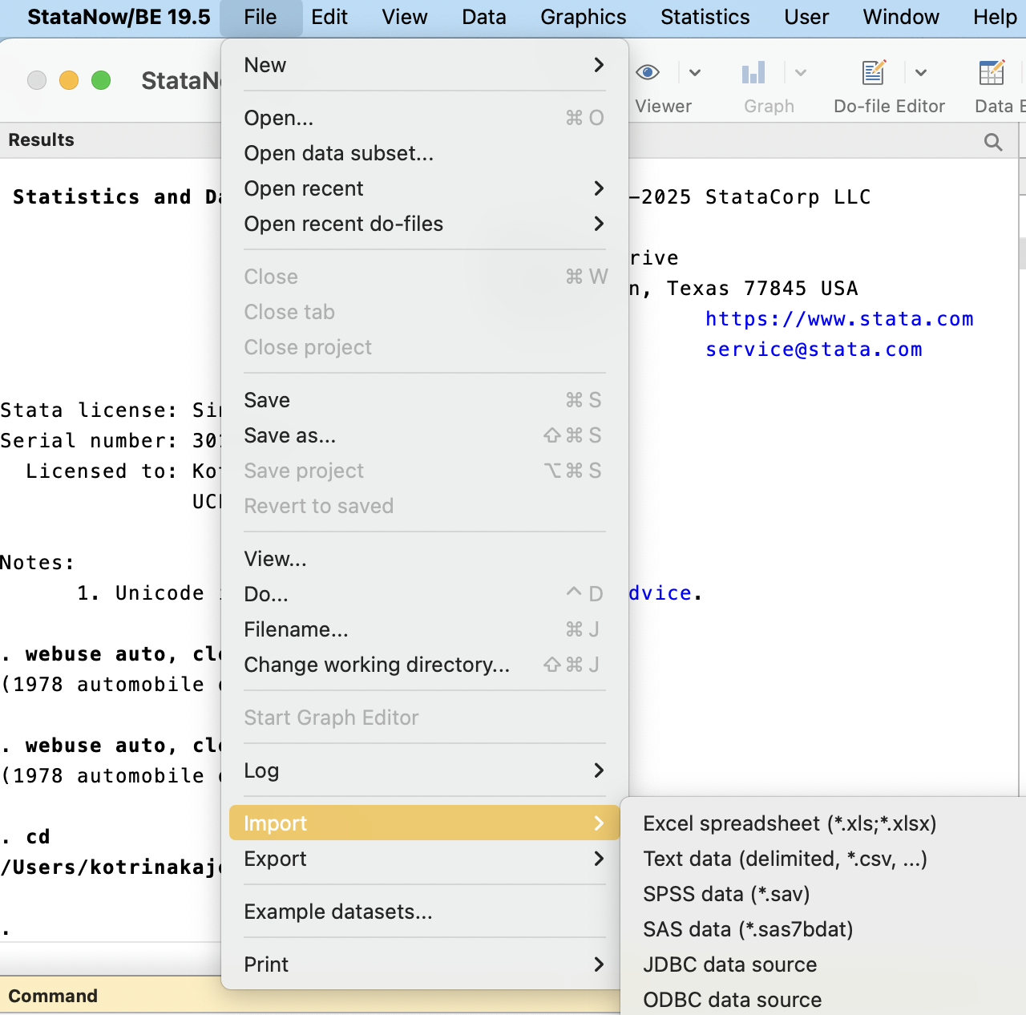
Using the menu to import EXCEL and .csv data
Because path names can be very long and many options are often needed, menus are often used to import data
Select File -> Import and then either “Excel spreadsheet” or “Text data(delimited,*.csv, …)”

Slide 29
Preparing data for import
To get data into Stata cleanly, make sure the data in your Excel file or .csv file have the following properties
Rectangular
Each column (variable) should have the same number of rows (observations)
No graphs, sums, or averages in the file
Missing data should be left as blank fields
Missing data codes like -999 are ok too (see command mvdecode)
Variable names should contain only alphanumeric characters or _ or .
Make as many variables numeric as possible
Many Stata commands will only accept numeric variables

Slide 30
Help files and Stata syntax
help command open help page for command

Slide 31
Help files
Precede a command name (and certain topic names) with help to access its help file.
*open help file for command summarize
help summarize

Slide 32
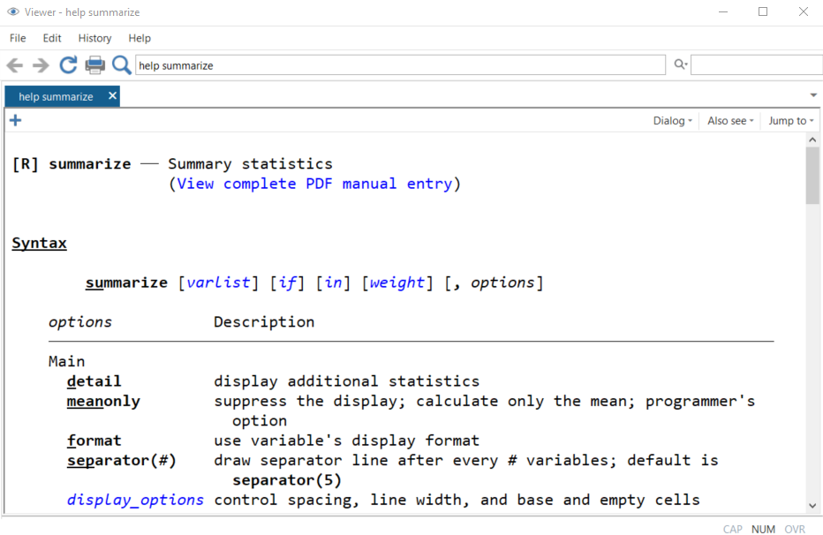
Help file: title section
command name and a brief description
link to a .pdf of the Stata manual entry for summarize
manual entries include details about methods and formulas used for estimation commands, and thoroughly explained examples.

Slide 33
Help file: syntax section
various uses of command and how to specify them
bolded words are required
the underlined part of the command name is the minimal abbreviation of the command required for Stata to understand it
We can use su for summarize
italicized words are to be substituted by the user
e.g. varlist is a list of one or more variables
[Bracketed] words are optional (don’t type the brackets)
a comma , is almost always used to initiate the list of options

Slide 34
Help file: options section
Under the syntax section, we find the list of options and their description
Most Stata commands come with a variety of options that alter how they process the data or how they output
Options will typically follow a comma
Options can also be abbreviated

Slide 35
Help file: syntax section
Summary statistics for all variables
summarize
Summary statistics for just variables read and write (using abbreviated command)
su read write
Provide additional statistics for variable read
su read, detail

Slide 36
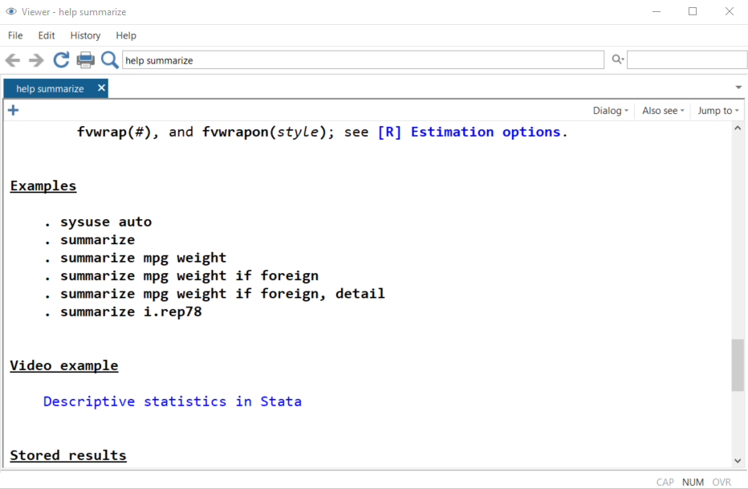
Help file : the rest
Below options are Examples of using the command, including video examples! (occasionally)
Click on “Also see” to open help files of related commands

Slide 37
Getting to know your data

Slide 38
Viewing data
browse open spreadsheet of data
list print data to Stata console

Slide 39
Seminar dataset
We will use a dataset consisting of 200 observations (rows) and 13 variables (columns)
Each observation is a student
Variables
Demographics
gender(1=male, 2=female), race, ses(low, middle, high), etc.
Academic test scores
read, write, math, science, socst
Go ahead and load the dataset!
* seminar dataset
use https://stats.idre.ucla.edu/stat/data/hs0, clear

Slide 40
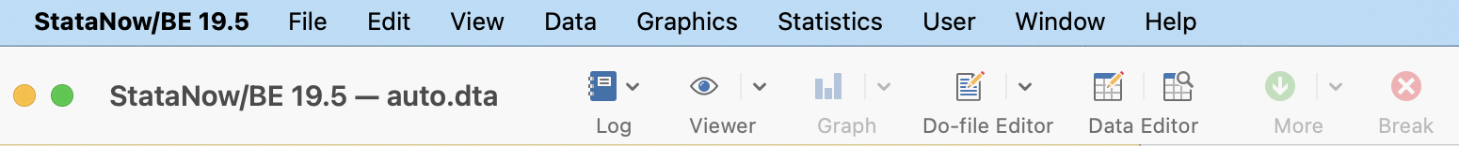
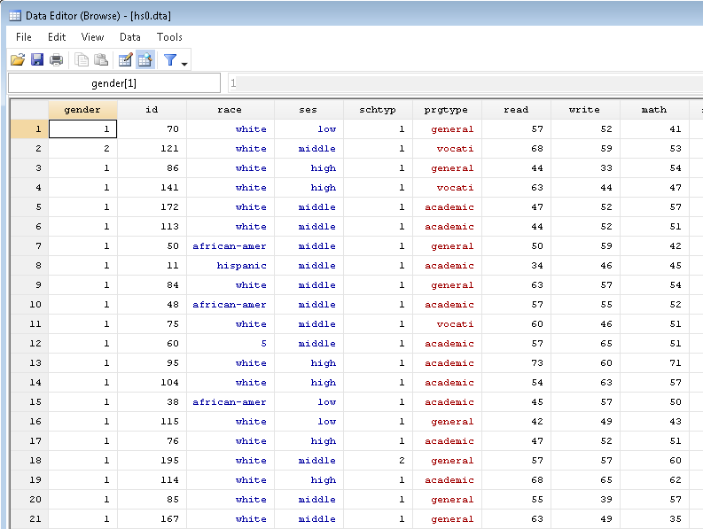
Browsing the dataset
Once the data are loaded, we can view the dataset as a spreadsheet using the command browse
The magnifying glass with spreadsheet icon also browses the dataset
Black columns are numeric, red columns are strings, and blue columns are numeric with string labels

Slide 41
Listing observations *
The list command prints observation to the Stata console
Simply issuing “list” will list all observations and variables
Not usually recommended except for small datasets
Specify variable names to list only those variables
We will soon see how to restrict to certain observations
* list read and write for first 5 observations
li read write in 1/5
+--------------+
| read write |
|--------------|
1. | 57 52 |
2. | 68 59 |
3. | 44 33 |
4. | 63 44 |
5. | 47 52 |
+--------------+

Slide 42
Selecting observations
in select by observation number
if select by condition

Slide 43
Selecting by observation number with in *
Many commands are run on a subset of the data set observations
in selects by observation (row) number
Syntax
in firstobs/lastobs
30/100 – observations 30 through 100
Negative numbers count from the end
“L” means last observation
-10/L – tenth observation from the last through last observation
* list science for last 3 observations
li science in -3/L
+---------+
| science |
|---------|
198. | 55 |
199. | 58 |
200. | 53 |
+---------+

Slide 44
Selecting by condition with if
if selects observations that meet a certain condition
gender == 1 (male)
math > 50
if clause usually placed after the command specification, but before the comma that precedes the list of options
* list gender, ses, and math if math > 70
with clean output
li gender ses math if math > 70, clean
gender ses math
13. 1 high 71
22. 1 middle 75
37. 1 middle 75
55. 1 middle 73
73. 1 middle 71
83. 1 middle 71
97. 2 middle 72
98. 2 high 71
132. 2 low 72
164. 2 low 72

Slide 45
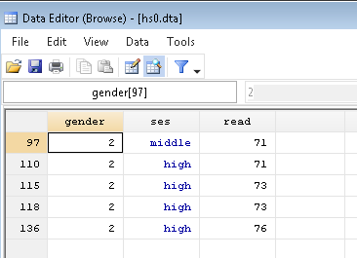
Stata logical and relational operators
== equal to
double equals used to check for equality
<, >, <=, >= greater than, greater than or equal to, less than, less than or equal to
! Not
!= not equal
& and
| or
* browse gender, ses, and read
* for females (gender=2) who have read > 70
browse gender ses read if gender == 2 & read > 70

Slide 46
Exercise 1
Load the hs0 dataset using the code:
use https://stats.idre.ucla.edu/stat/data/hs0, clear
Use the browse command to examine the ses values for students with write score greater than 65
Then, use the help file for the browse command to rewrite the command to examine the ses values without labels.
Answers to exercises are at the bottom of the seminar do-file

Slide 47
Exploring data
codebook inspect variable values
summarize summarize distribution
tabulate tabulate frequencies

Slide 48
Explore your data before analysis
Take the time to explore your data set before embarking on analysis
Get to know your sample with quick summaries of variables
Demographics of subjects
Distributions of key variables
Look for possible errors in variables

Slide 49
Use codebook to inspect variable values
* inspect values of variables read gender and prgtype
codebook read gender prgtype
-----------------------------------------------------------------------------------------------------
read reading score
-----------------------------------------------------------------------------------------------------
type: numeric (float)
range: [28,76] units: 1
unique values: 30 missing .: 0/200
mean: 52.23
std. dev: 10.2529
percentiles: 10% 25% 50% 75% 90%
39 44 50 60 67
-----------------------------------------------------------------------------------------------------
gender (unlabeled)
-----------------------------------------------------------------------------------------------------
type: numeric (float)
range: [1,2] units: 1
unique values: 2 missing .: 0/200
tabulation: Freq. Value
91 1
109 2
Use codebook, which provides the following:
For all variables
number of unique and missing values
For numeric variables
range, quantiles, means and standard deviation for continuous variables
frequencies for discrete variables
For string variables
frequencies
warnings about leading and trailing blanks

Slide 50
Summarizing continuous variables
The summarize command calculates a variable’s:
number of non-missing observations
mean
standard deviation
min and max
* summarize continuous variables
summarize read math
Variable | Obs Mean Std. Dev. Min Max
-------------+---------------------------------------------------------
read | 200 52.23 10.25294 28 76
math | 200 52.645 9.368448 33 75
* summarize read and math for females
summarize read math if gender == 2
Variable | Obs Mean Std. Dev. Min Max
-------------+---------------------------------------------------------
read | 109 51.73394 10.05783 28 76
math | 109 52.3945 9.151015 33 72

Slide 51
Detailed summaries *
Use the detail option with summary to get more estimates that characterize the distribution, such as:
percentiles
variance
skewness
kurtosis
* detailed summary of read for females
summarize read if gender == 2, detail
reading score
-------------------------------------------------------------
Percentiles Smallest
1% 34 28
5% 36 34
10% 39 34 Obs 109
25% 44 35 Sum of Wgt. 109
50% 50 Mean 51.73394
Largest Std. Dev. 10.05783
75% 57 71
90% 68 73 Variance 101.16
95% 68 73 Skewness .3234174
99% 73 76 Kurtosis 2.500028

Slide 52
Tabulating frequencies of categorical variables
tabulate (often shortened to tab) displays counts of each value of a variable
useful for variables with a limited number of levels
For variables with labeled values, use the nolabel option to display the underlying numeric values
* tabulate frequencies of ses
tabulate ses
ses | Freq. Percent Cum.
------------+-----------------------------------
low | 47 23.50 23.50
middle | 95 47.50 71.00
high | 58 29.00 100.00
------------+-----------------------------------
Total | 200 100.00
* remove labels
tab ses, nolabel
ses | Freq. Percent Cum.
------------+-----------------------------------
1 | 47 23.50 23.50
2 | 95 47.50 71.00
3 | 58 29.00 100.00
------------+-----------------------------------
Total | 200 100.00

Slide 53
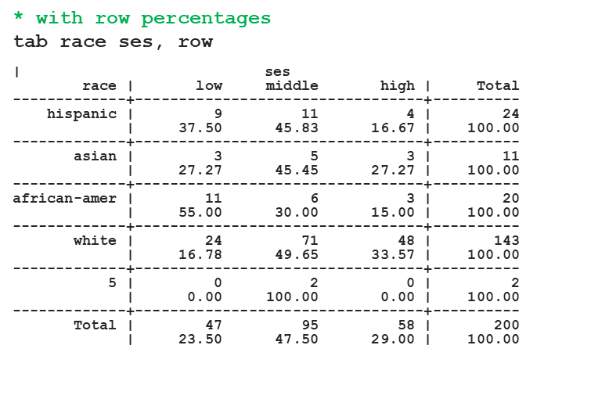
Two-way tabulations
tabulate can also calculate the joint frequencies of two variables
Use the row and col options to display row and column percentages
We may have found an error in a race value (5?)

Slide 54
Exercise 2
Use the tab command to determine the numeric code for “Asians” in the race variable
Then use summarize to estimate the mean of the variable science for Asians

Slide 55
Data visualization
histogram histogram
graph box boxplot
scatter scatter plot
graph bar bar plots
twoway layered graphics

Slide 56
Data visualization
Visualizing data helps reveal patterns, trends, and relationships.
Graphs can be used to explore your data, to familiarize yourself with distributions and associations in your data
Graphs can also be used to present the results of statistical analysis

Slide 57
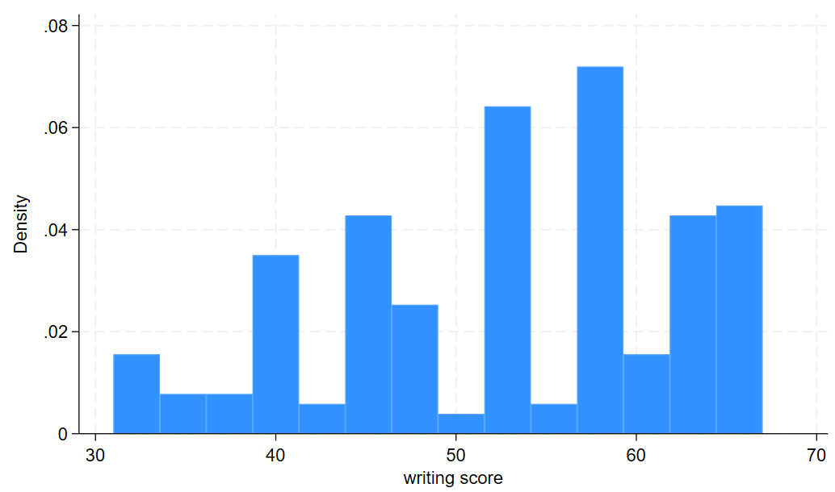
Histograms
Histograms plot distributions of variables by displaying counts (or density) of values that fall into various intervals of the variable
*histogram of write
histogram write

Slide 58
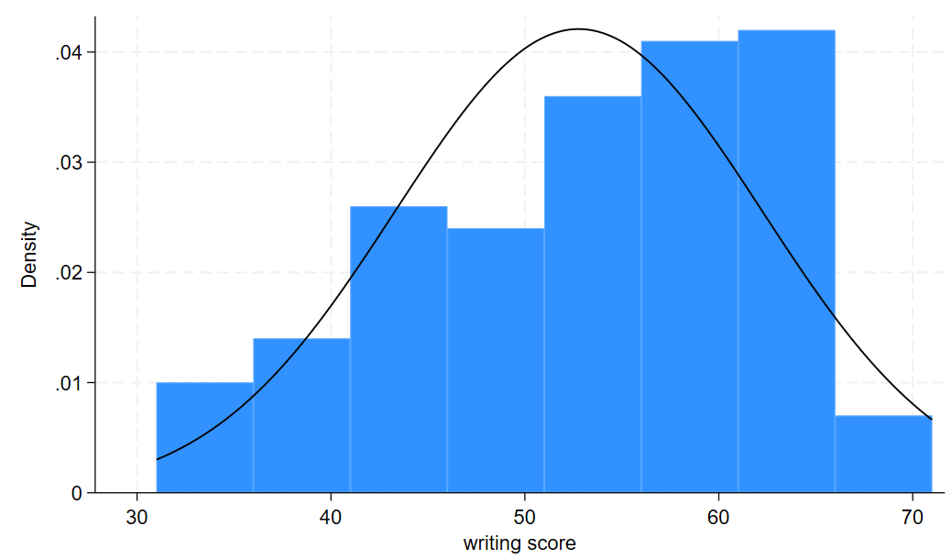
histogram options *
Use the option normal with histogram to overlay a theoretical normal density
Use the width() option to specify interval width
* histogram of write with normal density and intervals of length 5
hist write, normal width(5)

Slide 59
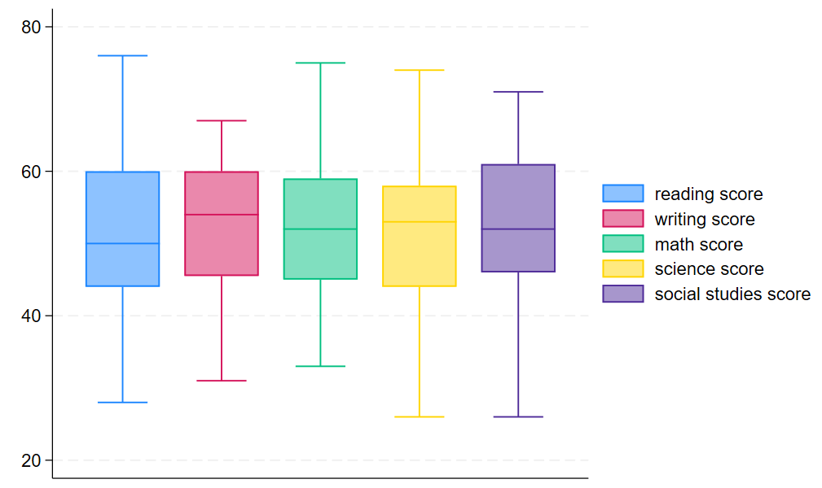
Boxplots *
Boxplots are another popular option for displaying distributions of continuous variables
They display the median, the interquartile range, (IQR) and outliers (beyond 1.5*IQR)
You can request boxplots for multiple variables on the same plot
* boxplot of all test scores
graph box read write math science socst

Slide 60
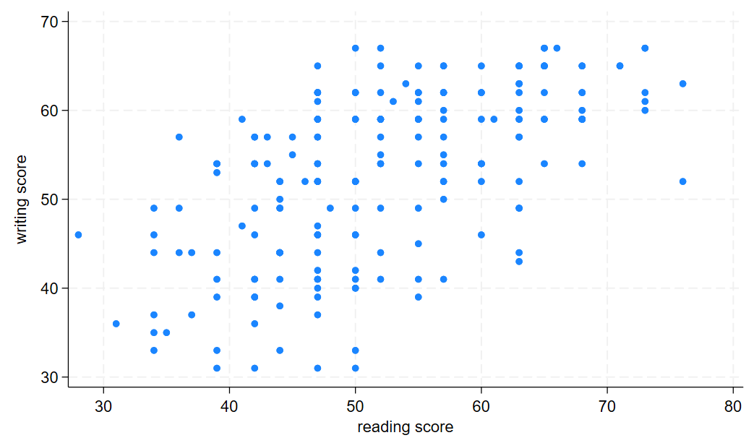
Scatter plots
Explore the relationship between two continuous variables with a scatter plot
The syntax scatter var1 var2 will create a scatter plot with var1 on the y-axis and var2 on the x-axis
* scatter plot of write vs read
scatter write read

Slide 61
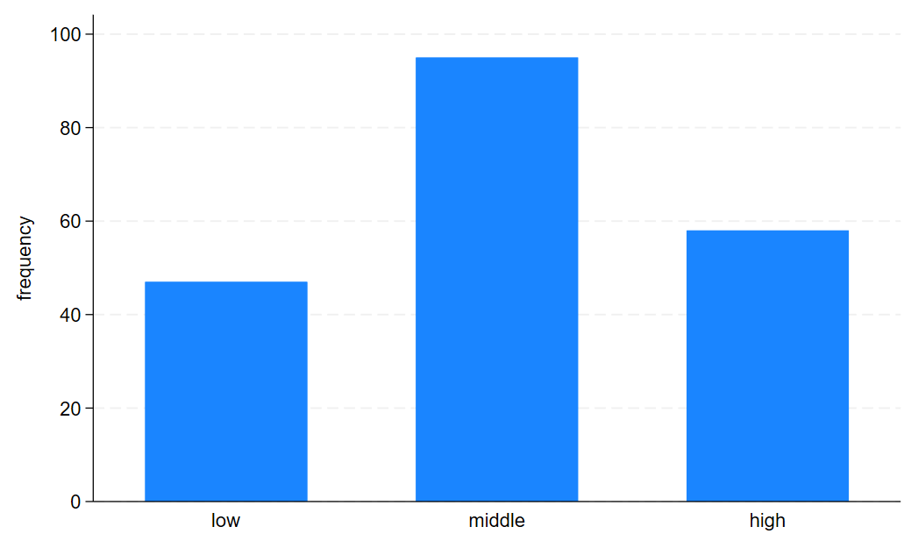
Bar graphs to visualize frequencies *
Bar graphs are often used to visualize frequencies
graph bar produces bar graphs in Stata
its syntax is a bit tricky to understand
For displays of frequencies (counts) of each level of a variable, use this syntax:
graph bar (count), over(variable)
* bar graph of count of ses
graph bar (count), over(ses)

Slide 62
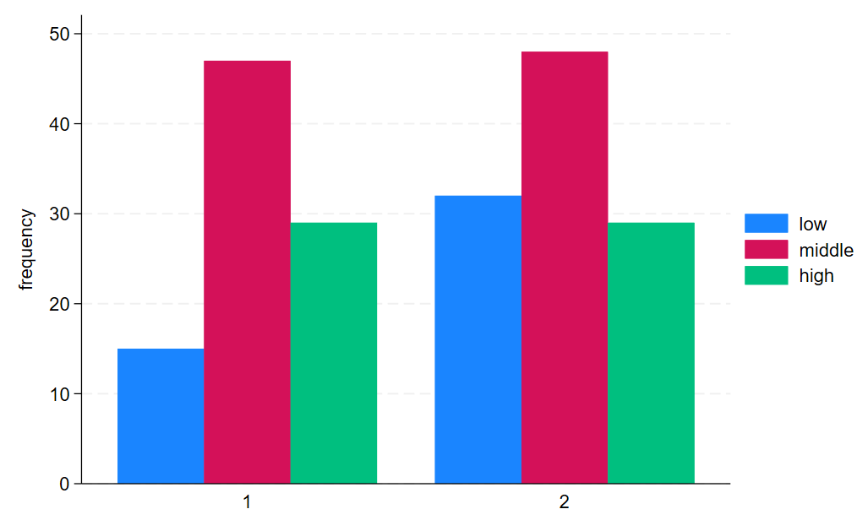
Two-way bar graphs *
Multiple over(variable)options can be specified
The option asyvars will color the bars by the first over() variable
* frequencies of gender by ses
* asyvars colors bars by ses
graph bar (count), over(ses) over(gender) asyvars

Slide 63
Two-way, layered graphics
The Stata graphing command twoway produces layered graphics, where multiple plots can be overlayed on the same graph
Each plot should involve a y-variable and an x-variable that appear on the y-axis and x-axis, respectively
Syntax (generally): twoway (plottype1 yvar xvar) (plottype2 yvar xvar)…
plottype is one of several types of plots available to twoway, and yvar and xvar are the variables to appear on the y-axis and x-axis
See help twoway for a list of the many plottypes available

Slide 64
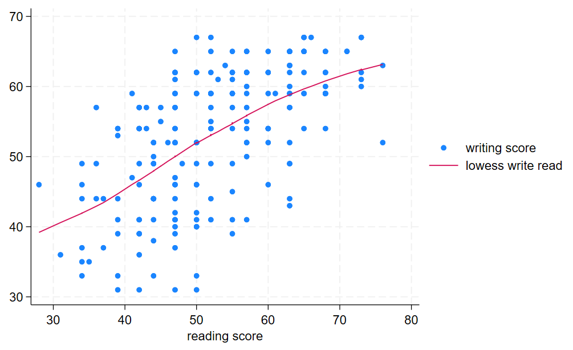
Layered graph example 1
Layered graph of scatter plot and lowess plot (best fit curve)
* layered graph of scatter plot and lowess curve
twoway (scatter write read) (lowess write read)

Slide 65
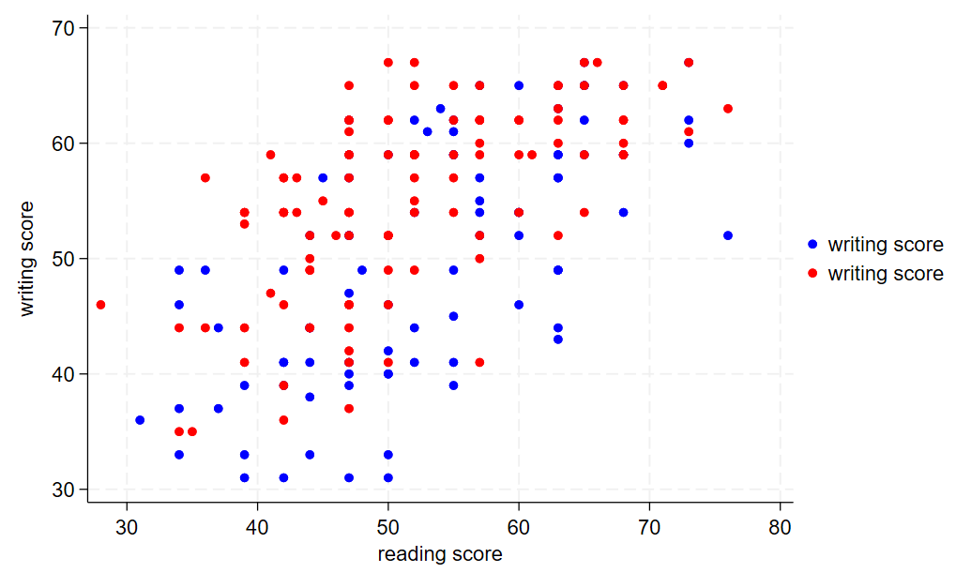
Layered graph example 2*
You can also overlay separate plots by group to the same graph with different colors
Use if to select groups
the mcolor() option controls the color of the markers
* layered scatter plots of write and read
* colored by gender
twoway (scatter write read if gender == 1, mcolor(blue)) ///
(scatter write read if gender == 2, mcolor(red))

Slide 66
Exercise 3
Use the scatter command to create a scatter plot of math on the x-axis vs write on the y-axis
Use the help file for scatter to change the shape of the markers to triangles.

Slide 67
data management

Slide 68
Creating, transforming, and labeling variables
generate create variable
replace replace values of variable
egen extended variable generation
rename rename variable
recode recode variable values
label variable give variable description
label define generate value label set
label value apply value labels to variable
encode convert string variable to
numeric

Slide 69
Generating variables
Variables often do not arrive in the form that we need
Use generate (often abbreviated gen or g) to create variables, usually from operations on existing variables
e.g. sums, logs, recodes
If an input value to a generated variable is missing, the result will be missing
* generate a sum of 3 variables
generate total = math + science + socst
(5 missing values generated)
* it seems 5 missing values were generated
* let's look at variables
summarize total math science socst
Variable | Obs Mean Std. Dev. Min Max
-------------+---------------------------------------------------------
total | 195 156.4564 24.63553 96 213
math | 200 52.645 9.368448 33 75
science | 195 51.66154 9.866026 26 74
socst | 200 52.405 10.73579 26 71

Slide 70
Missing values in Stata
Missing numeric values in Stata are represented by .
Missing string values in Stata are represented by “” (empty quotes)
You can check for missing by testing for equality to . (or “” for string variables)
You can also use the missing() function
When using estimation commands observations with missing on any variable used will generally be dropped from the analysis
* list variables when science is missing
li math science socst if science == .
* same as above, using missing() function
li math science socst if missing(science)
+------------------------+
| math science socst |
|------------------------|
9. | 54 . 51 |
18. | 60 . 56 |
37. | 75 . 66 |
55. | 73 . 66 |
76. | 43 . 31 |
+------------------------+

Slide 71
Replacing values
Use replace to replace values of existing variables
Often used with if to replace values for a subset of observations
* replace total with just (math+socst)
* if science is missing
replace total = math + socst if science == .
* no missing totals now
summarize total
Variable | Obs Mean Std. Dev. Min Max
-------------+---------------------------------------------------------
total | 200 155.42 25.47565 74 213

Slide 72
Extended generation of variables
egen (extended generate) creates variables using a wide array of functions, which include:
statistical functions that accept multiple variables as arguments
e.g. means across several variables
functions that accept a single variable, but do not involve simple arithmetic operations
e.g. standardizing a variable (subtract mean and divide by standard deviation)
See the help file for egen to see a full list of available functions
* egen with function rowmean generates variable that
* is mean of all non-missing values of those * variables
egen meantest = rowmean(read math science socst)
summarize meantest read math science socst
Variable | Obs Mean Std. Dev. Min Max
-------------+---------------------------------------------------------
meantest | 200 52.28042 8.400239 32.5 70.66666
read | 200 52.23 10.25294 28 76
math | 200 52.645 9.368448 33 75
science | 195 51.66154 9.866026 26 74
socst | 200 52.405 10.73579 26 71
* standardize read
egen zread = std(read)
summarize zread
Variable | Obs Mean Std. Dev. Min Max
-------------+---------------------------------------------------------
zread | 200 -1.84e-09 1 -2.363225 2.31836

Slide 73
Renaming and recoding variables
rename changes the name of a variable
Syntax: rename old_name new_name
recode changes the values of a variable to another set of values
Syntax: recode (old=new) (old=new)…
Here we will change the gender variable (1=male, 2=female) to “female” and will recode its values to (0=male, 1=female)
Thus, it will be clear what the coding of female signifies
* renaming variables
rename gender female
* recode values to 0,1
recode female (1=0)(2=1)
tab female
female | Freq. Percent Cum.
------------+-----------------------------------
0 | 91 45.50 45.50
1 | 109 54.50 100.00
------------+-----------------------------------
Total | 200 100.00

Slide 74
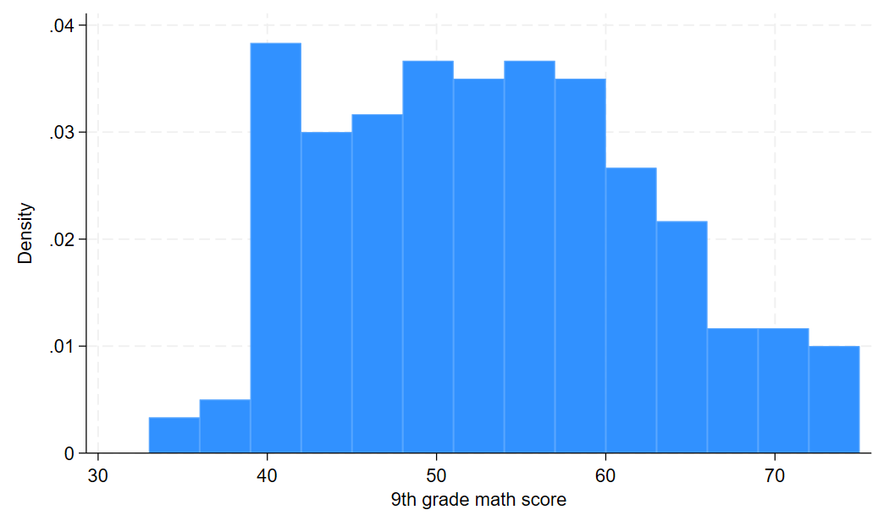
Labeling variables (1)
Short variable names make coding more efficient but can obscure the variable’s meaning
Use label variable to give the variable a longer description
The variable label will sometimes be used in output and often in graphs
* labeling variables (description)
label variable math "9th grade math score”
label variable schtyp "public/private school"
* the variable label will be used in some output
histogram math
tab schtyp

Slide 75
Labeling variables (2)
Short variable names make coding more efficient but can obscure the variable’s meaning
Use label variable to give the variable a longer description
The variable label will sometimes be used in output and often in graphs
* labeling variables (description)
label variable math "9th grade math score”
label variable schtyp "public/private school"
* the variable label will be used in some output
histogram math
tab schtyp
public/priv |
ate school | Freq. Percent Cum.
------------+-----------------------------------
1 | 168 84.00 84.00
2 | 32 16.00 100.00
------------+-----------------------------------
Total | 200 100.00

Slide 76
Labeling values
Value labels give text descriptions to the numerical values of a variable.
To create a new set of value labels use label define
Syntax: label define labelname # label…, where labelname is the name of the value label set, and (# label…) is a list of numbers, each followed by its label.
Then, to apply the labels to variables, use label values
Syntax: label values varlist labelname, where varlist is one or more variables, and labelname is the value label set name
* schtyp before labeling values
tab schtyp
public/priv |
ate school | Freq. Percent Cum.
------------+-----------------------------------
1 | 168 84.00 84.00
2 | 32 16.00 100.00
------------+-----------------------------------
Total | 200 100.00
* create and apply labels for schtyp
label define pubpri 1 public 2 private
label values schtyp pubpri
tab schtyp
public/priv |
ate school | Freq. Percent Cum.
------------+-----------------------------------
public | 168 84.00 84.00
private | 32 16.00 100.00
------------+-----------------------------------
Total | 200 100.00

Slide 77
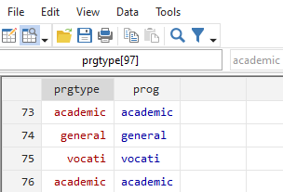
Encoding string variables into numeric (1)
encode converts a string variable into a numeric variable
remember that some Stata commands require numeric variables
encode will use alphabetical order to order the numeric codes
encode will convert the original string values into a set of value labels
encode will create a new numeric variable, which must be specified in option gen(varname)
* encoding string prgtype into
* numeric variable prog
encode prgtype, gen(prog)
* we see that prog is a numeric with labels (blue)
*while the old variable prog is string (red)
browse prog prgtype

Slide 78
Encoding string variables into numeric (2)
* we see labels by default in tab
tab prog
prog | Freq. Percent Cum.
------------+-----------------------------------
academic | 105 52.50 52.50
general | 45 22.50 75.00
vocati | 50 25.00 100.00
------------+-----------------------------------
Total | 200 100.00
* use option nolabel to remove the labels
tab prog, nolabel
prog | Freq. Percent Cum.
------------+-----------------------------------
1 | 105 52.50 52.50
2 | 45 22.50 75.00
3 | 50 25.00 100.00
------------+-----------------------------------
Total | 200 100.00
remember to use the option nolabel to remove value labels from tabulate output
Notice that numbering begins at 1

Slide 79
Exercise 4
Use the generate and replace commands to create a variable called “highmath” that takes on the value 1 if math is greater than 60, and 0 otherwise
Then use the label define command to create a set of value labels called “mathlabel”, which labels the value 1 “high” and the value 0 “low”
Finally, use the label values command to apply the “mathlabel” labels to the newly generated variable highmath. Use the tab command on highmath to check your results.

Slide 80
Dataset operations
keep keep variables, drop others
drop drop variables, keep others
keep if keep observations, drop others
drop if drop observations, keep others
sort sort by variables, ascending
gsort ascending and descending sort

Slide 81
Save your data before making big changes
We are about to make changes to the dataset that cannot easily be reversed, so we should save the data before continuing
* save dataset, overwrite existing file
save hs1, replace

Slide 82
Keeping and dropping variables
drop removes the selected variables and keeps the rest
Use drop if you want to remove a few variables but keep most of them
keep preserves the selected variables and drops the rest
Use keep if you want to remove most of the variables but keep a select few
* drop variable prgtype from dataset
drop prgtype
* keep just id read and math
keep id read math

Slide 83
Keeping and dropping observations
* keep observation if reading > 40
keep if read > 40
summ read
Variable | Obs Mean Std. Dev. Min Max
-------------+---------------------------------------------------------
read | 178 54.23596 8.96323 41 76
* now drop if math outside range [30,70]
drop if math < 30 | math > 70
summ math
Variable | Obs Mean Std. Dev. Min Max
-------------+---------------------------------------------------------
math | 168 52.68452 8.118243 35 70
Specify if after keep or drop to preserve or remove observations by condition
To be clear, keep if and drop if select observations, while keep and drop select variables

Slide 84
Sorting data (1)
Use sort to order the observations by one or more variables
sort var1 var2 var3, for example, will sort first by var1, then by var2, then by var3, all in ascending order
* sorting
* first look at unsorted
li in 1/5
+-------------------+
| id read math |
|-------------------|
1. | 70 57 41 |
2. | 121 68 53 |
3. | 86 44 54 |
4. | 141 63 47 |
5. | 172 47 57 |
+-------------------+

Slide 85
Sorting data (2)
Use sort to order the observations by one or more variables
sort var1 var2 var3, for example, will sort first by var1, then by var2, then by var3, all in ascending order
* now sort by read and then math
sort read math
li in 1/5
+-------------------+
| id read math |
|-------------------|
1. | 37 41 40 |
2. | 30 41 42 |
3. | 145 42 38 |
4. | 22 42 39 |
5. | 124 42 41 |
+-------------------+

Slide 86
Sorting data (3) *
Use gsort with + or – before each variable to specify ascending and descending order, respectively
* sort descending read then ascending math
gsort -read +math
li in 1/5
+-------------------+
| id read math |
|-------------------|
1. | 61 76 60 |
2. | 103 76 64 |
3. | 34 73 57 |
4. | 93 73 62 |
5. | 95 73 71 |
+-------------------+

Slide 87
Exercise 5
Re-load the hs0 data set fresh using the following command:
use https://stats.idre.ucla.edu/stat/data/hs0, clear
Subset the dataset to observations with write score greater than or equal to 60. Then remove all variables except for id and write. Save this as a Stata dataset called “highwrite”
Reload the hs0 dataset, subset to observations with write score less than 60, remove all variables except id and write, and save this dataset as “lowwrite”
Reload the hs0 dataset. Drop the write variable. Save this dataset as “nowrite”.

Slide 88
Combining datasets
append add more observations
merge add more variables, join by
matching variable

Slide 89
Appending datasets
Datasets are not always complete when we receive them
multiple data collectors
multiple waves of data
The append command combines datasets by stacking them row-wise, adding more observations of the same variables

Slide 90
Appending datasets
Let’s append together two of the datasets we just created in the previous exercise
Begin with one of the datasets in memory
First load the “highwrite” dataset
Then append the “lowwrite” dataset
Syntax: append using dtaname
dtaname is the name of the Stata data file to append
Variables that appear in only one file will be filled with missing in observations from the other file
* first load highwrite
use highwrite, clear
* append lowwrite
append using lowwrite
* summarize write shows 200 observations and write scores above and below 70
summ write
Variable | Obs Mean Std. Dev. Min Max
-------------+---------------------------------------------------------
write | 200 52.775 9.478586 31 67

Slide 91
Merging datasets (1)
To add a dataset of columns of variables to another dataset, we merge them
In Stata terms, the dataset in memory is termed the master dataset
the dataset to be merged in is called the “using” dataset
Observations in each dataset to be merged should be linked by an id variable
the id variable should uniquely identify observations in at least one of the datasets
If the id variable uniquely identifies observations in both datasets, Stata calls this a 1:1 merge
If the id variable uniquely identifies observations in only one dataset, Stata calls this a 1:m (or m:1) merge

Slide 92
Merging datasets (2)
Let’s merge our dataset of id and write with the dataset “nowrite” using id as the merge variable
merge syntax:
1-to-1: merge 1:1 idvar using dtaname
1-to-many: merge 1:m idvar using dtaname
many-to-1: merge m:1 idvar using dtaname
Note that idvar can be multiple variables used to match
Let’s try this 1-to-1merge
Stata will output how many observations were successfully and unsuccessfully merged
* merge in nowrite dataset using id to link
merge 1:1 id using nowrite
Result # of obs.
-----------------------------------------
not matched 0
matched 200 (_merge==3)
-----------------------------------------

Slide 93
basic statistical analysis

Slide 94
Analysis of continuous, normally distributed outcomes
mean means and confidence intervals
ttest t-tests
correlate correlation matrices
regress linear regression
predict model predictions
test test of linear combinations of
coefficients

Slide 95
Load dataset
Please load the dataset hs1, which is dataset hs0 altered by our data management commands, using the following syntax:
use https://stats.idre.ucla.edu/stat/data/hs1, clear

Slide 96
Means and confidence intervals (1)
Confidence intervals express a range of plausible values for a population statistic, such as the mean of a variable, consistent with the sample data
The mean command provides a 95% confidence interval, as do many other commands
* many commands provide 95% CI
mean read
Mean estimation Number of obs = 200
--------------------------------------------------------------
| Mean Std. Err. [95% Conf. Interval]
-------------+------------------------------------------------
read | 52.23 .7249921 50.80035 53.65965
--------------------------------------------------------------

Slide 97
T-tests test whether the means are different between 2 groups
t-tests test whether the mean of a variable is different between 2 groups
The t-test assumes that the variable is normally distributed
The independent samples t-test assumes that the two groups are independent (uncorrelated)
Syntax for independent samples t-test:
ttest var, by(groupvar), where var is the variable whose mean will be tested for differences between levels of groupvar
The ttest command can also perform a paired-samples t-test, using slightly different syntax
Let’s peform a t-test to see if the means of write are different between the 2 genders

Slide 98
Independent samples t-test example
* independent samples t-test
ttest read, by(female)
Two-sample t test with equal variances
------------------------------------------------------------------------------
Group | Obs Mean Std. Err. Std. Dev. [95% Conf. Interval]
---------+--------------------------------------------------------------------
0 | 91 52.82418 1.101403 10.50671 50.63605 55.0123
1 | 109 51.73394 .9633659 10.05783 49.82439 53.6435
---------+--------------------------------------------------------------------
combined | 200 52.23 .7249921 10.25294 50.80035 53.65965
---------+--------------------------------------------------------------------
diff | 1.090231 1.457507 -1.783998 3.964459
------------------------------------------------------------------------------
diff = mean(0) - mean(1) t = 0.7480
Ho: diff = 0 degrees of freedom = 198
Ha: diff < 0 Ha: diff != 0 Ha: diff > 0
Pr(T < t) = 0.7723 Pr(|T| > |t|) = 0.4553 Pr(T > t) = 0.2277

Slide 99
Correlation
A correlation coefficient quantifies the linear relationship between two (continuous) variables on a scale between -1 and 1
Syntax: correlate varlist
The output will be a correlation matrix that shows the pairwise correlation between each pair of variables
If you need p-values for correlations, use the command pwcorr
* correlation matrix of 5 variables
corr read write math science socst
(obs=195)
| read write math science socst
-------------+---------------------------------------------
read | 1.0000
write | 0.5960 1.0000
math | 0.6492 0.6203 1.0000
science | 0.6171 0.5671 0.6166 1.0000
socst | 0.6175 0.5996 0.5299 0.4529 1.0000

Slide 100
Model estimation command syntax
Most model estimation commands in Stata use a standard syntax:
model_command depvar indepvarlist, options
Where
model_command is the name of a model estimation command
depvar is the name of the dependent variable (outcome)
indepvarlist is a list of independent variables (predictors)
options are options specific to that command

Slide 101
Linear regression
Linear regression, or ordinary least squares regression, models the effects of one or more predictors, which can be continuous or categorical, on a normally-distributed outcome
Syntax: regress depvar indepvarlist, where depvar is the name of the dependent variable, and indepvarlist is a list of independent variables
To be safe, precede independent variables names with i. to denote categorical predictors and c. to denote continuous predictors
For categorical predictors with the i. prefix, Stata will automatically create dummy 0/1 indicator variables and enter all but one (the first, by default) into the regression
Let’s run a linear regression of the dependent variable write predicted by independent variables math (continuous) and ses (categorical)

Slide 102
Linear regression example
* linear regression of write on continuous
* predictor math and categorical predictor ses
regress write c.math i.ses
Source | SS df MS Number of obs = 200
-------------+---------------------------------- F(3, 196) = 41.07
Model | 6901.40673 3 2300.46891 Prob > F = 0.0000
Residual | 10977.4683 196 56.0074912 R-squared = 0.3860
-------------+---------------------------------- Adj R-squared = 0.3766
Total | 17878.875 199 89.843593 Root MSE = 7.4838
------------------------------------------------------------------------------
write | Coef. Std. Err. t P>|t| [95% Conf. Interval]
-------------+----------------------------------------------------------------
math | .6115218 .0588735 10.39 0.000 .495415 .7276286
|
ses |
middle | -.5499235 1.346566 -0.41 0.683 -3.205542 2.105695
high | 1.014773 1.52553 0.67 0.507 -1.993786 4.023333
|
_cons | 20.54836 3.093807 6.64 0.000 14.44694 26.64979
------------------------------------------------------------------------------

Slide 103
Estimating statistics based on a model
Stata provides excellent support for estimating and testing additional statistics after a regression model has been run
Stata refers to these as “postestimation” commands, and they can be used after most regression models
To see which commands can be issued as follow-ups to a model estimation command, use:
help model_command postestimation
Where model_command is a Stata model command
e.g. for regress, try help regress postestimation
Examples: model predictions, joint tests of coefficients or linear combination of statistics, marginal estimates

Slide 104
Postestimation example 1: prediction
The predict: command can be used to make model-based predictions of various statistics such as:
Predicted value of dependent variable (default)
Residuals (difference between observed and predicted dependent variable)
Add option residuals to predict
Influence statistics
e.g. add option cooksd to predict
* predicted dependent variable
predict pred
* get residuals
predict res, residuals
* first 5 predicted values and residuals with observed write
li pred res write in 1/5
+------------------------------+
| pred res write |
|------------------------------|
1. | 45.62076 6.379242 52 |
2. | 52.4091 6.590904 59 |
3. | 54.58532 -21.58531 33 |
4. | 50.30466 -6.304662 44 |
5. | 54.85518 -2.855183 52 |
+------------------------------+

Slide 105
Exercise 6
Use the regress command to determine if the variables female (categorical) and science (continuous) are predictive of the dependent variable math.
One of the assumptions of linear regression is that the errors (estimated by residuals) are normally distributed. Use the predict command and the histogram command to assess this assumption.

Slide 106
Analysis of categorical outcomes
tab …, chi2 chi-square test of
independence
logit logistic regression

Slide 107
Chi-square test of independence
The chi-square test of independence assesses association between 2 categorical variables
Answers the question: Are the category proportions of one variable the same across levels of another variable?
Syntax: tab var1 var2, chi2
* chi square test of independence
tab prog ses, chi2
| ses
prog | low middle high | Total
-----------+---------------------------------+----------
academic | 19 44 42 | 105
general | 16 20 9 | 45
vocati | 12 31 7 | 50
-----------+---------------------------------+----------
Total | 47 95 58 | 200
Pearson chi2(4) = 16.6044 Pr = 0.002

Slide 108
* Logistic regression
Logistic regression is used to estimate the effect of multiple predictors on a binary outcome
Syntax very similar to regress: logit depvar indepvarlist, where depvar is a binary outcome variable and indepvarlist is a list of predictors
Add the or option to output the coefficients as odds ratios
Let’s perform a logistic regression:
We will use the binary variable “highmath” that we created in exercise 4 as the outcome
The variables write (continuous) and ses (categorical) will serve as predictors

Slide 109
* Logistic regression example
* logistic regression of binary outcome highmath predicted by
* by continuous(write) and female (categorical)
logit highmath c.write i.female, or
Logistic regression Number of obs = 200
LR chi2(2) = 62.16
Prob > chi2 = 0.0000
Log likelihood = -74.300928 Pseudo R2 = 0.2949
------------------------------------------------------------------------------
highmath | Odds Ratio Std. Err. z P>|z| [95% Conf. Interval]
-------------+----------------------------------------------------------------
write | 1.253272 .050584 5.59 0.000 1.157949 1.356442
1.female | .4330014 .1823694 -1.99 0.047 .1896638 .9885398
_cons | 1.19e-06 2.82e-06 -5.76 0.000 1.14e-08 .0001237
------------------------------------------------------------------------------

Slide 110
additional stata modeling commands

Slide 111
A few of Stata’s additional regression commands
glm: generalized linear model
ologit and mlogit: ordinal logistic and multinomial logistic regression
poisson and nbreg: poisson and negative binomial regression (count outcomes)
mixed – mixed effects (multilevel) regression
meglm – mixed effects generalized linear model
stcox – Cox proportional hazards model
ivregress – instrumental variable regression

Slide 112
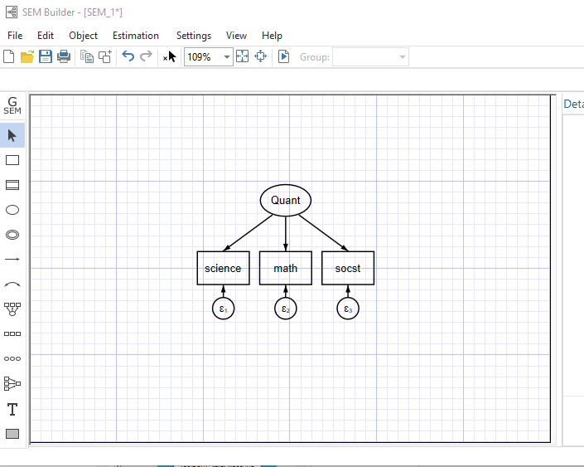
Structural equation modeling
Stata features 2 ways to build a structural equation model (SEM)
Through syntax:
sem (Quant -> science math socst)
And through the SEM Builder, accessible through the “Statistics menu” through Statistics>SEM (structural equation modeling)> Model building and estimation
The gsem command is used for generalized SEM, which allows for non-normally distributed outcomes, multilevel models, and categorical latent variables, among other extensions

Slide 113
Outputting to word and excel

Slide 114
Outputting to Word
putdocx begin Create a .docx file
putdocx paragraph Initiate a new paragraph
putdocx textblock begin Insert a block of text
putdocx textblock end
putdocx table Insert a table
putdocx image Insert an image
putdocx save Save .docx file

Slide 115
Opening the Word file and writing blocks of text
The putdocx suite of commands is used to output text, tables and images to Word files.
Most commands have many options to format and style the output
putdocx begin opens a .docx file for output
The name of the file is specified when The file is saved
putdocx textblock begin and putdocx textblock end enclose text to be written to the Word file as is.
* create a Word docx file to export results, set default font size to 12
putdocx begin, font(12)
* first line starts a block of text in a new paragraph, using a Title style
* second line is the text to appear
* third line ends the text block
putdocx textblock begin, style(Title)
Regression of read results
putdocx textblock end
* start a block of text in a new paragraph
putdocx textblock begin
This report displays the results of the regression of read on write and math and a residuals vs fitted plot to check some of the assumptions of the linear regression model.
putdocx textblock end

Slide 116
Inserting a table of results and an image
putdocx paragraph initiates a new paragraph
putdocx table tablename = etable inserts a table of results from the last command run
putdocx image filename inserts an image
* run regression of read on write, math and prog
regress read write math
* put table of regression results into Word table
putdocx table model1 = etable
* make residuals vs fitted plot
rvfplot, yline(0)
* export plot to .png file
graph export rvf.png, replace
* start a new paragraph to add spacing
putdocx paragraph
* insert .png file
putdocx image rvf.png

Slide 117
Saving the Word output file
putdocx save filename closes and saves the Word file
The replace option replaces the file if it exists
If the file exists, make sure it is closed before using putdocx save
* save and close the .docx file, replace file if it already exists
putdocx save regress_read.docx, replace

Slide 118
Outputting to Excel
putexcel set Create a working spreadsheet for output
putexcel cell = Insert something (e.g. text, table, image) into
cell of working spreadsheet
putexcel save Save .xlsx file

Slide 119
Open a working spreadsheet for output
The putexcel suite of commands is used to output text, matrices, tables and images to Excel files.
putexcel set filename, sheet(sheetname) opens sheet sheetname in file filename for output
* open Excel file for output, replace if it exists already
putexcel set "output.xlsx", sheet("regress results") replace

Slide 120
Adding content to spreadsheet cells
putexcel cell = “text” adds text to cell (e.g A1) in the open sheet
putexcel cell = etable adds the last set of estimation results to cell
putexcel cell = image(filename) inserts the image store in filename into cell
cell will hold the upper left part of a table of results or image
* regression of read on write and female
regress read write female
* write bolded text to cell A1 in Excel file
putexcel A1 = "Regression of read", bold
* write regression table to cell A2 in Excel file
putexcel A2 = etable
* make a boxplot of read by female
graph box read, over(female)
* export plot to .png file
graph export boxread.png, replace
* add plot to cell A7 of Excel file
putexcel A7 = image("boxread.png")

Slide 121
Close and save the Excel spreadsheet
putexcel save closes and saves the open spreadsheet
* close and save Excel file
putexcel save

Slide 122
additional resources for learning stata

Slide 123
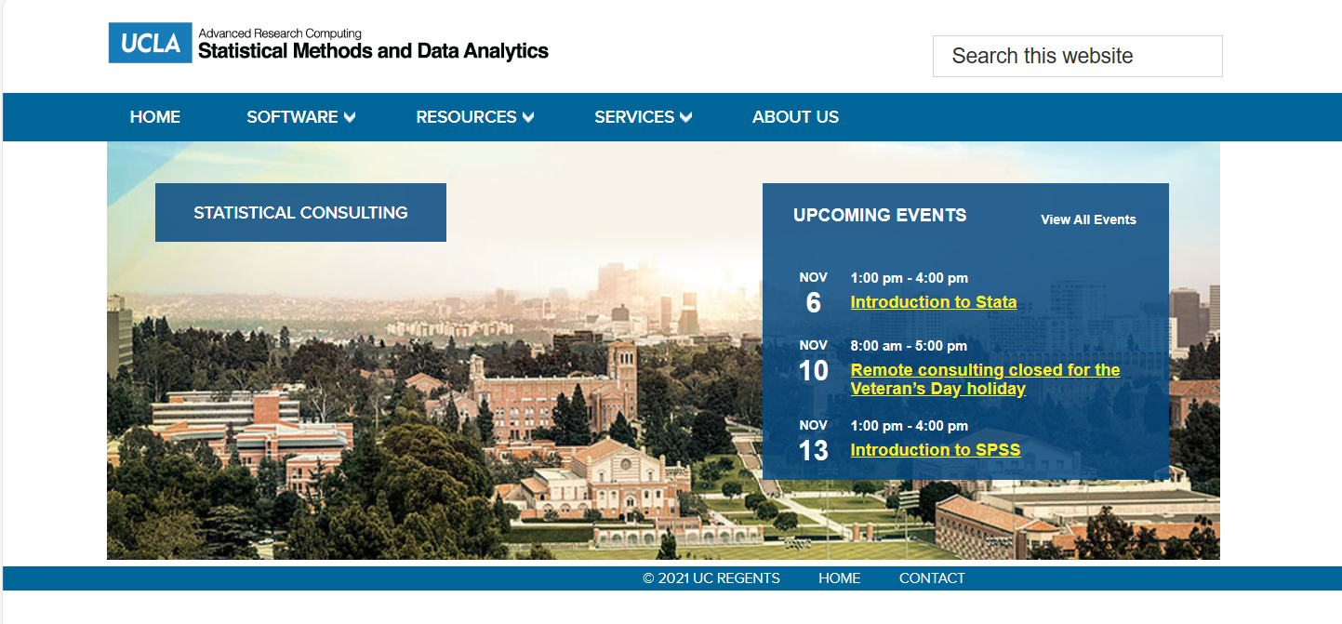
OARC Statistical Methods and Data Analytics website
The OARC Statistical Methods and Data Analytics website is a well-known resource for coding support for several statistical software packages
https://stats.idre.ucla.edu
Stata was beloved by previous members of the group, so Stata is particularly well represented on our website

Slide 124

OARC statistical consulting website Stata pages
On the website landing page for Stata, you’ll find many links to our Stata resources pages
Stata (ucla.edu)
These resources include:
seminars, deeper dives into Stata topics that are often delivered live on campus
learning modules for basic Stata commands
data analysis examples of many different regression commands
annotated output of many regression commands

Slide 125
External resources
Stata YouTube channel (run by StataCorp)
Stata FAQ (compiled by StataCorp)
Stata cheat sheets (compact guides to Stata commands)
OARC YouTube channel (Stata and other workshops)

Slide 126
end thank you!

